Slide 1
National findings

Slide 2
Summary of findings
Abortion volume is higher in 2024 than it was in 2023 or 2022.
The majority of abortions occur in-person.
The number of abortions delivered via telehealth continued to increase.
  By the end of 2024, 1 in 4 abortions was delivered via telehealth.
Shield laws continue to facilitate abortion access, with an average of 12,330 abortions per month in the final quarter of 2024.
Implications of these trends are unclear in the context of multiple changes in the service delivery environment:
  Shifting price of abortion
  Decreases in abortion funds to cover patient costs
  Election-related spikes in demand
  Ongoing financial pressure on brick-and-mortar clinics

Slide 3
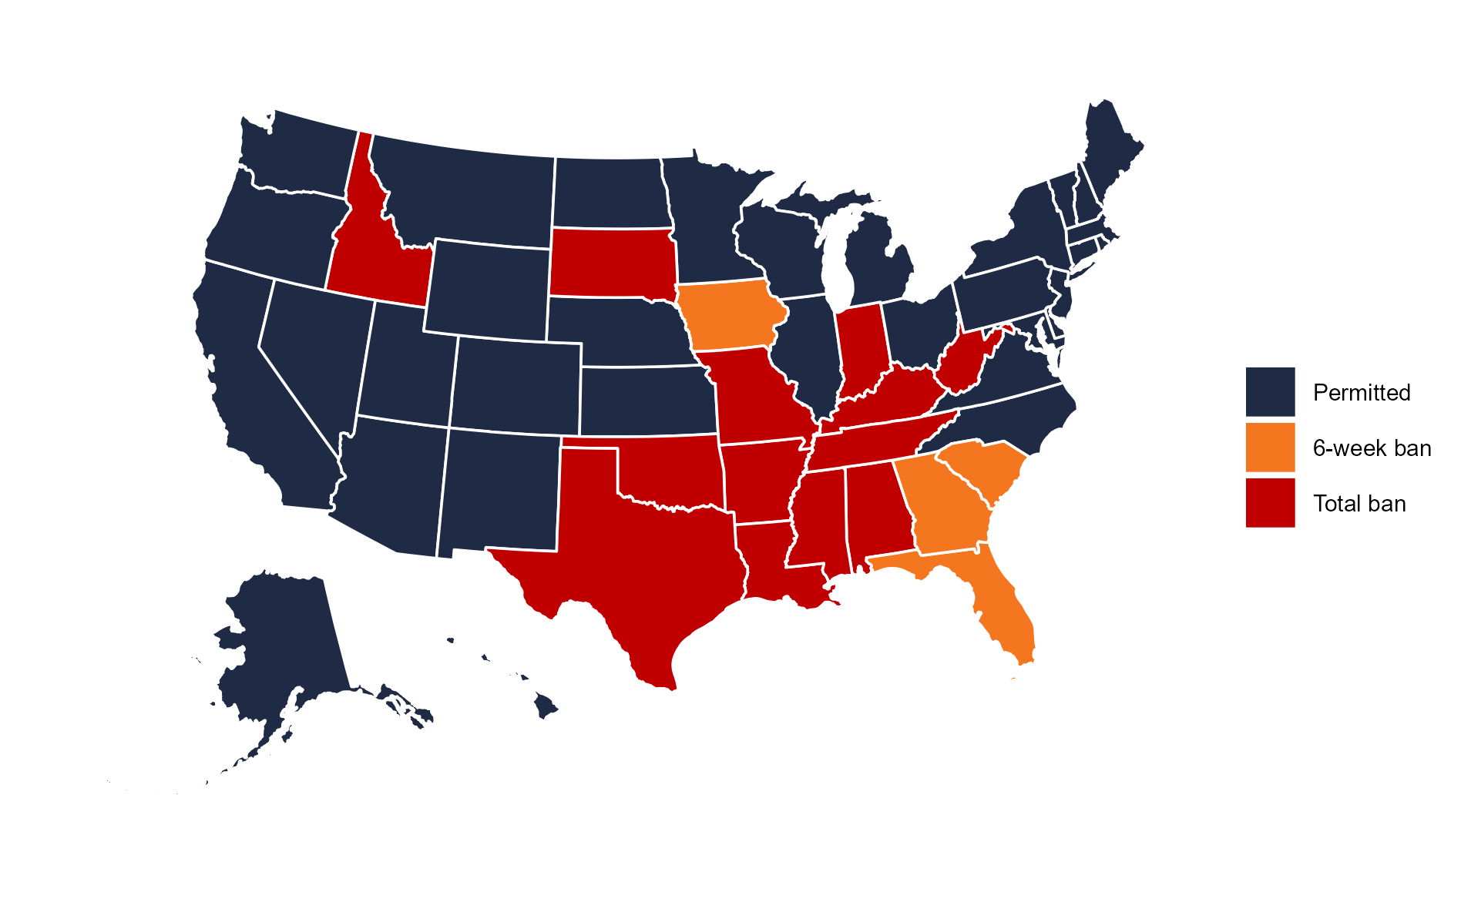
Changes in legal status since January 2024
In Florida, a 6-week ban went into effect in May 2024
In Iowa, a 6-week ban went into effect in August 2024
In North Dakota, a total ban was ruled unconstitutional in October 2024
  No brick-and-mortar facilities providing
States with total bans as of December 2024:
  Alabama, Arkansas, Idaho, Indiana, Kentucky, Louisiana, Mississippi, Missouri, Oklahoma, South Dakota, Tennessee, Texas, West Virginia
States with 6-week bans as of December 2024:
  Florida, Georgia, Iowa, South Carolina

Slide 4
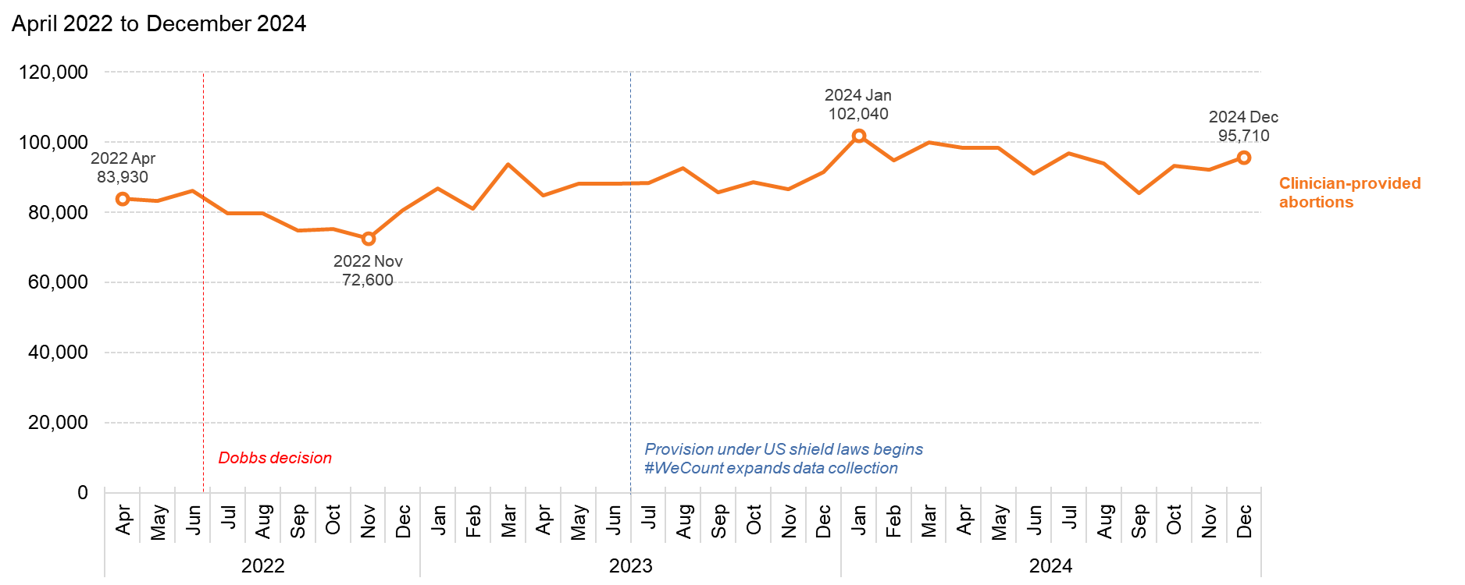
Total abortions in the US have increased since Dobbs
Source: Society of Family Planning, June 2025

Slide 5
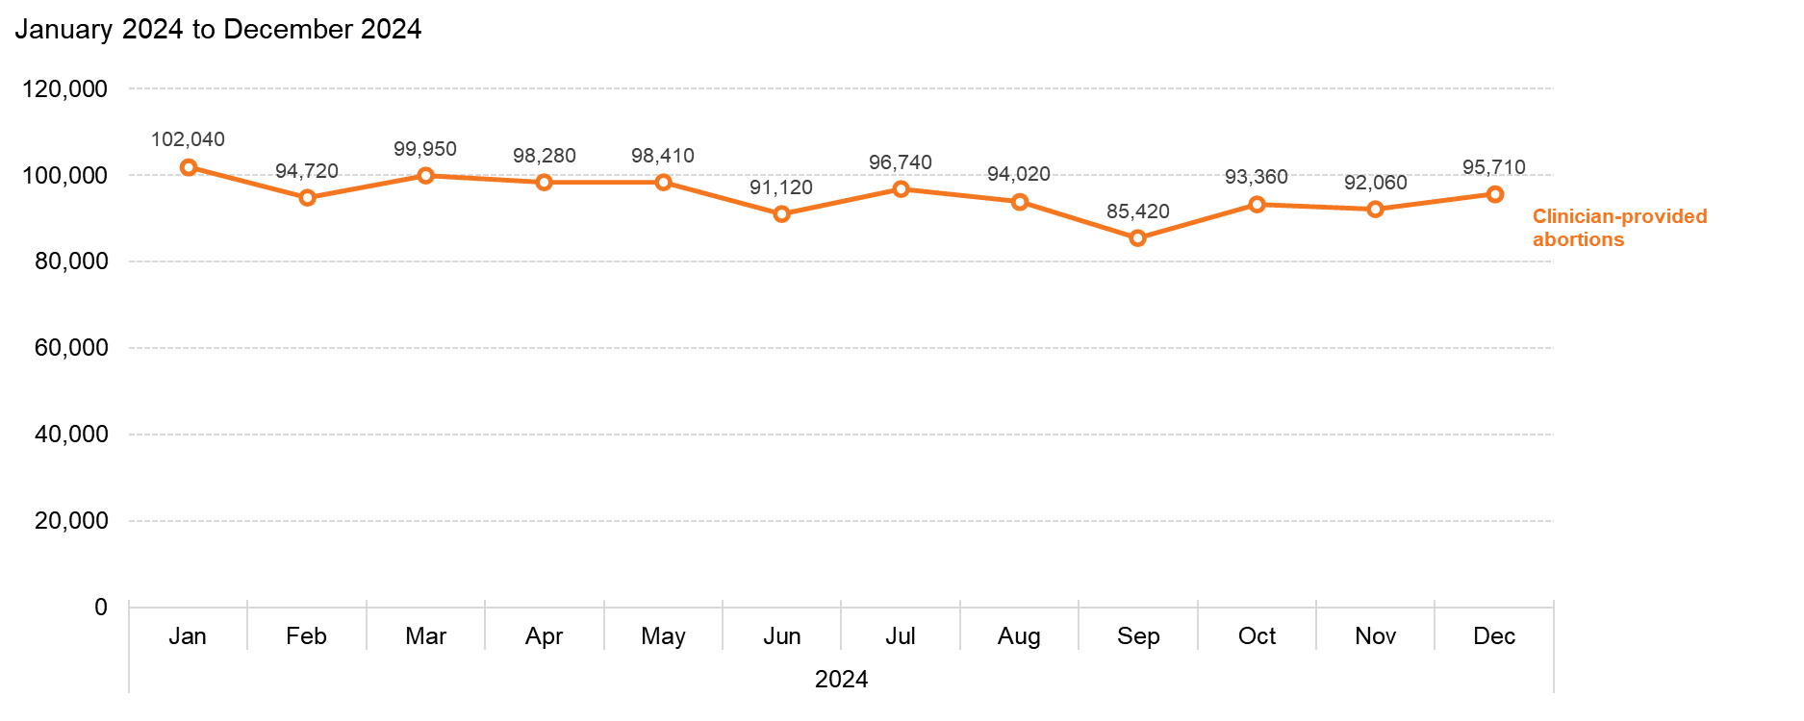
US abortions totaled 1.14 million in 2024
Source: Society of Family Planning, June 2025

Slide 6
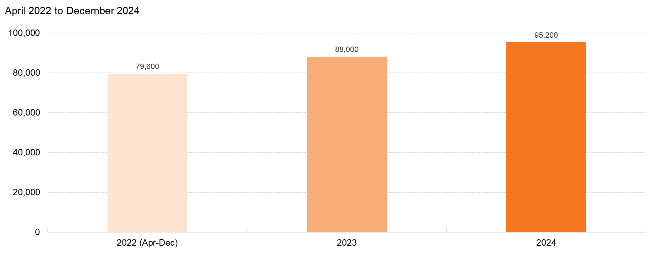
Monthly average number of abortions increased each year
Source: Society of Family Planning, June 2025

Slide 7
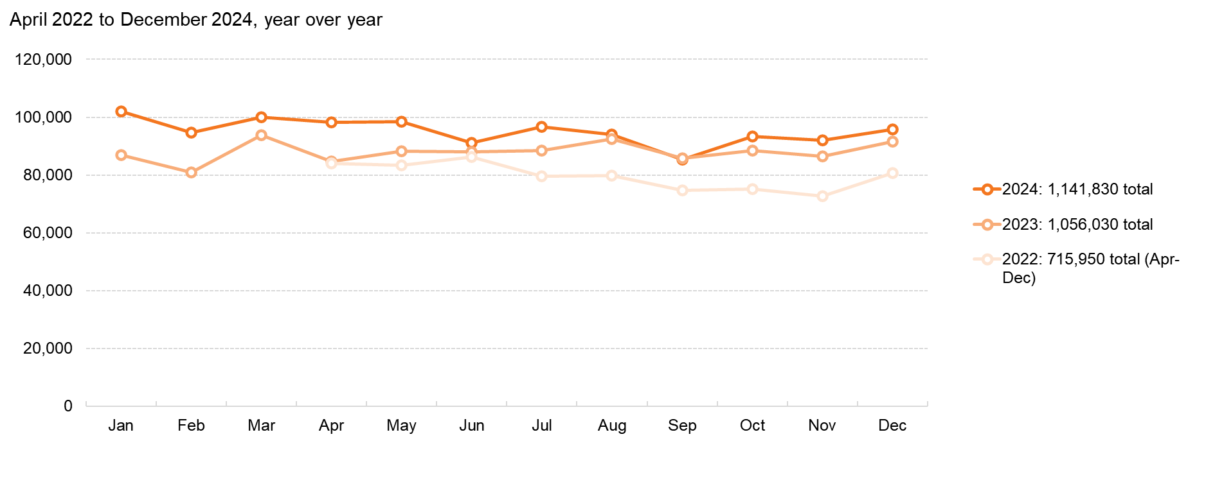
The monthly number of abortions increased each year
Source: Society of Family Planning, June 2025

Slide 8
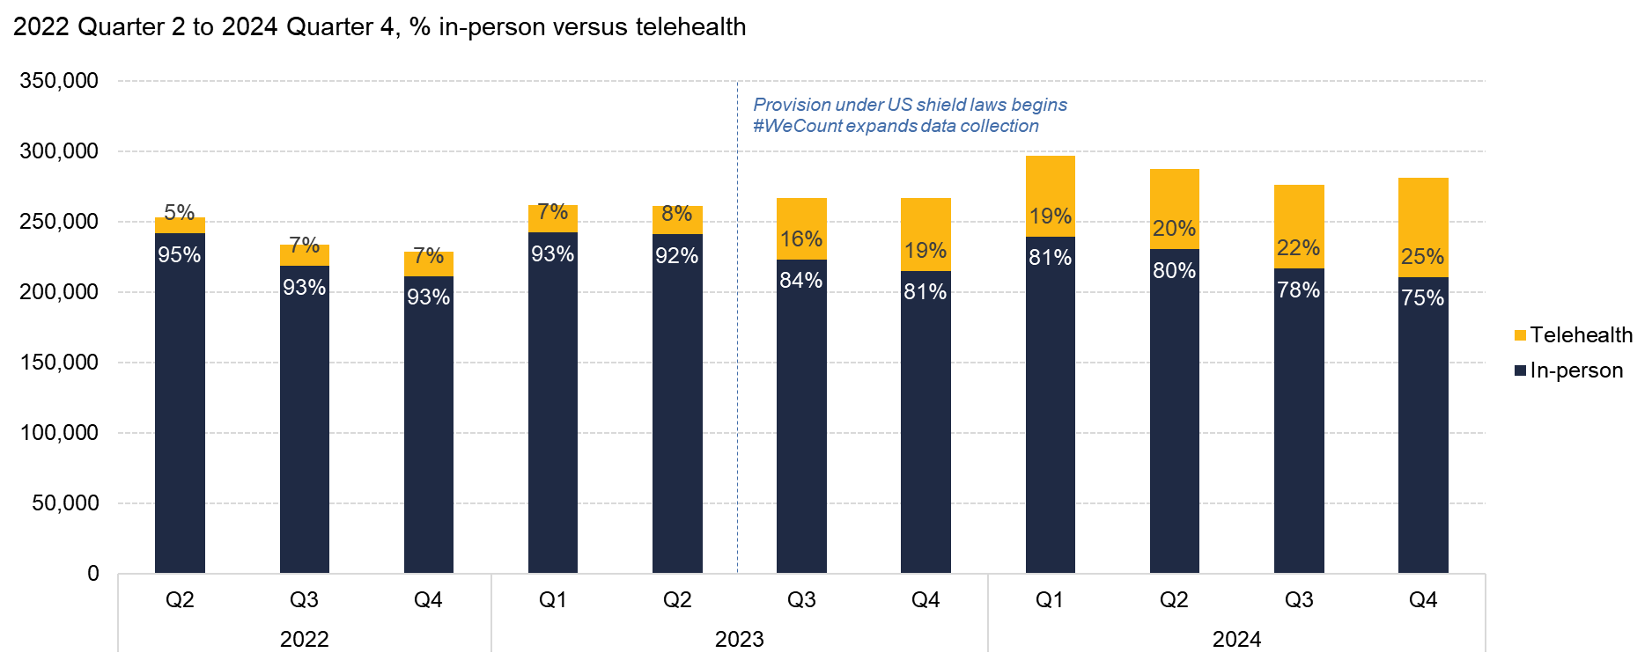
By Q4 of 2024, 1 in 4 abortions were provided via telehealth
Source: Society of Family Planning, June 2025

Slide 9
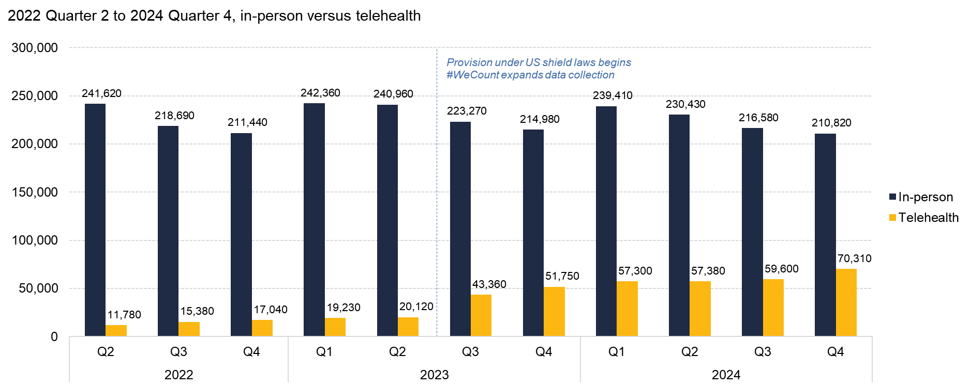
In-person abortion care declined slightly, while telehealth grew
Source: Society of Family Planning, June 2025

Slide 10
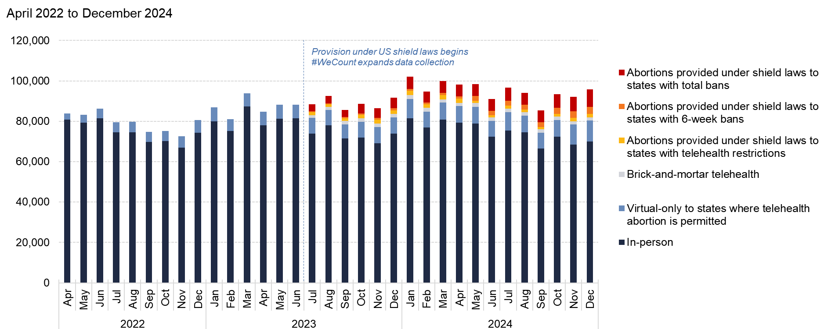
The majority of abortions still take place in-person
Source: Society of Family Planning, June 2025

Slide 11
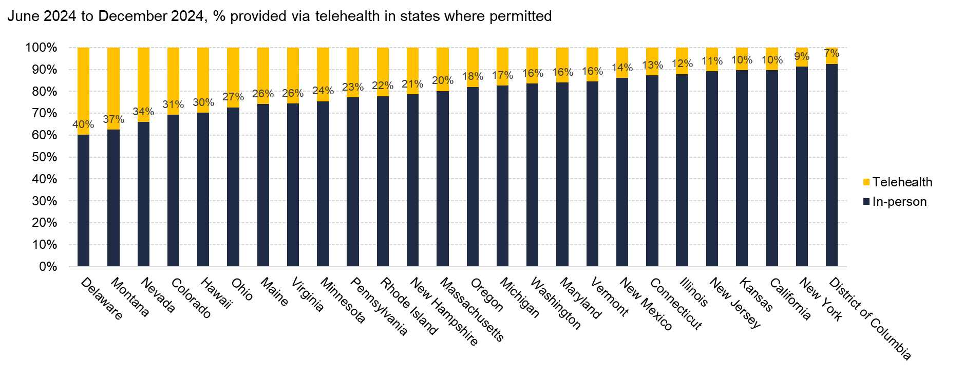
The proportion of abortions provided via telehealth varied by state, 2024
Source: Society of Family Planning, June 2025

Slide 12
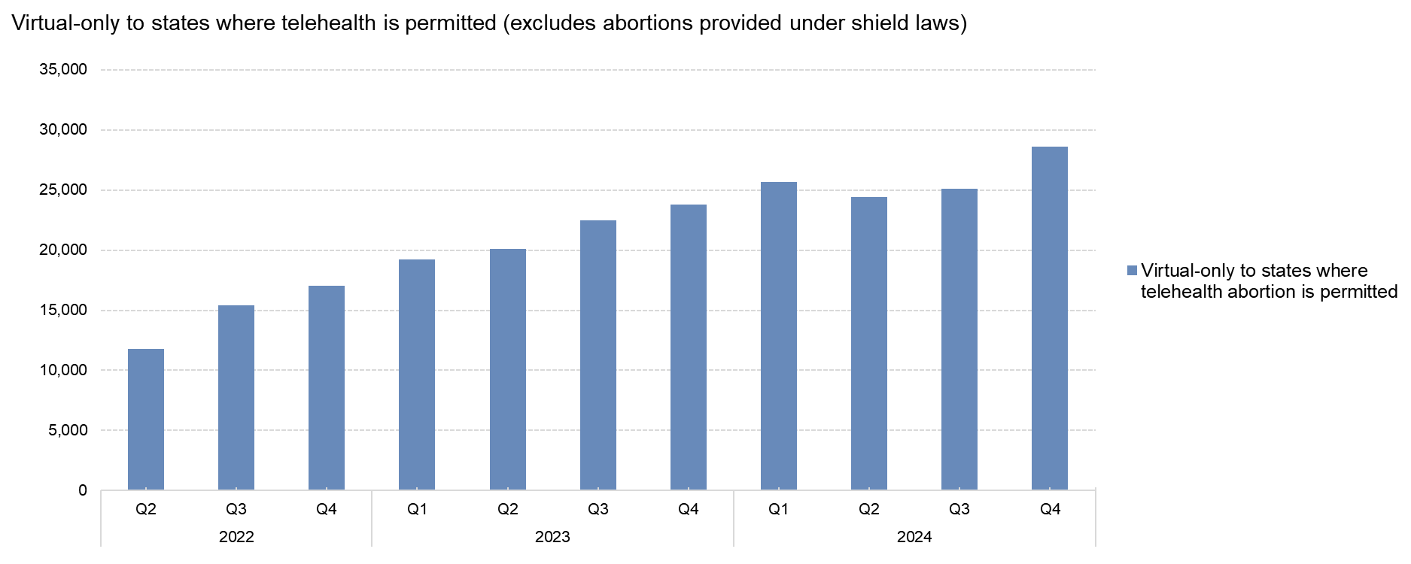
Abortions provided by virtual-only clinics have increased since Dobbs
Source: Society of Family Planning, June 2025

Slide 13
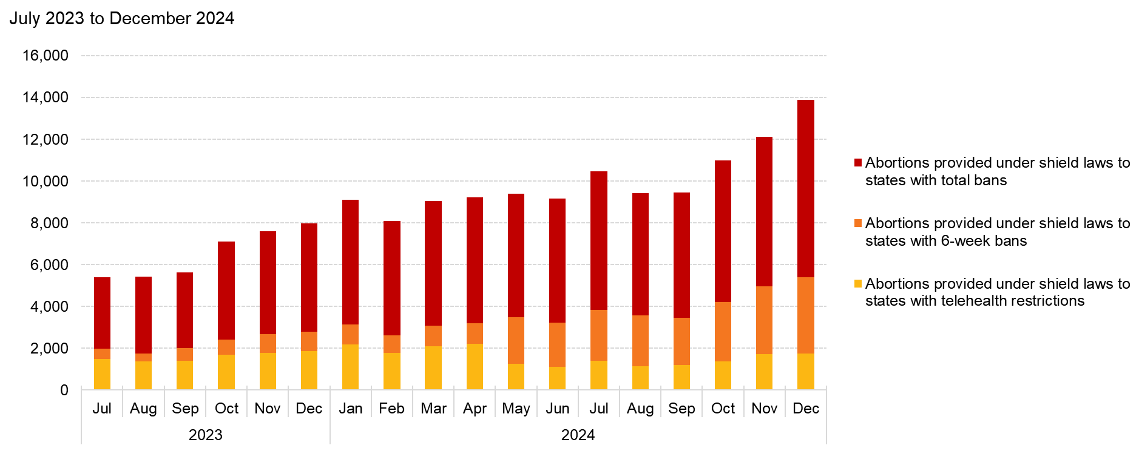
Abortions provided under shield laws have increased since this route to care became available
Source: Society of Family Planning, June 2025

Slide 14
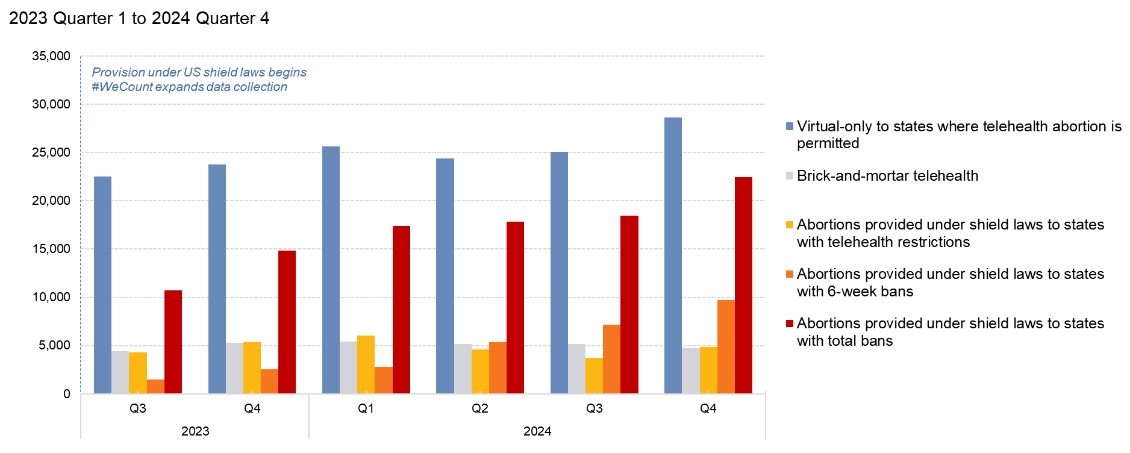
Legal climates appear to play an important role in telehealth use
Source: Society of Family Planning, June 2025

Slide 15
Half of abortions provided via telehealth in 2024 were facilitated by shield laws
2024 monthly average number of abortions
 | In-person | Telehealth
Abortion and telehealth permitted | 60,780 | 10,360
Abortion permitted, telehealth restricted | 8,610 | 1,610
6-week abortion ban, telehealth restricted | 5,350 | 2,080
Abortion is totally banned | 30 | 6,350
Source: Society of Family Planning, June 2025

Slide 16
State-level findings

Slide 17
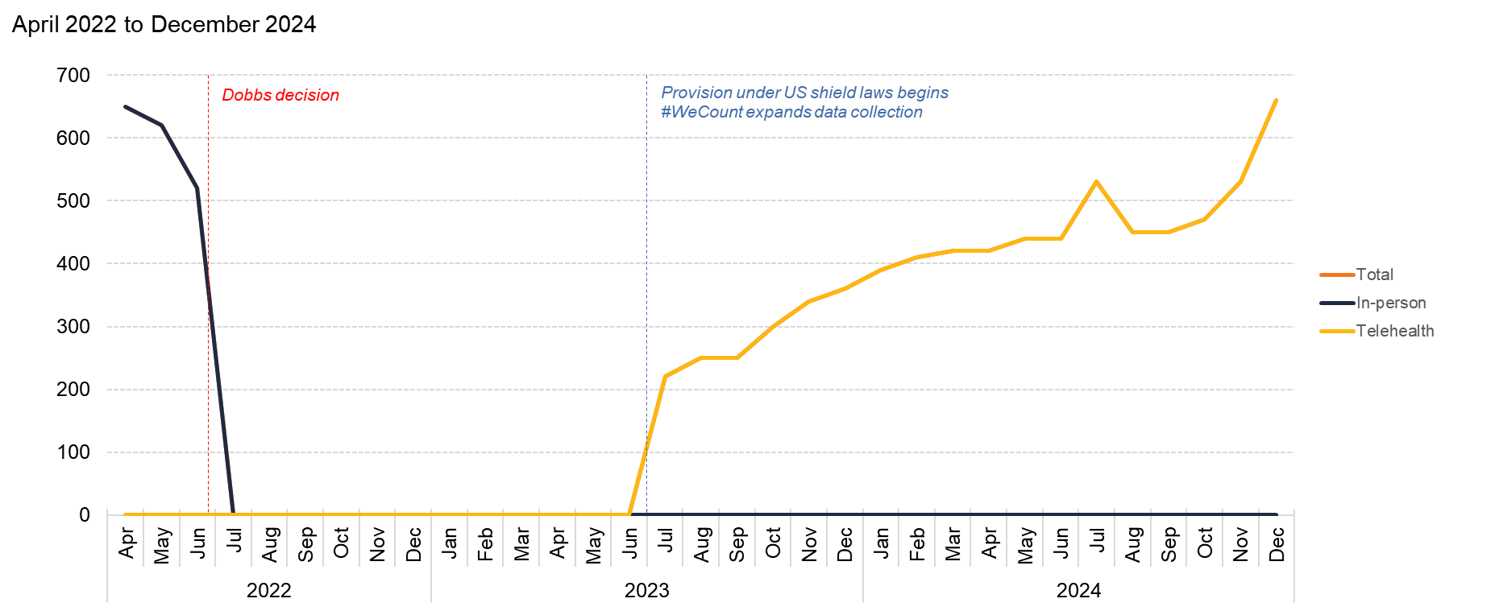
Alabama
Source: Society of Family Planning, June 2025

Slide 18
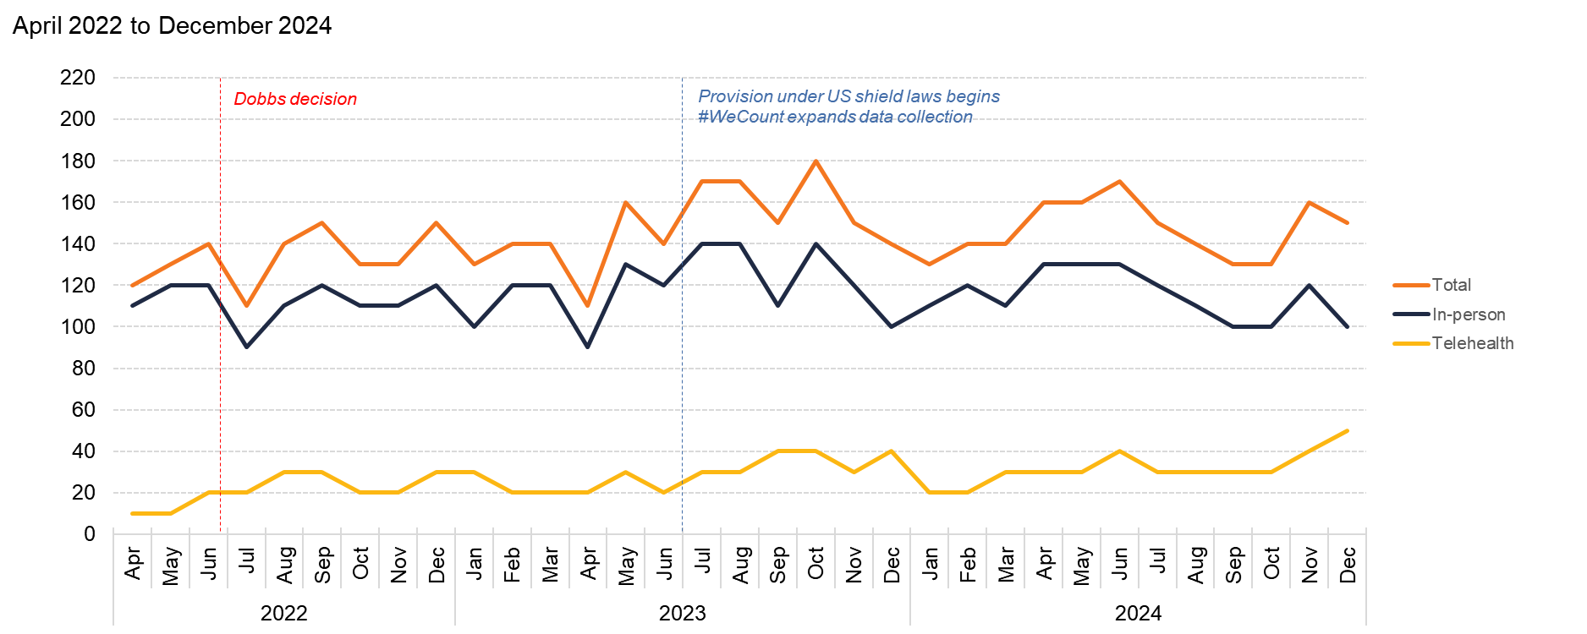
Alaska
Source: Society of Family Planning, June 2025

Slide 19
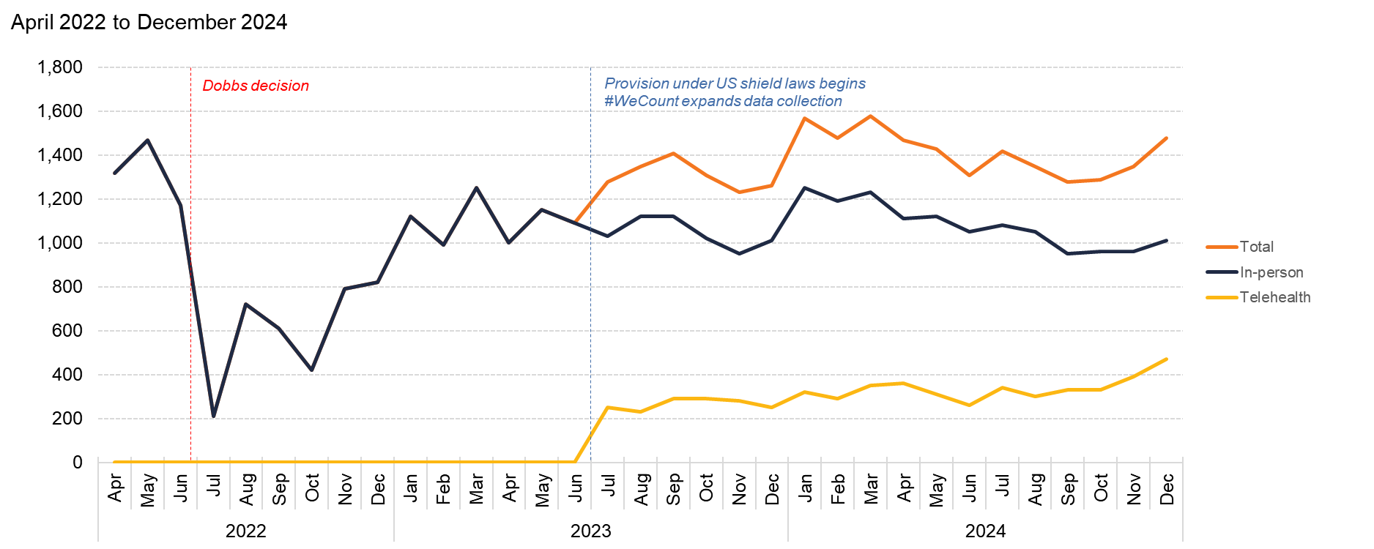
Arizona
Source: Society of Family Planning, June 2025

Slide 20
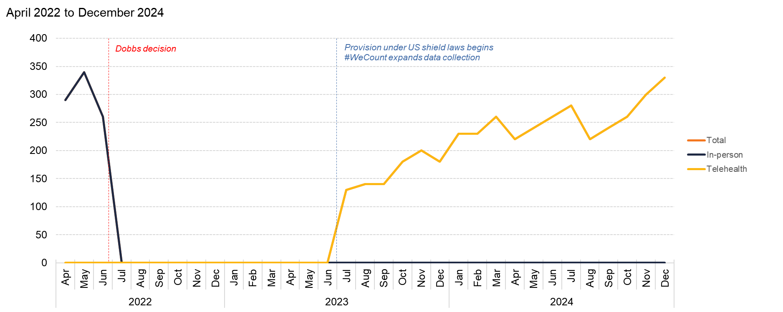
Arkansas
Source: Society of Family Planning, June 2025

Slide 21
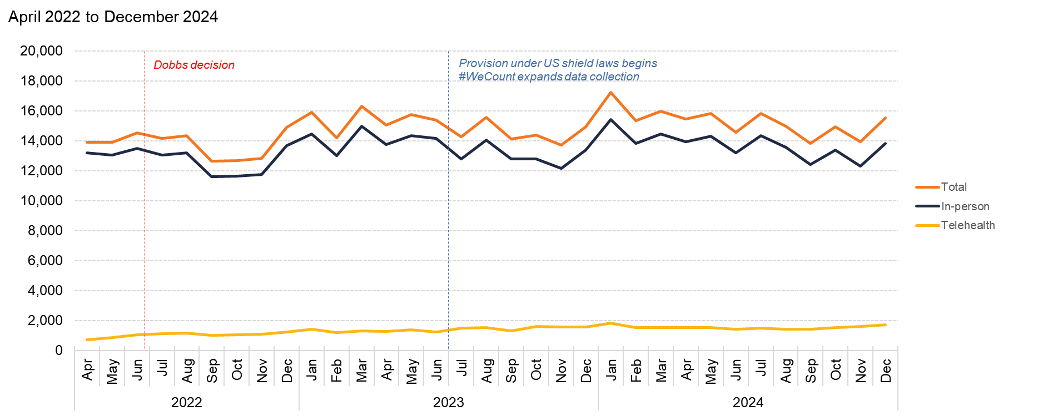
California
Source: Society of Family Planning, June 2025

Slide 22
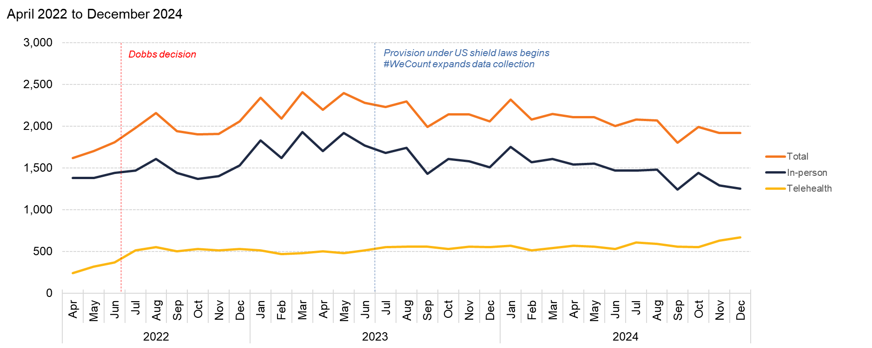
Colorado
Source: Society of Family Planning, June 2025

Slide 23
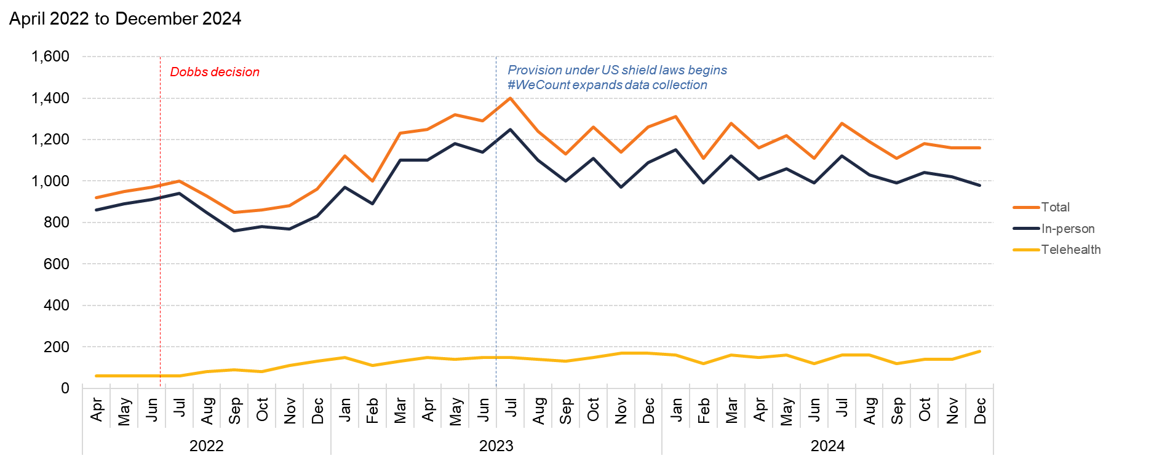
Connecticut
Source: Society of Family Planning, June 2025

Slide 24
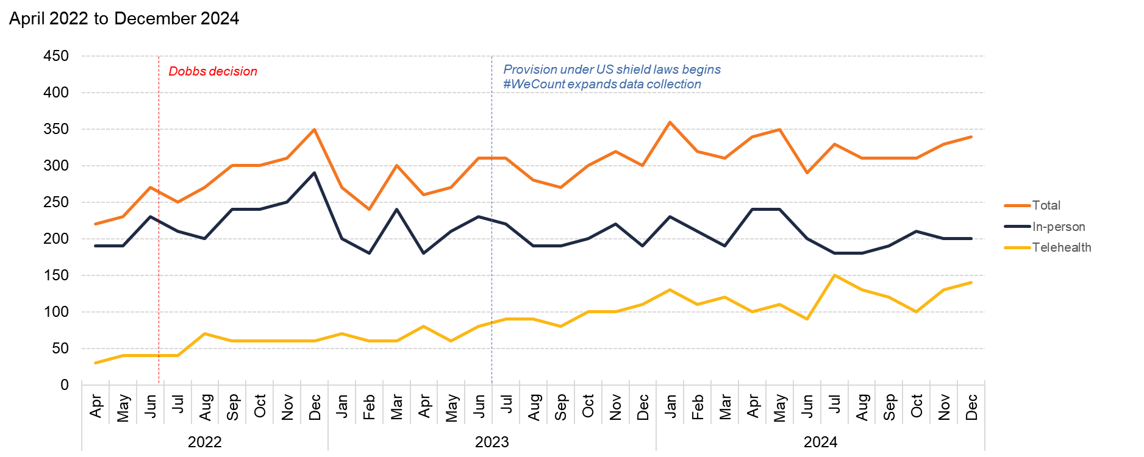
Delaware
Source: Society of Family Planning, June 2025

Slide 25
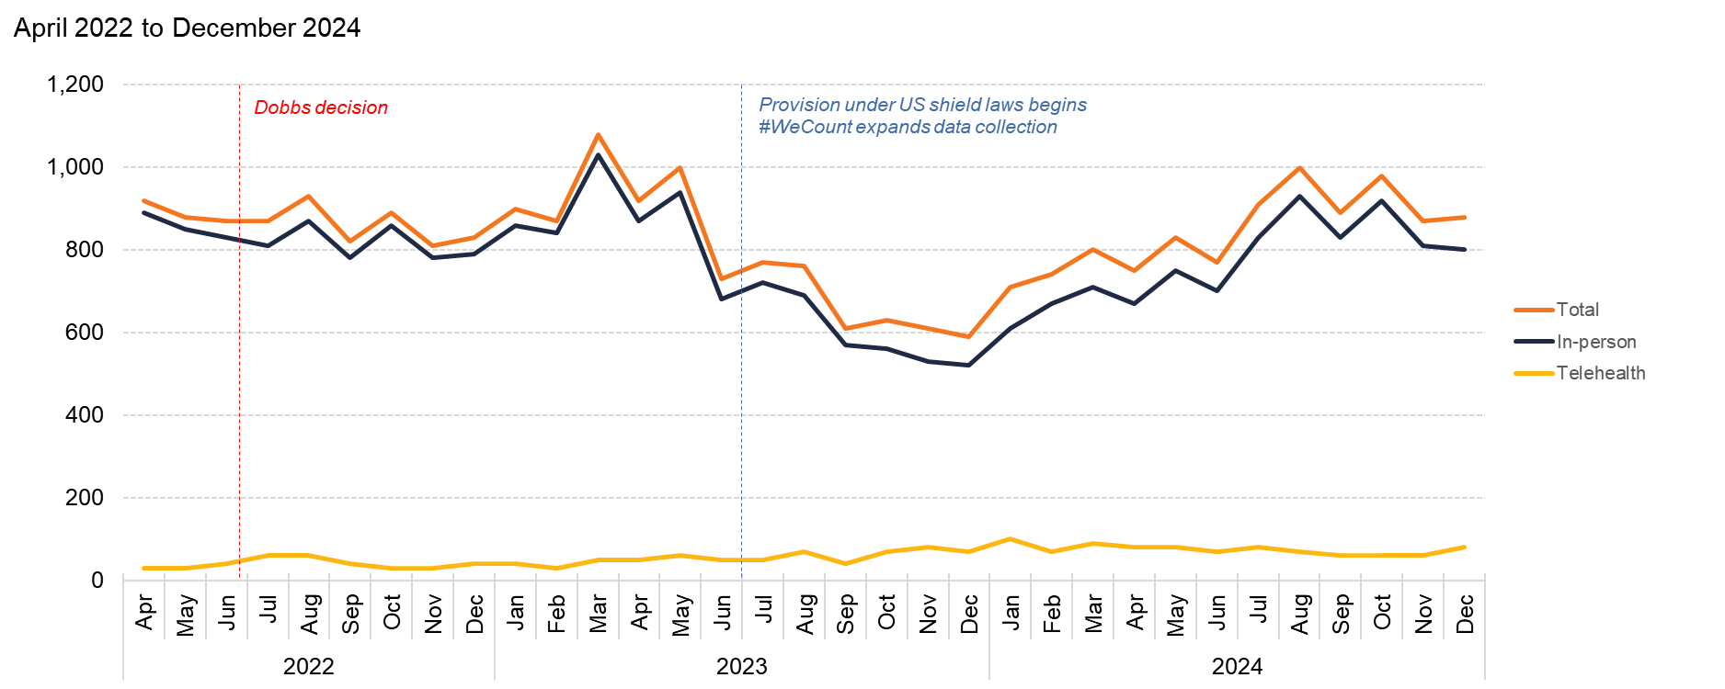
District of Columbia
Source: Society of Family Planning, June 2025

Slide 26
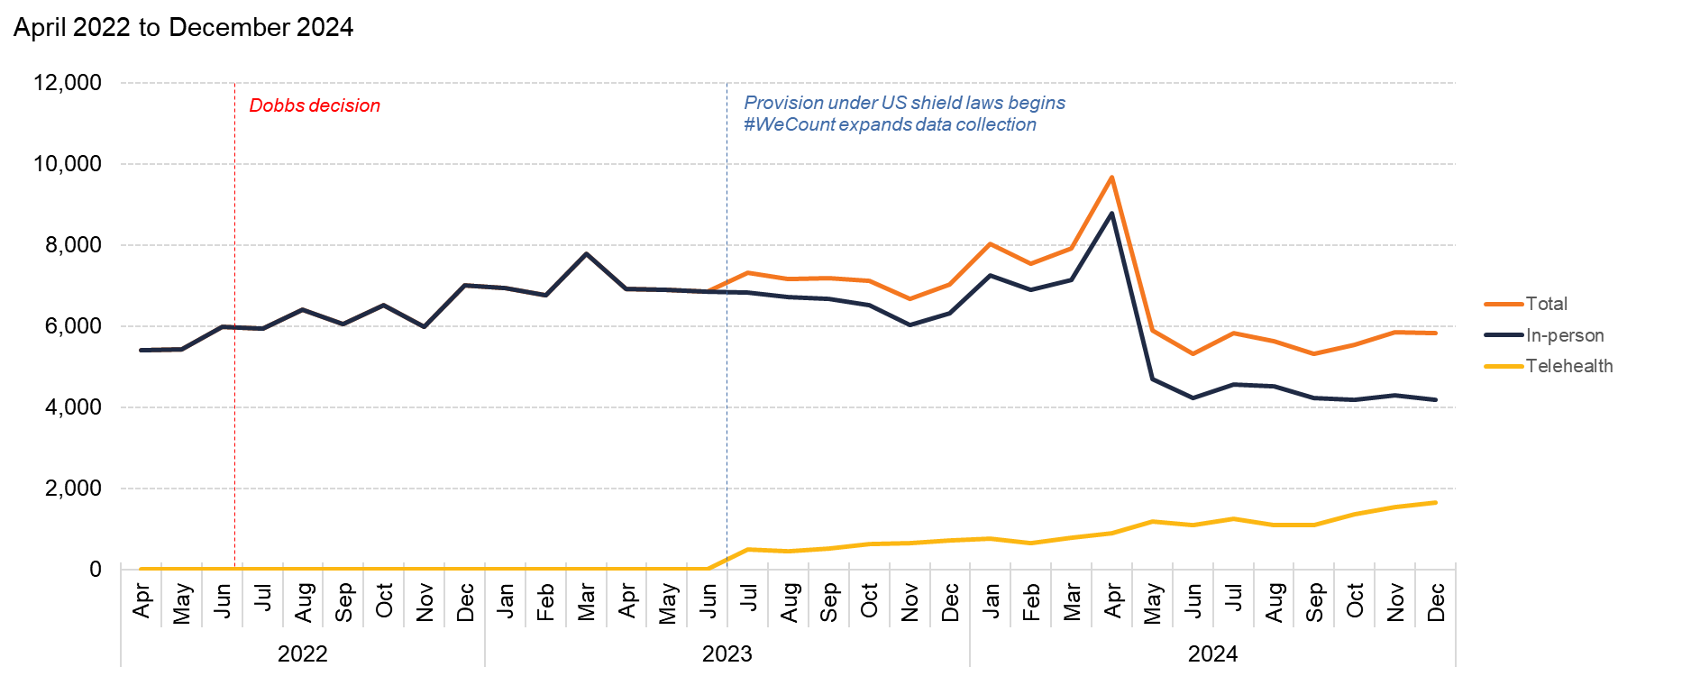
Florida
Source: Society of Family Planning, June 2025

Slide 27
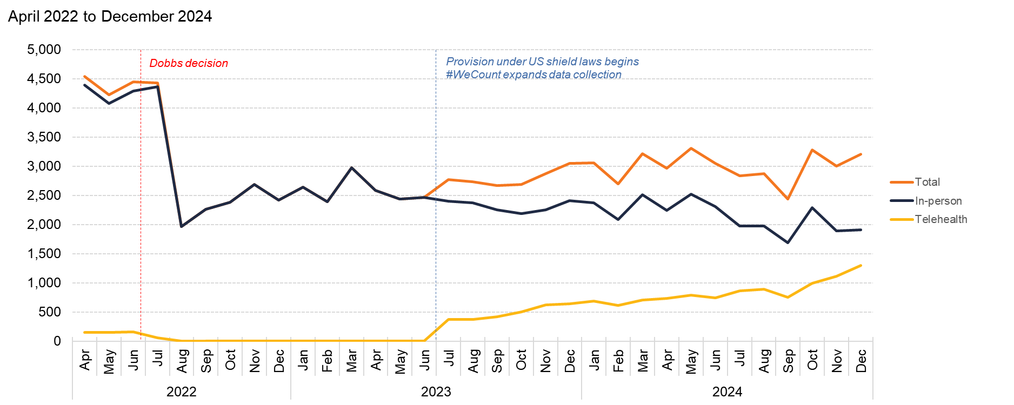
Georgia
Source: Society of Family Planning, June 2025

Slide 28
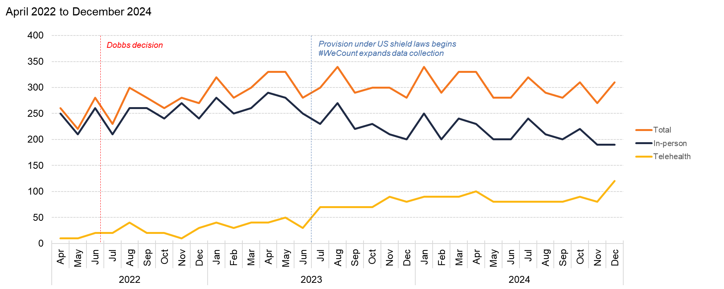
Hawaii
Source: Society of Family Planning, June 2025

Slide 29
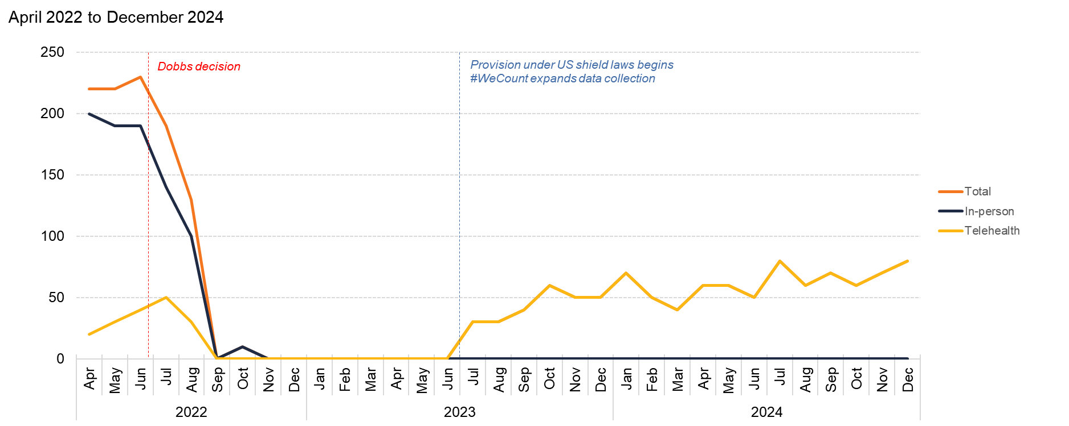
Idaho
Source: Society of Family Planning, June 2025

Slide 30
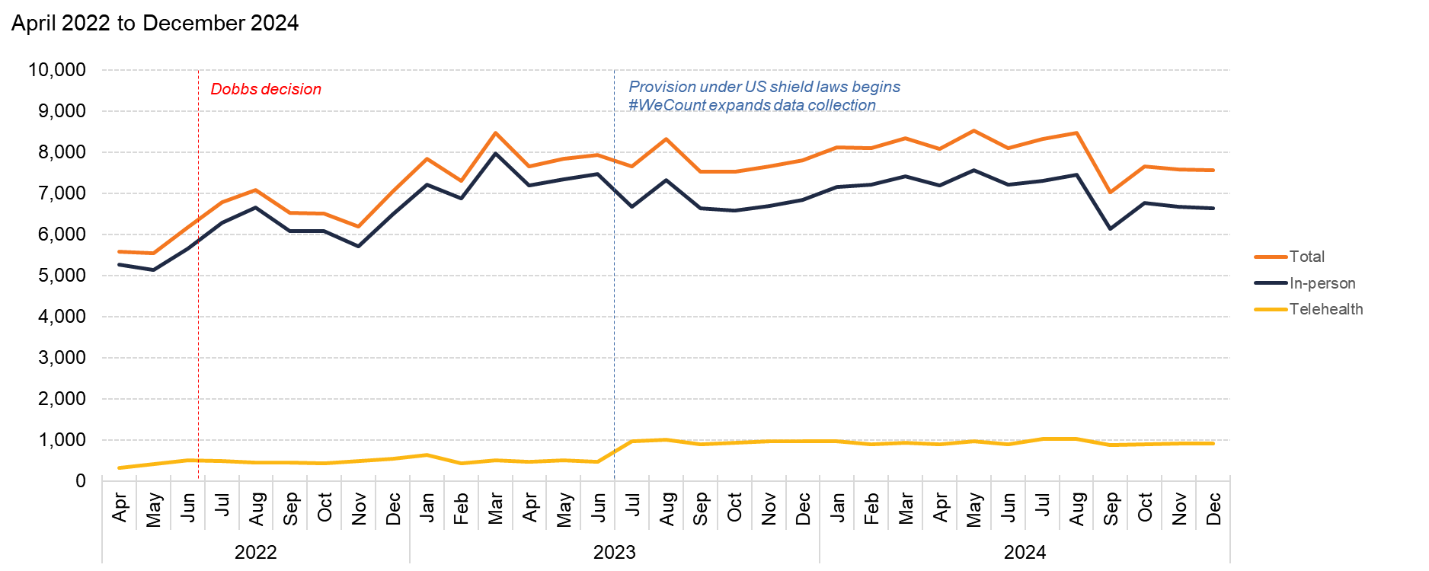
Illinois
Source: Society of Family Planning, June 2025

Slide 31
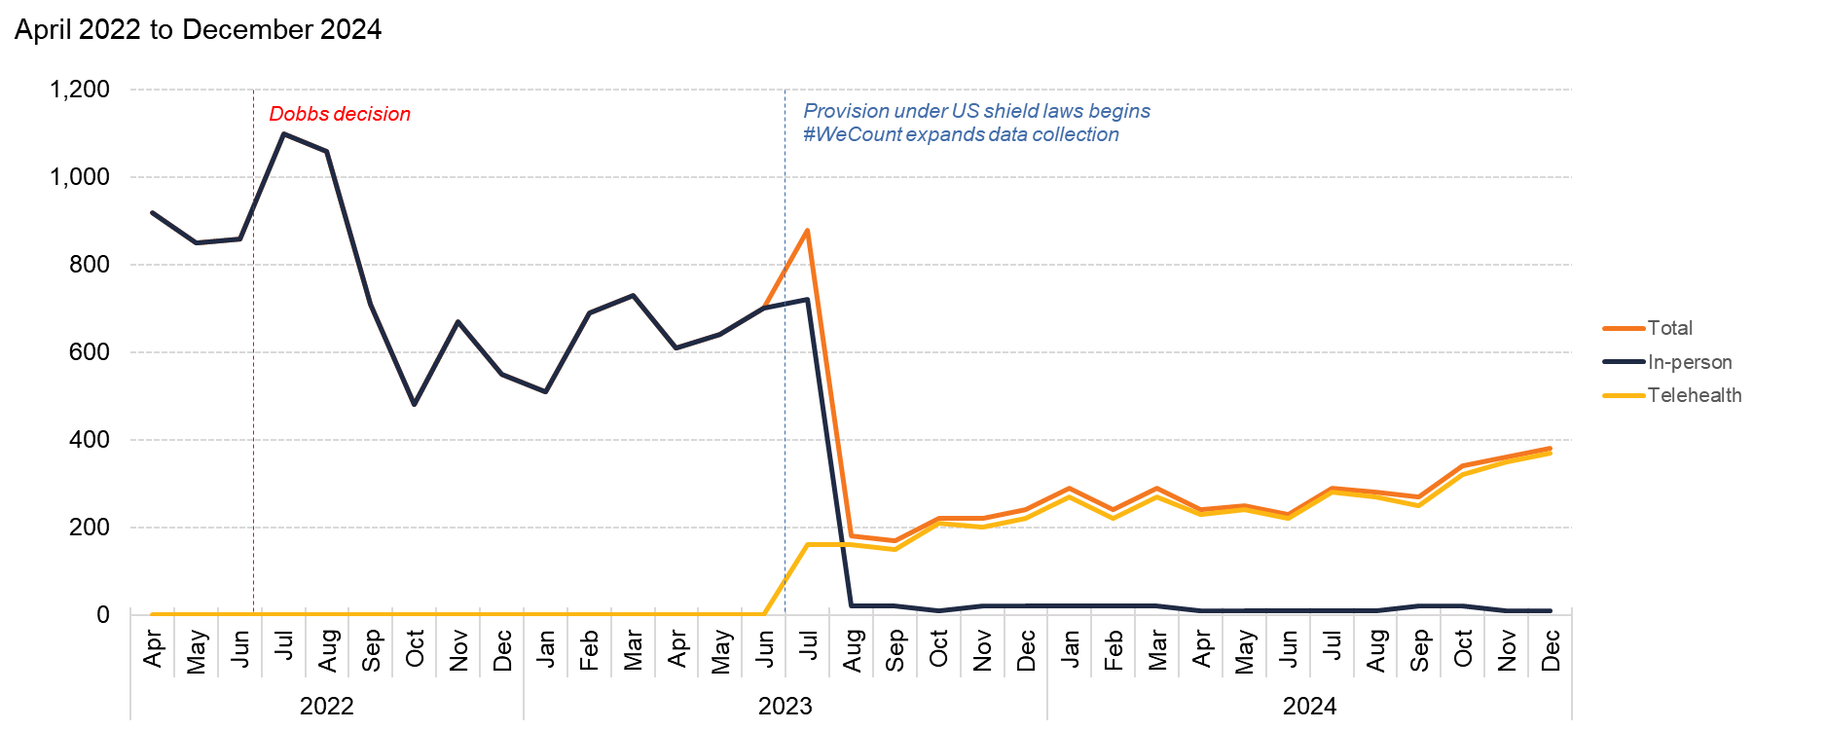
Indiana
Source: Society of Family Planning, June 2025

Slide 32
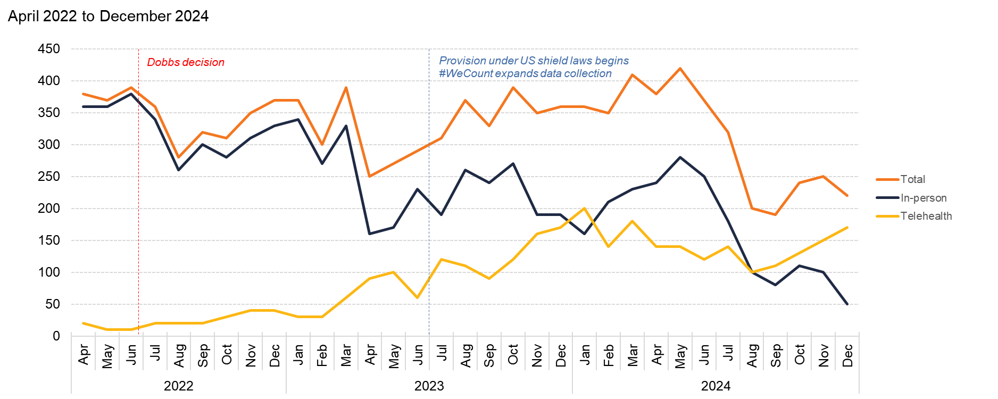
Iowa
Source: Society of Family Planning, June 2025

Slide 33
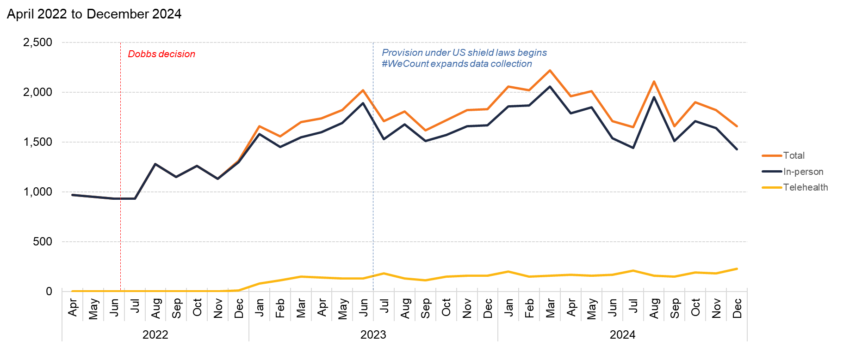
Kansas
Source: Society of Family Planning, June 2025

Slide 34
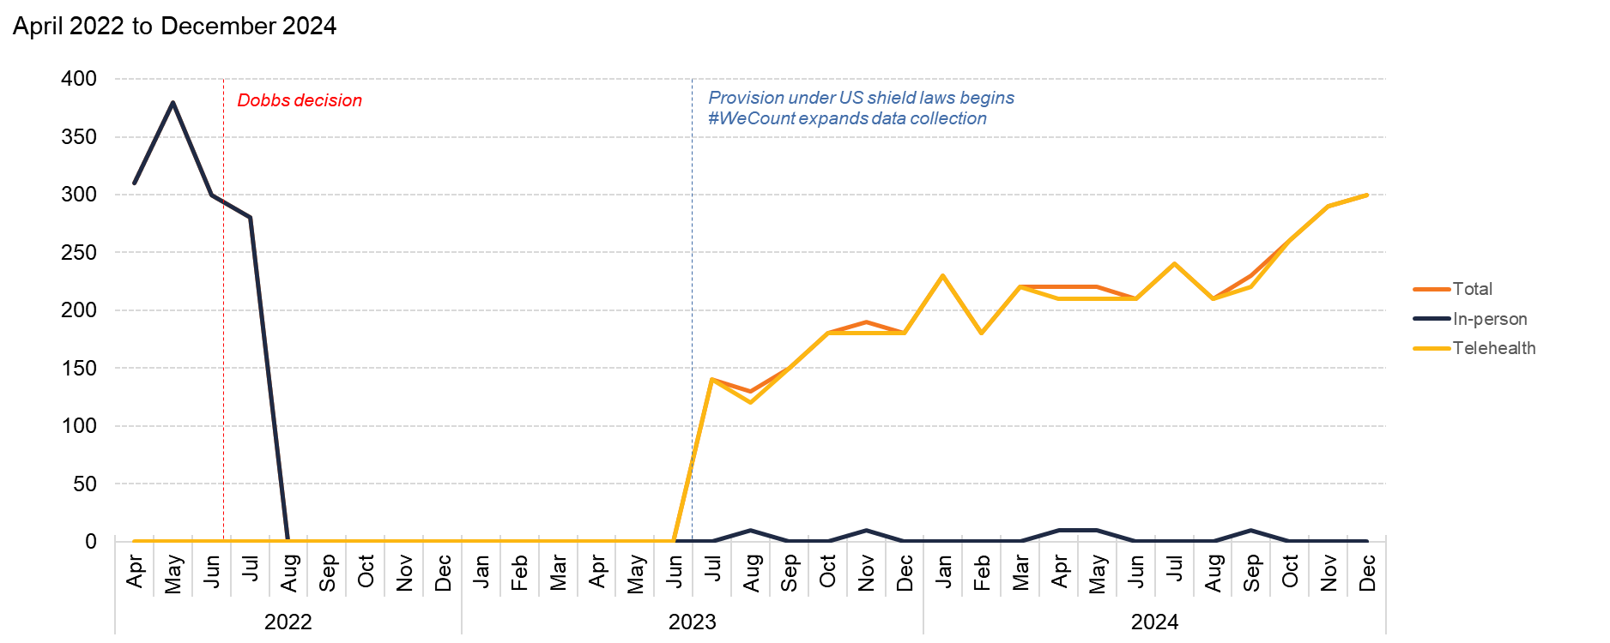
Kentucky
Source: Society of Family Planning, June 2025

Slide 35
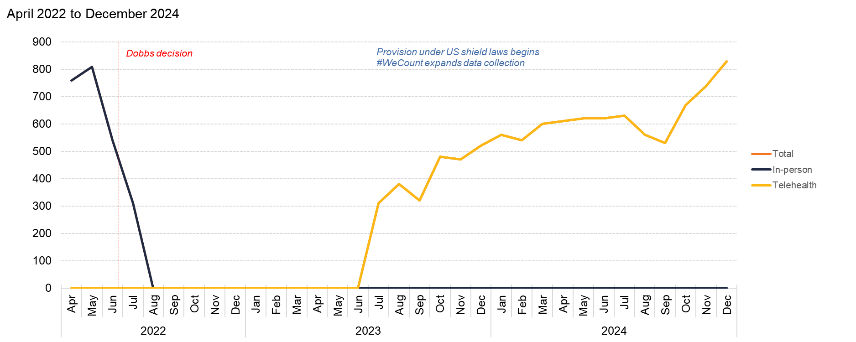
Louisiana
Source: Society of Family Planning, June 2025

Slide 36
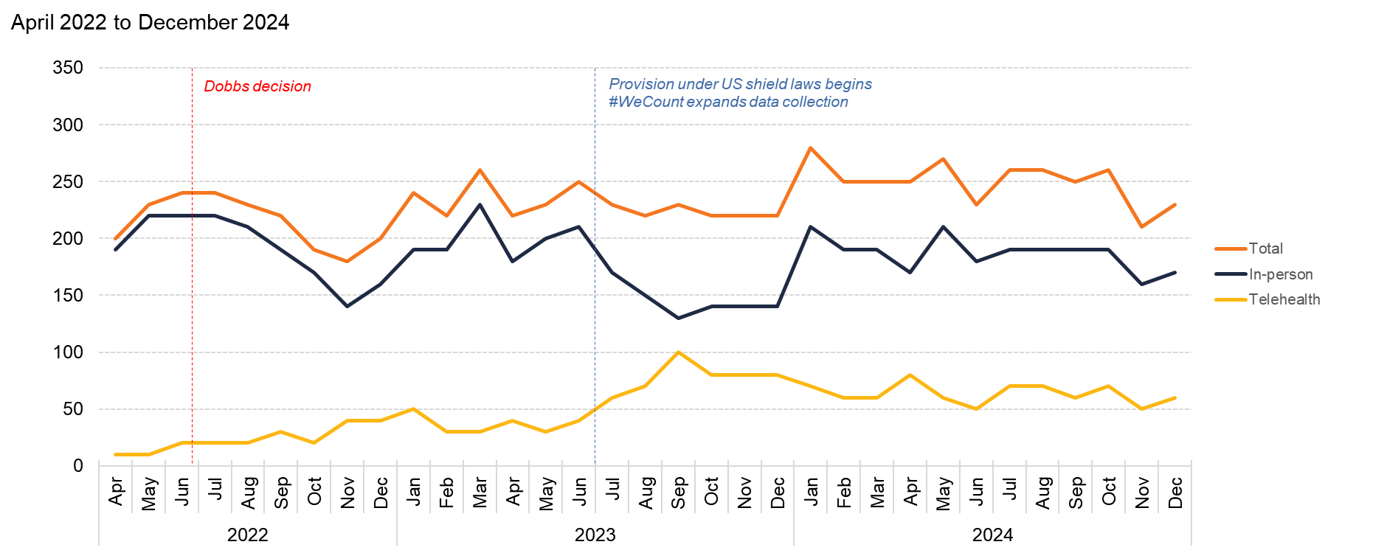
Maine
Source: Society of Family Planning, June 2025

Slide 37
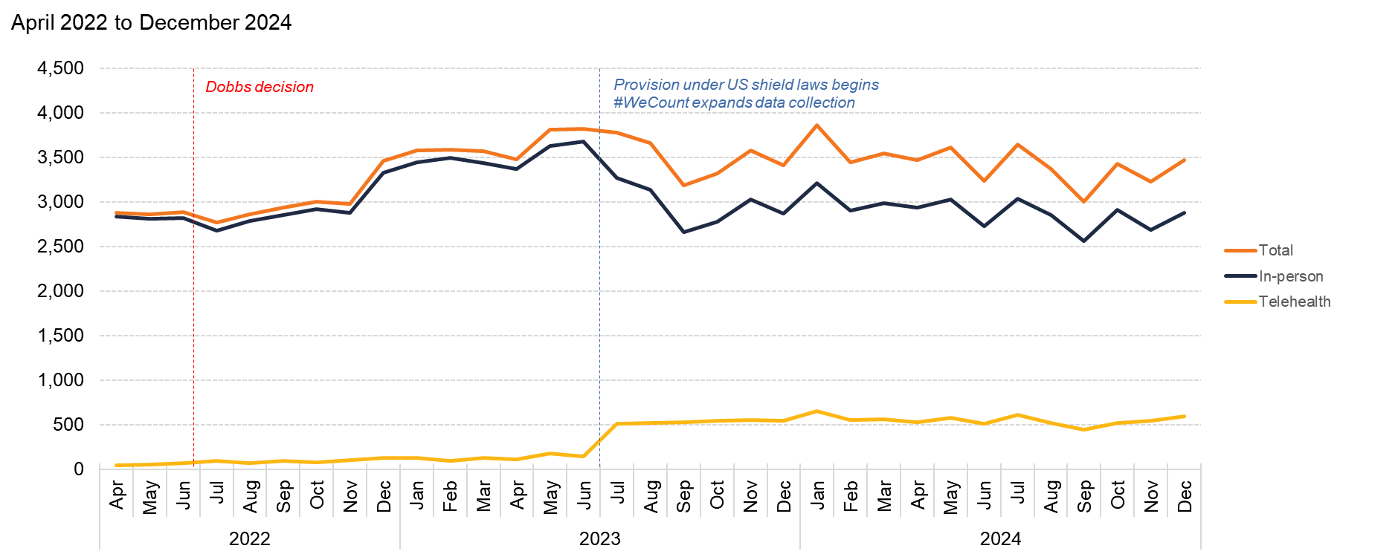
Maryland
Source: Society of Family Planning, June 2025

Slide 38
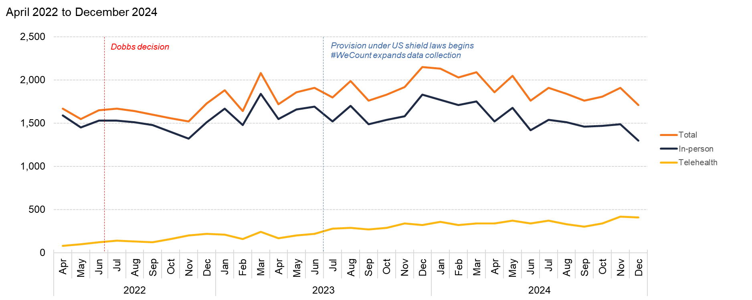
Massachusetts
Source: Society of Family Planning, June 2025

Slide 39
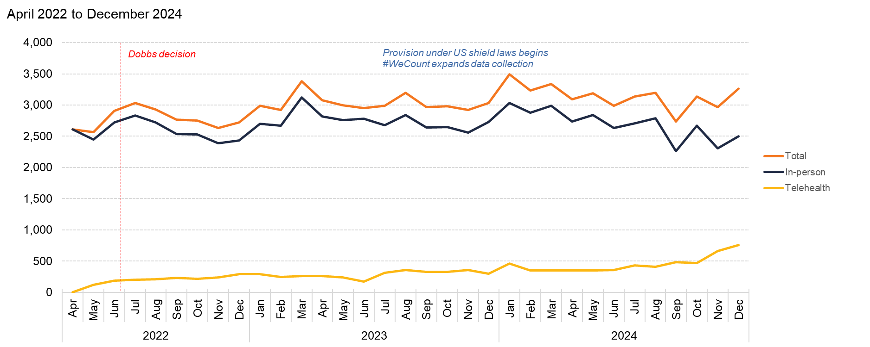
Michigan
Source: Society of Family Planning, June 2025

Slide 40
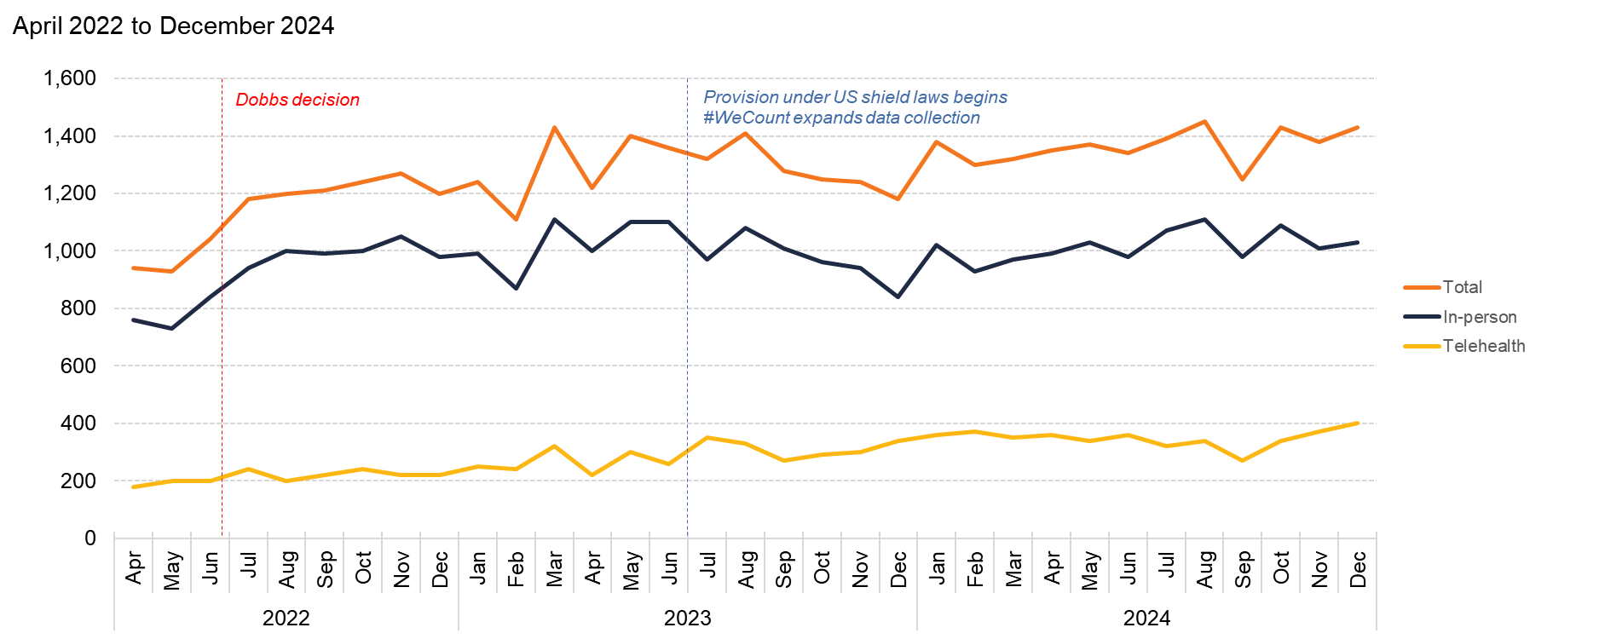
Minnesota
Source: Society of Family Planning, June 2025

Slide 41
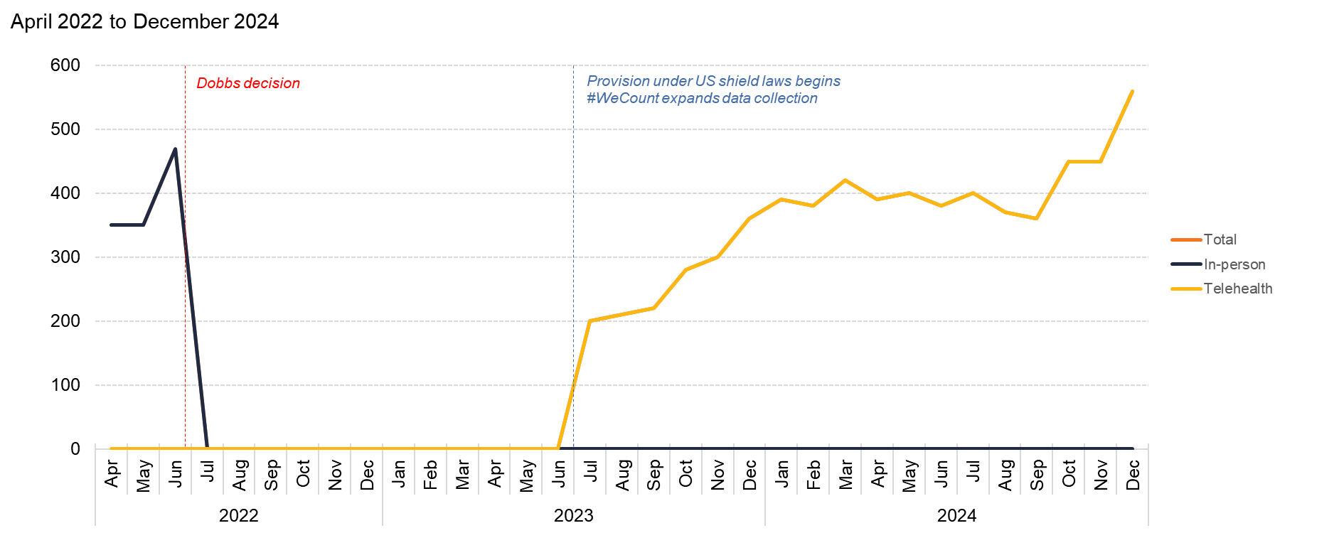
Mississippi
Source: Society of Family Planning, June 2025

Slide 42
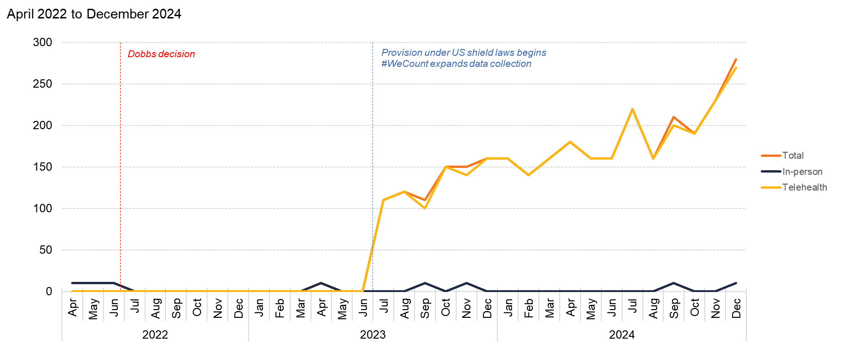
Missouri
Source: Society of Family Planning, June 2025

Slide 43
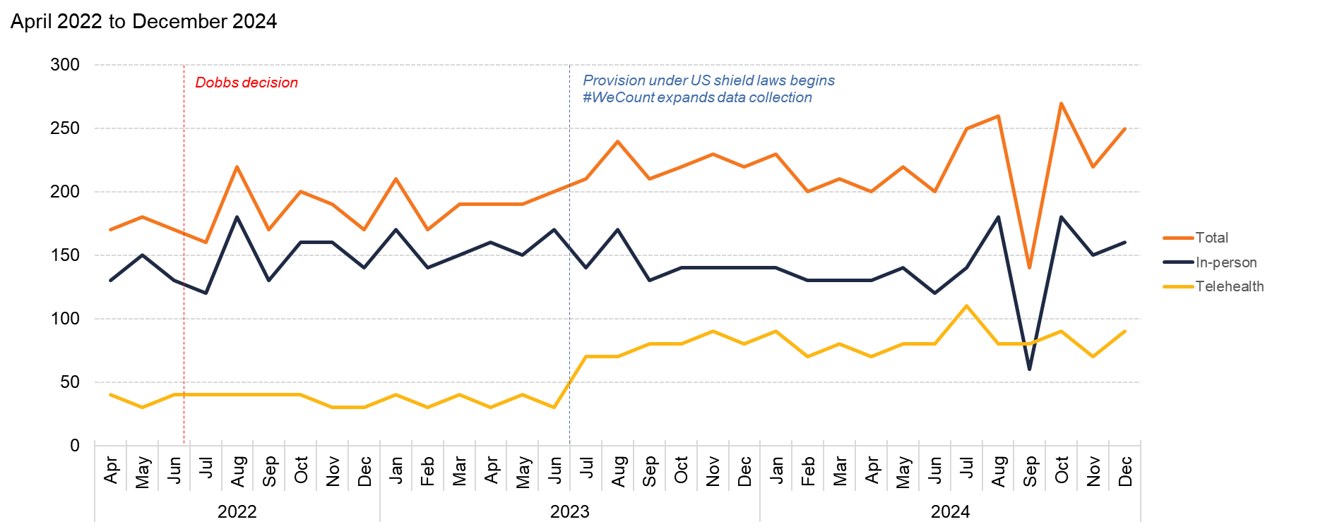
Montana
Source: Society of Family Planning, June 2025

Slide 44
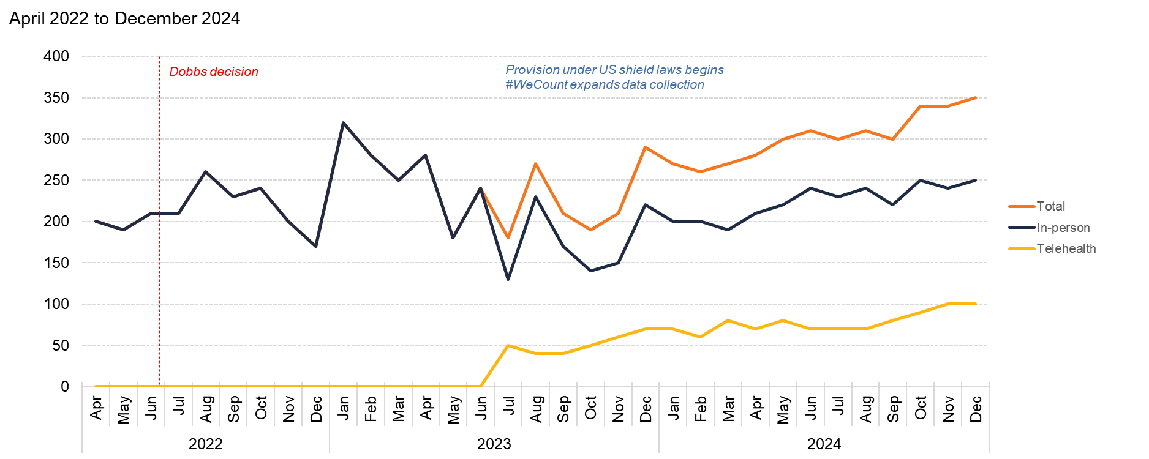
Nebraska
Source: Society of Family Planning, June 2025

Slide 45
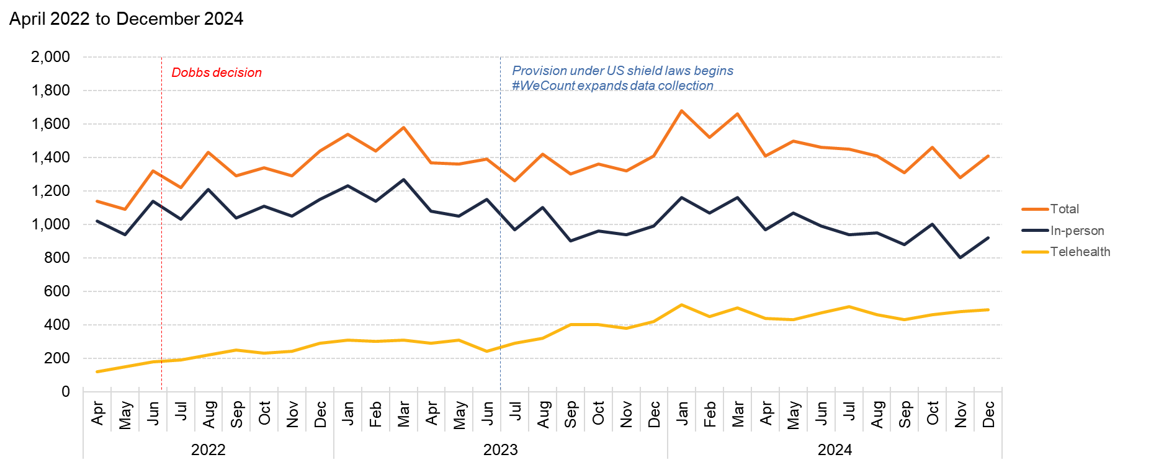
Nevada
Source: Society of Family Planning, June 2025

Slide 46
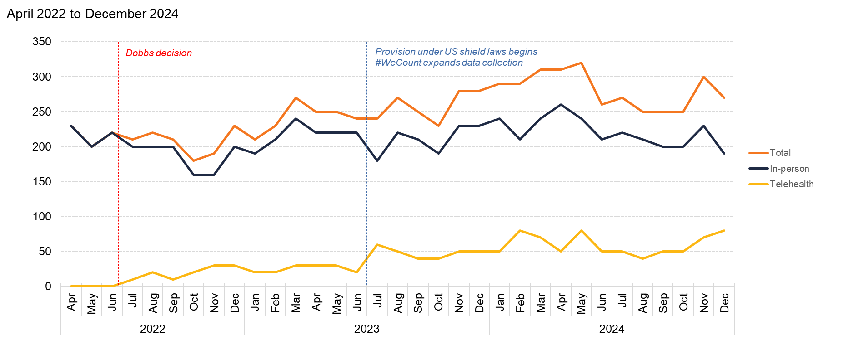
New Hampshire
Source: Society of Family Planning, June 2025

Slide 47
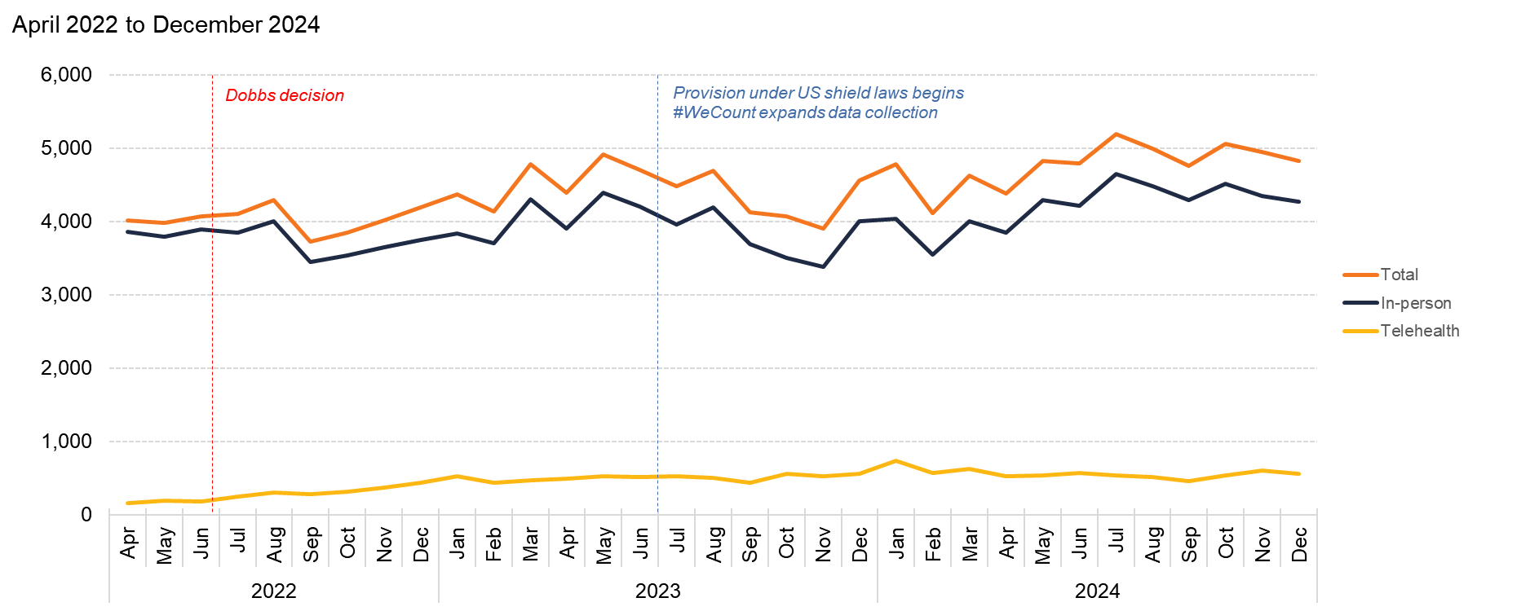
New Jersey
Source: Society of Family Planning, June 2025

Slide 48
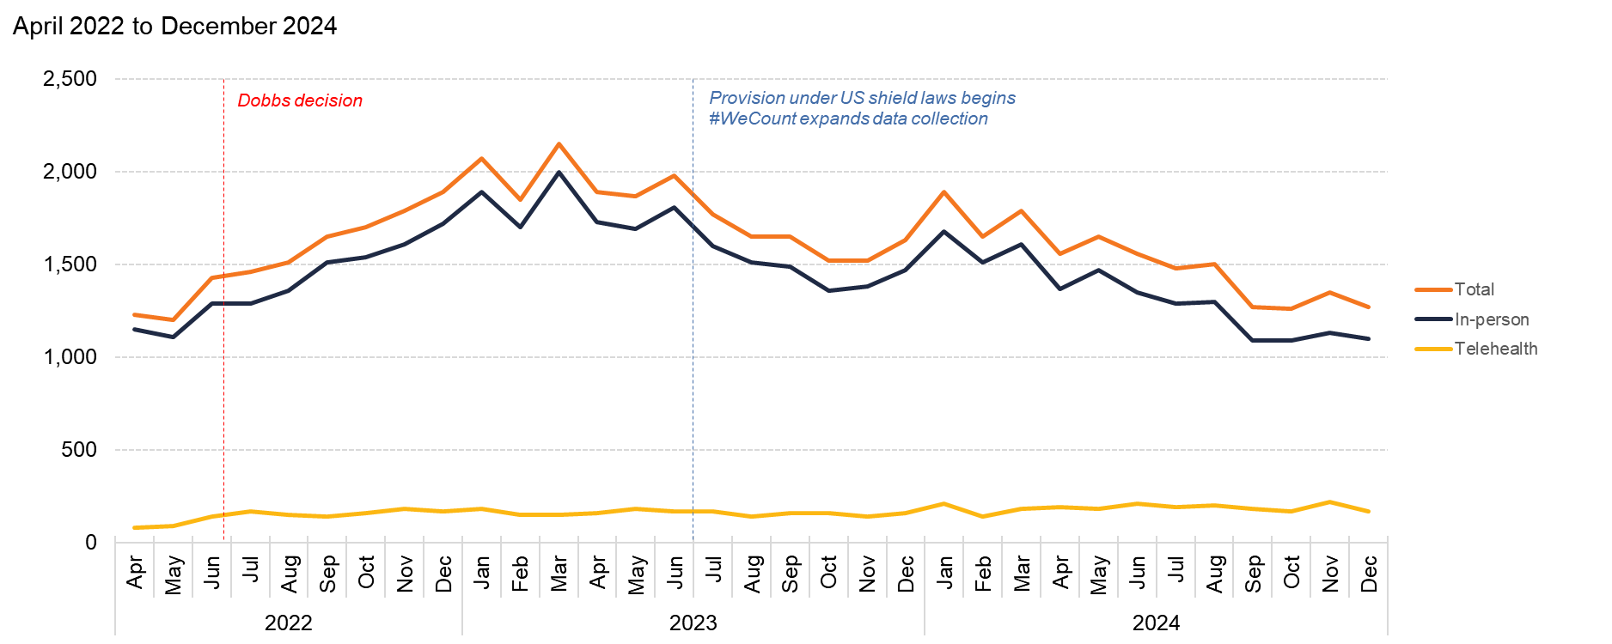
New Mexico
Source: Society of Family Planning, June 2025

Slide 49
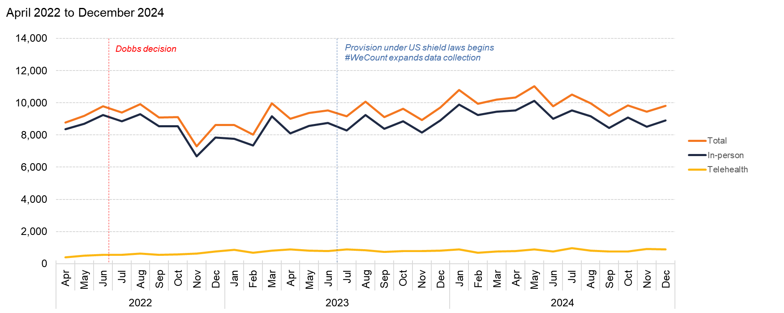
New York
Source: Society of Family Planning, June 2025

Slide 50
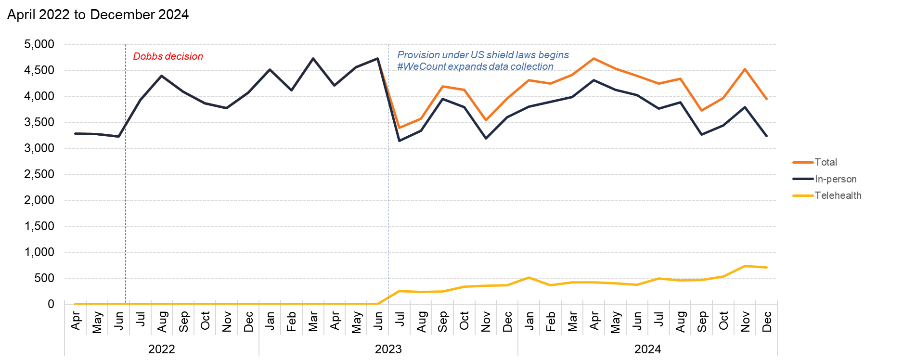
North Carolina
Source: Society of Family Planning, June 2025

Slide 51
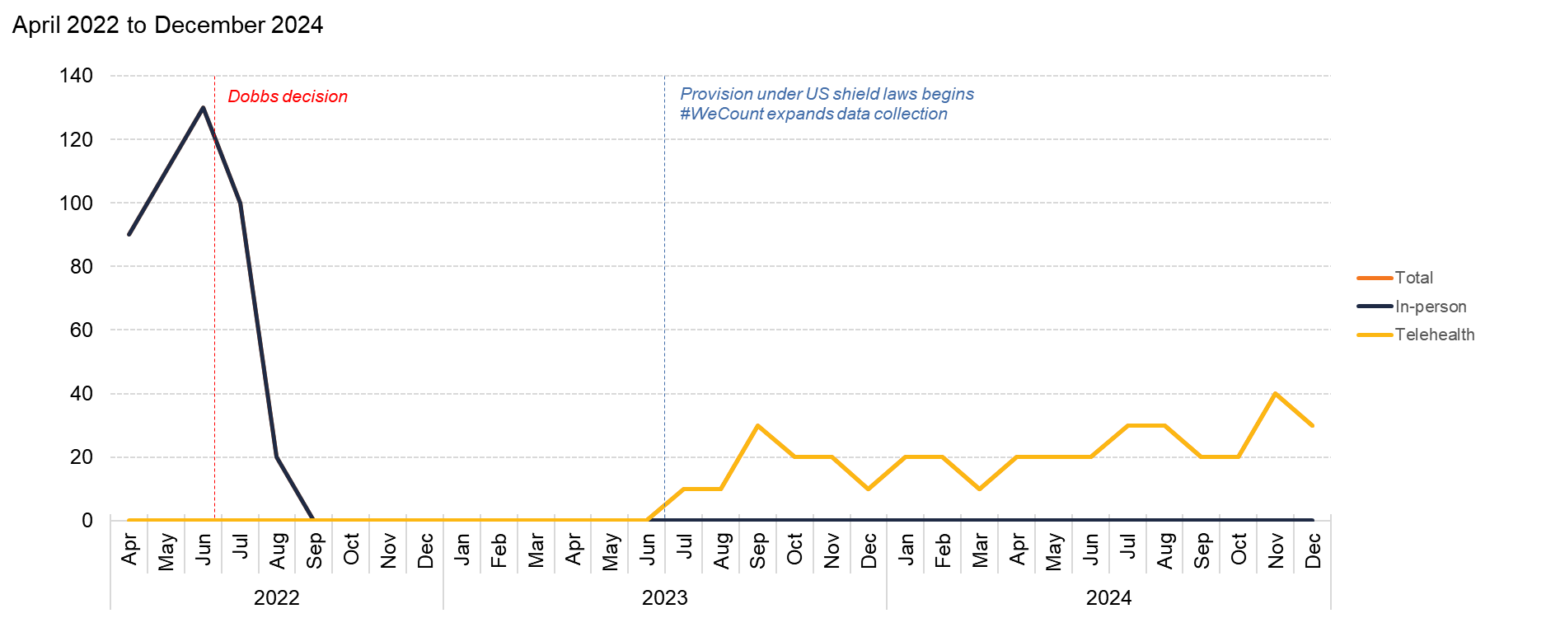
North Dakota
Source: Society of Family Planning, June 2025

Slide 52
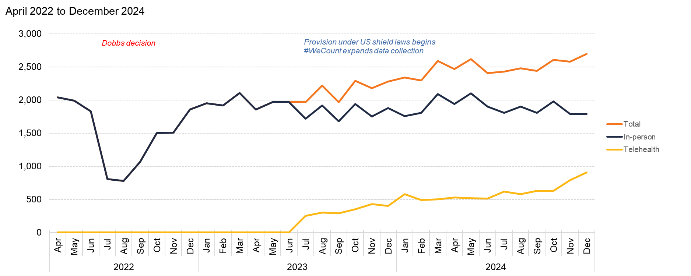
Ohio
Source: Society of Family Planning, June 2025

Slide 53
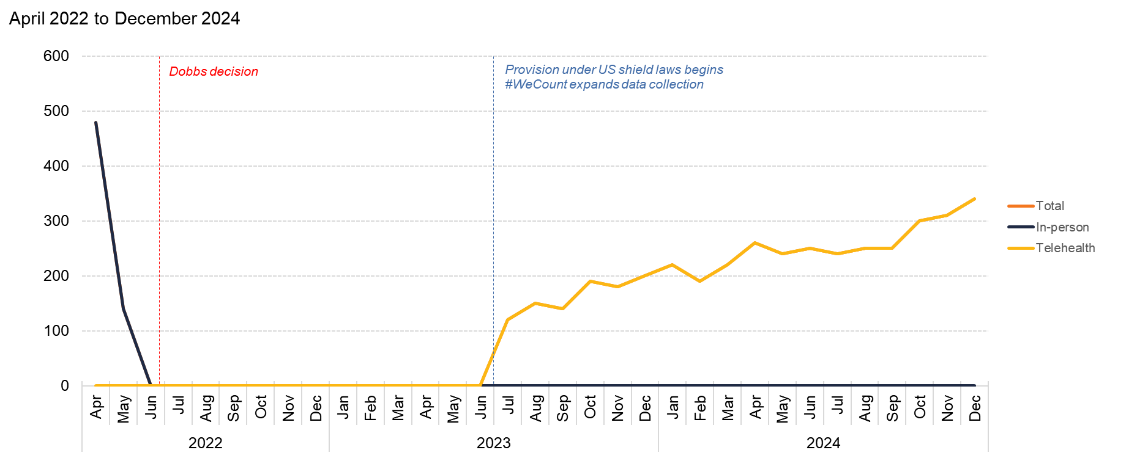
Oklahoma
Source: Society of Family Planning, June 2025

Slide 54
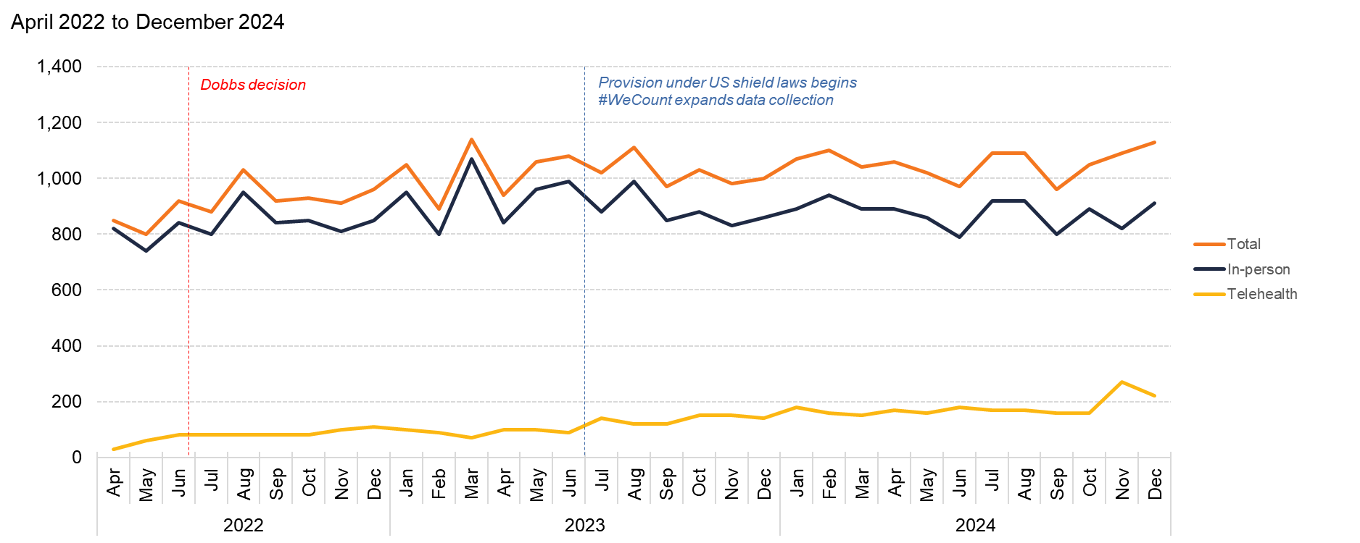
Oregon
Source: Society of Family Planning, June 2025

Slide 55

Pennsylvania
Source: Society of Family Planning, June 2025

Slide 56

Rhode Island
Source: Society of Family Planning, June 2025

Slide 57

South Carolina
Source: Society of Family Planning, June 2025

Slide 58

South Dakota
Source: Society of Family Planning, June 2025

Slide 59

Tennessee
Source: Society of Family Planning, June 2025

Slide 60

Texas
Source: Society of Family Planning, June 2025

Slide 61

Utah
Source: Society of Family Planning, June 2025

Slide 62

Vermont
Source: Society of Family Planning, June 2025

Slide 63

Virginia
Source: Society of Family Planning, June 2025

Slide 64

Washington
Source: Society of Family Planning, June 2025

Slide 65

West Virginia
Source: Society of Family Planning, June 2025

Slide 66

Wisconsin
Source: Society of Family Planning, June 2025

Slide 67

Wyoming
Source: Society of Family Planning, June 2025

Slide 68
Routes to care in states with telehealth restrictions

Slide 69

Alaska, 12-month totals by route to care in 2024
Source: Society of Family Planning, June 23, 2025; Guttmacher, June 25, 2025

Slide 70

Arizona, 12-month totals by route to care in 2024
Source: Society of Family Planning, June 23, 2025; Guttmacher, June 25, 2025

Slide 71

Nebraska, 12-month totals by route to care in 2024
Source: Society of Family Planning, June 23, 2025; Guttmacher, June 25, 2025

Slide 72

North Carolina, 12-month totals by route to care in 2024
Source: Society of Family Planning, June 23, 2025; Guttmacher, June 25, 2025

Slide 73

North Dakota, 12-month totals by route to care in 2024
Source: Society of Family Planning, June 23, 2025; Guttmacher, June 25, 2025

Slide 74

Utah, 12-month totals by route to care in 2024
Source: Society of Family Planning, June 23, 2025; Guttmacher, June 25, 2025

Slide 75

Wisconsin, 12-month totals by route to care in 2024
Source: Society of Family Planning, June 23, 2025; Guttmacher, June 25, 2025

Slide 76

Wyoming, 12-month totals by route to care in 2024
Source: Society of Family Planning, June 23, 2025; Guttmacher, June 25, 2025

Slide 77
Routes to care in states with 6-week bans

Slide 78

Florida, 12-month totals by route to care in 2024
Source: Society of Family Planning, June 23, 2025; Guttmacher, June 25, 2025

Slide 79

Georgia, 12-month totals by route to care in 2024
Source: Society of Family Planning, June 23, 2025; Guttmacher, June 25, 2025

Slide 80

Iowa, 12-month totals by route to care in 2024
Source: Society of Family Planning, June 23, 2025; Guttmacher, June 25, 2025

Slide 81

South Carolina, 12-month totals by route to care in 2024
Source: Society of Family Planning, June 23, 2025; Guttmacher, June 25, 2025

Slide 82
Routes to care in states with total bans

Slide 83

Alabama, 12-month totals by route to care in 2024
Source: Society of Family Planning, June 23, 2025; Guttmacher, June 25, 2025

Slide 84

Arkansas, 12-month totals by route to care in 2024
Source: Society of Family Planning, June 23, 2025; Guttmacher, June 25, 2025

Slide 85

Idaho, 12-month totals by route to care in 2024
Source: Society of Family Planning, June 23, 2025; Guttmacher, June 25, 2025

Slide 86

Indiana, 12-month totals by route to care in 2024
Source: Society of Family Planning, June 23, 2025; Guttmacher, June 25, 2025

Slide 87

Kentucky, 12-month totals by route to care in 2024
Source: Society of Family Planning, June 23, 2025; Guttmacher, June 25, 2025

Slide 88

Louisiana, 12-month totals by route to care in 2024
Source: Society of Family Planning, June 23, 2025; Guttmacher, June 25, 2025

Slide 89

Mississippi, 12-month totals by route to care in 2024
Source: Society of Family Planning, June 23, 2025; Guttmacher, June 25, 2025

Slide 90

Missouri, 12-month totals by route to care in 2024
Source: Society of Family Planning, June 23, 2025; Guttmacher, June 25, 2025

Slide 91

Oklahoma, 12-month totals by route to care in 2024
Source: Society of Family Planning, June 23, 2025; Guttmacher, June 25, 2025

Slide 92

South Dakota, 12-month totals by route to care in 2024
Source: Society of Family Planning, June 23, 2025; Guttmacher, June 25, 2025

Slide 93

Tennessee, 12-month totals by route to care in 2024
Source: Society of Family Planning, June 23, 2025; Guttmacher, June 25, 2025

Slide 94

Texas, 12-month totals by route to care in 2024
Source: Society of Family Planning, June 23, 2025; Guttmacher, June 25, 2025

Slide 95

West Virginia, 12-month totals by route to care in 2024
Source: Society of Family Planning, June 23, 2025; Guttmacher, June 25, 2025

