Slide 1
National findings
Notes:
Alison

Slide 2
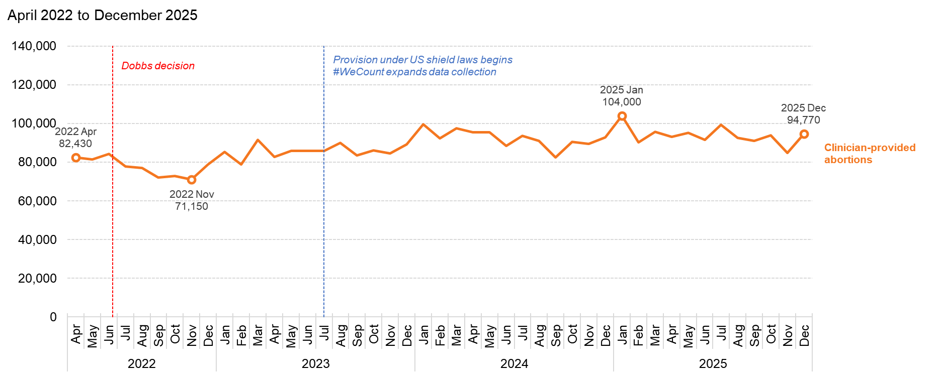
Abortions in the US have increased since Dobbs
Source: Society of Family Planning, June 2026

Slide 3
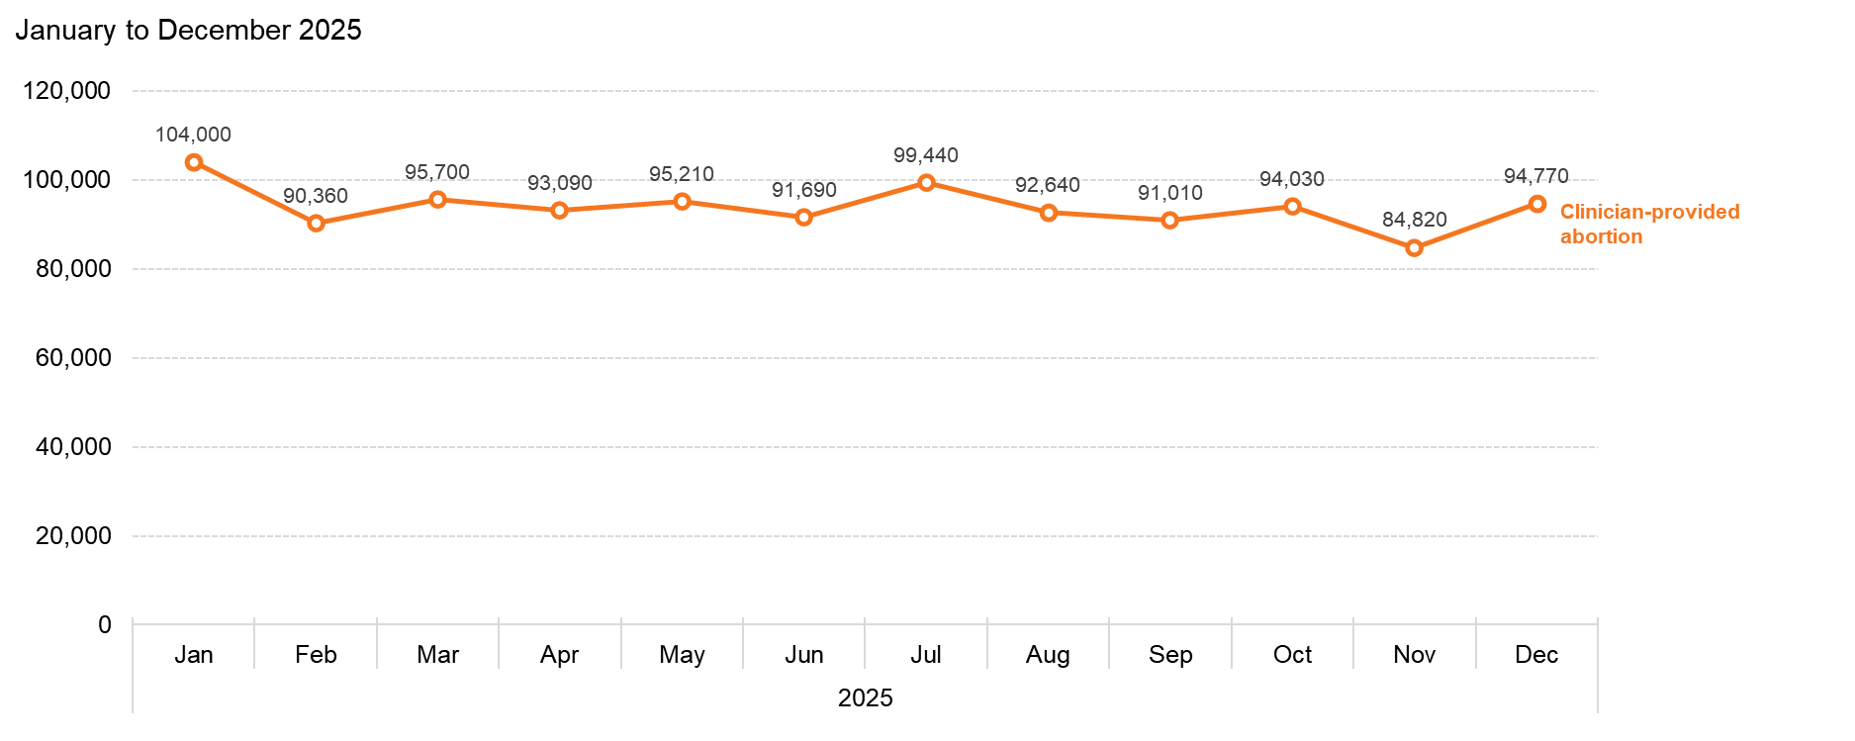
US abortions totaled 1.13 million in 2025
Source: Society of Family Planning, June 2026

Slide 4
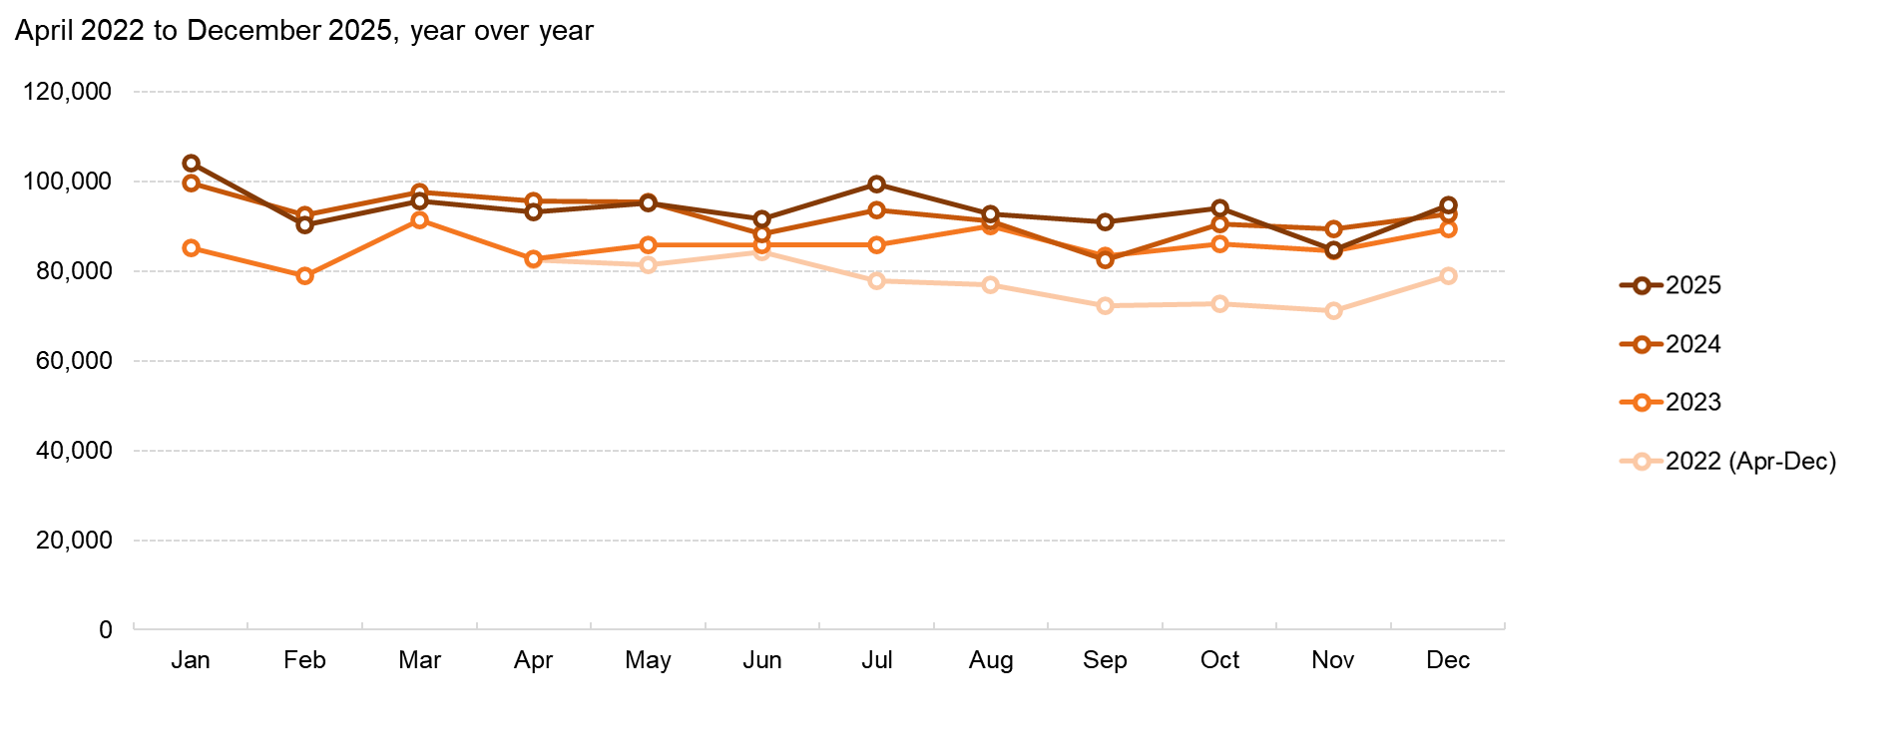
Abortion volume fluctuates from month to month, and has increased year over year
Source: Society of Family Planning, June 2026

Slide 5
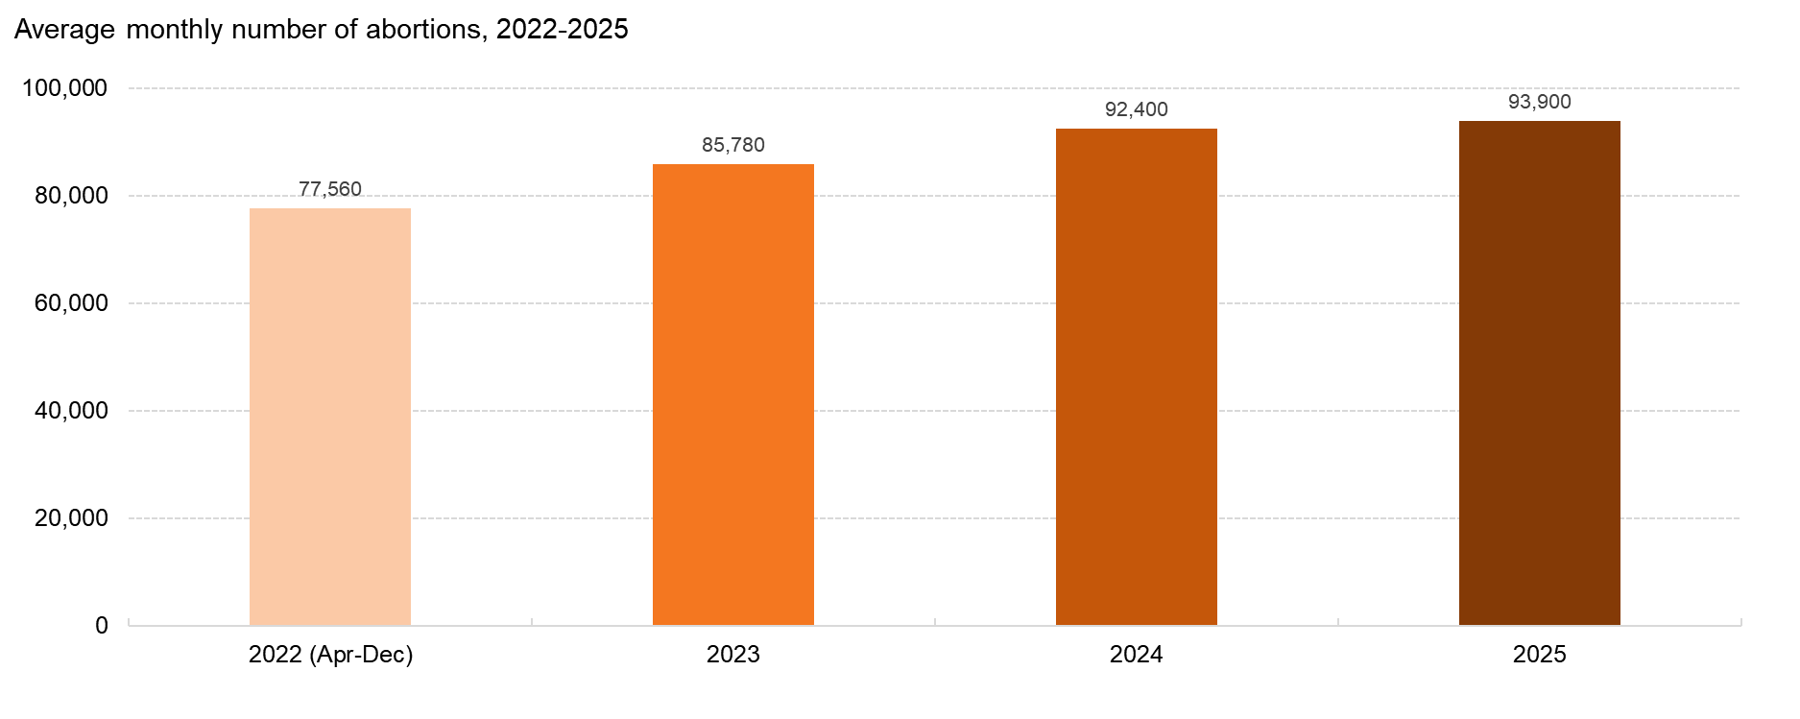
Growth in the monthly number of abortions has slowed
Source: Society of Family Planning, June 2026

Slide 6
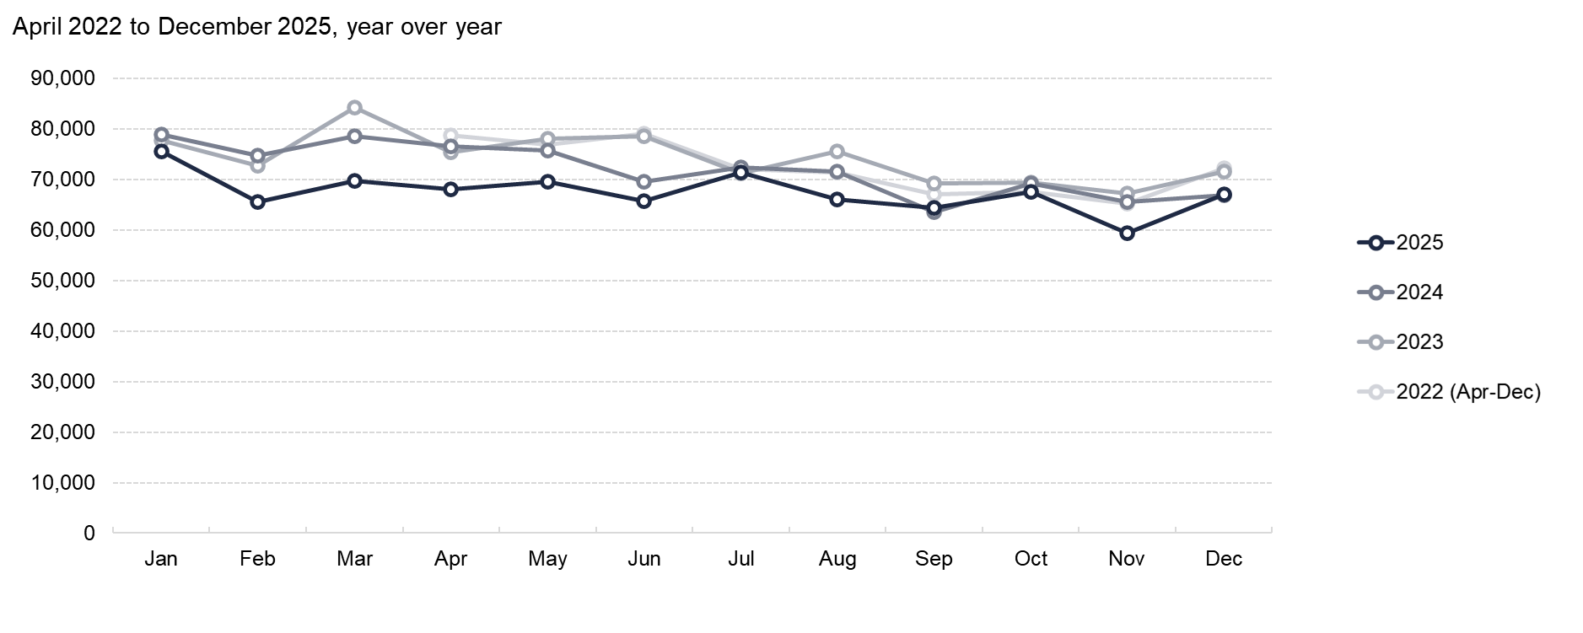
In-person abortion volume fluctuates from month to month, and was lower in 2025 than in 2024
Source: Society of Family Planning, June 2026

Slide 7
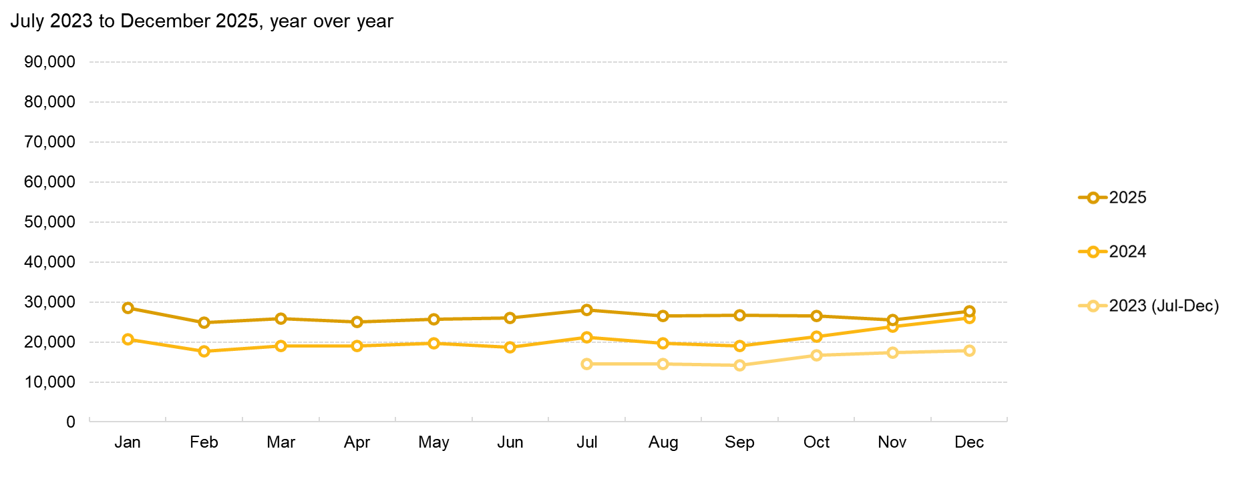
Telehealth abortion volume has increased year over year
Source: Society of Family Planning, June 2026

Slide 8
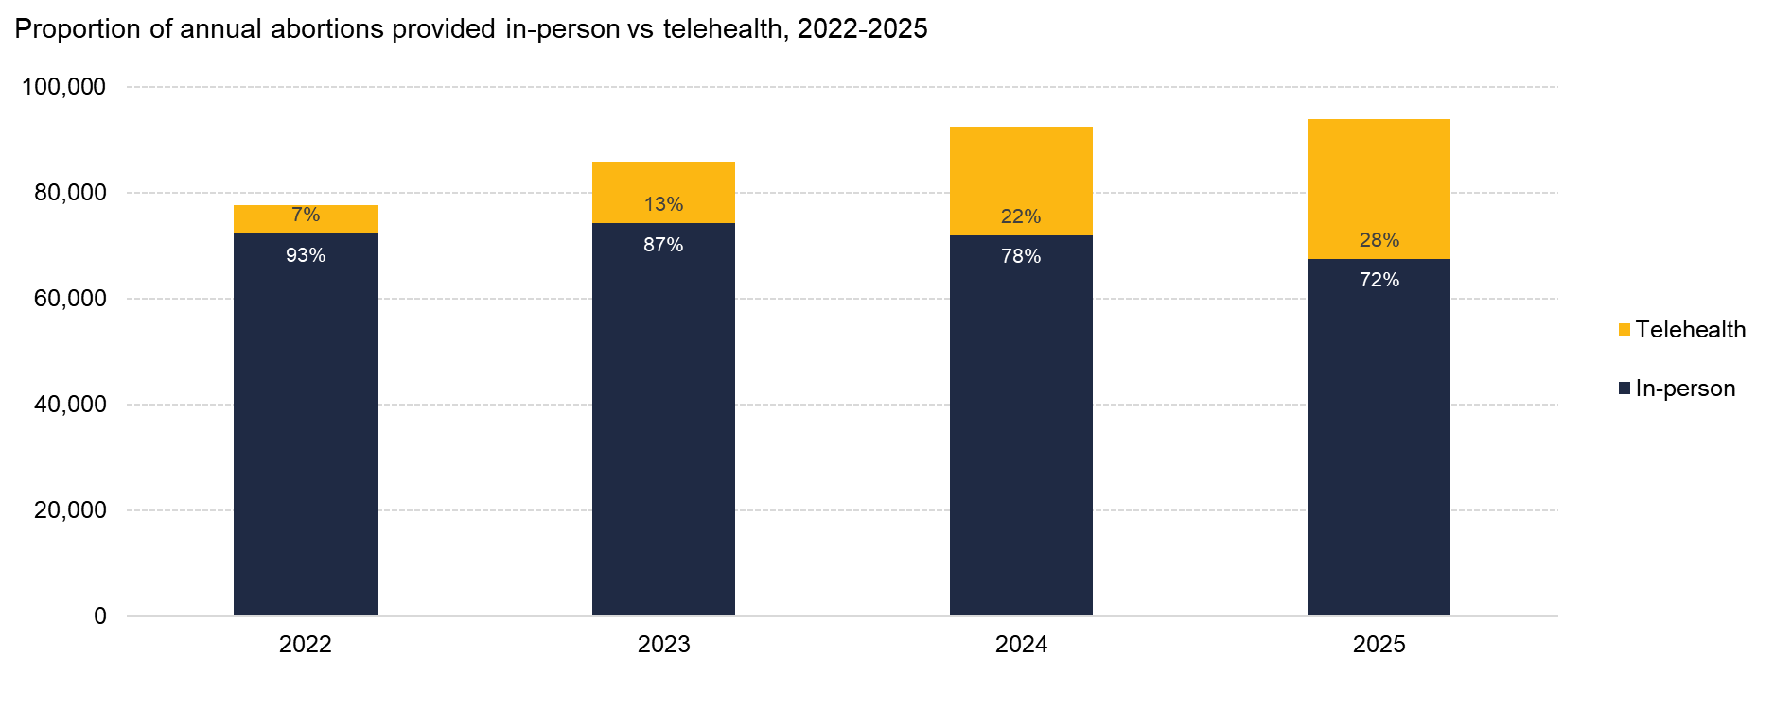
In 2025, 28% of abortions were provided via telehealth
Source: Society of Family Planning, June 2026

Slide 9
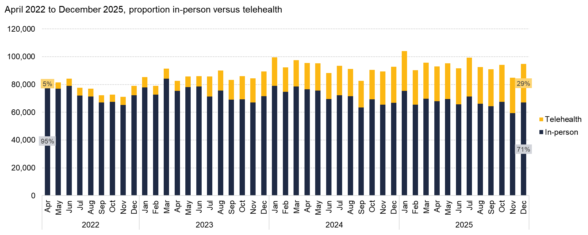
Telehealth abortion grew from 5% of all abortions in April 2022 to 29% in December 2025
Source: Society of Family Planning, June 2026

Slide 10
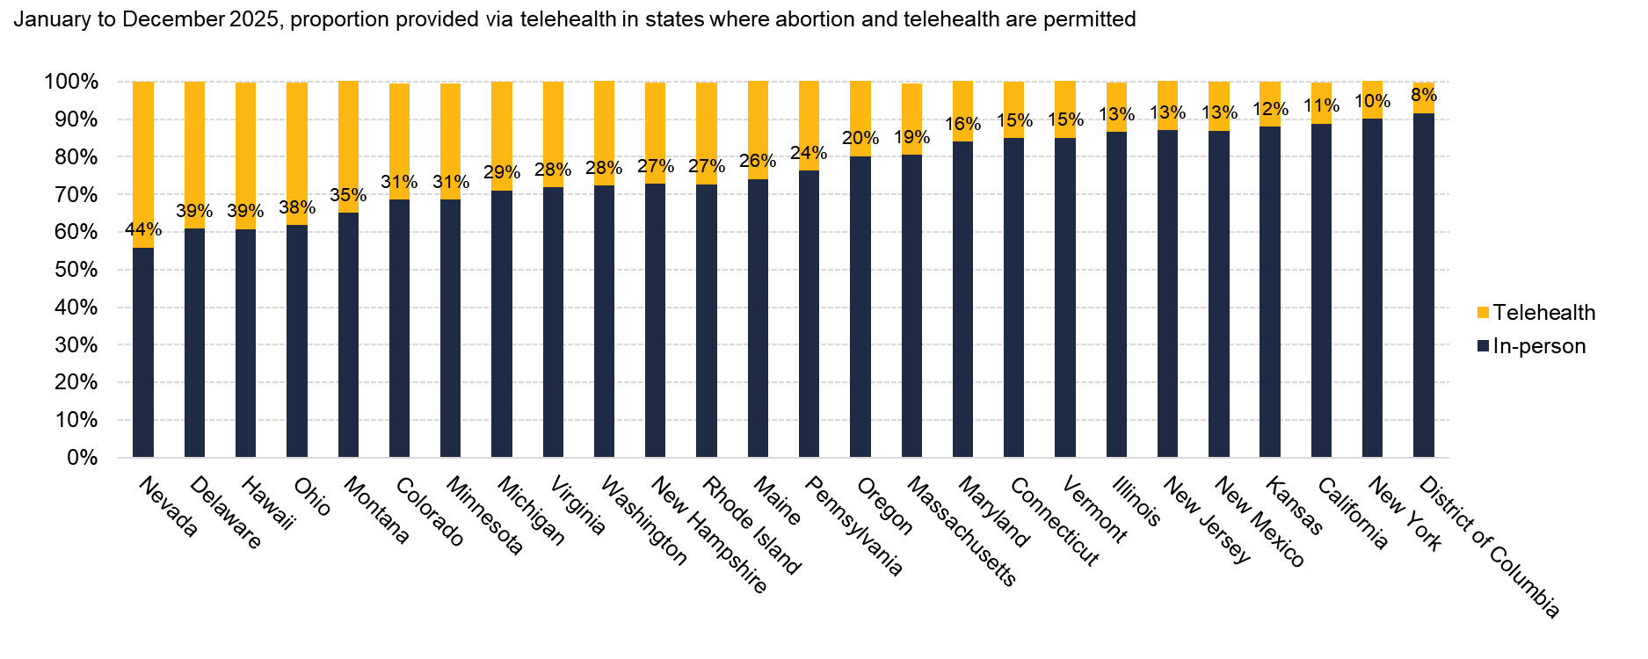
Where abortion and telehealth are permitted, the share of abortions provided via telehealth varied widely, 2025
Source: Society of Family Planning, June 2026

Slide 11
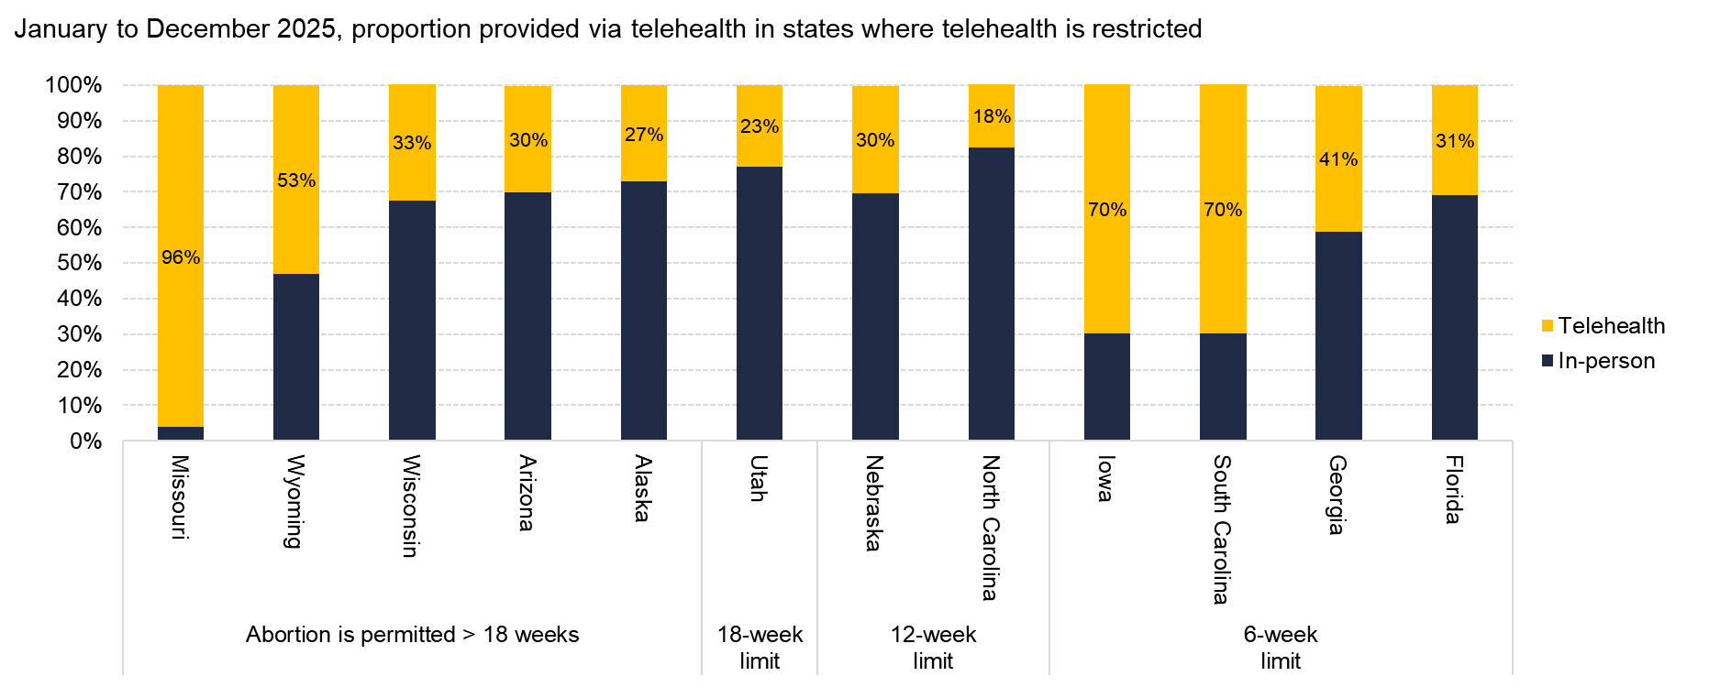
Where telehealth abortion is restricted, the share of abortions provided via telehealth under shield laws varied widely, 2025
Source: Society of Family Planning, June 2026

Slide 12
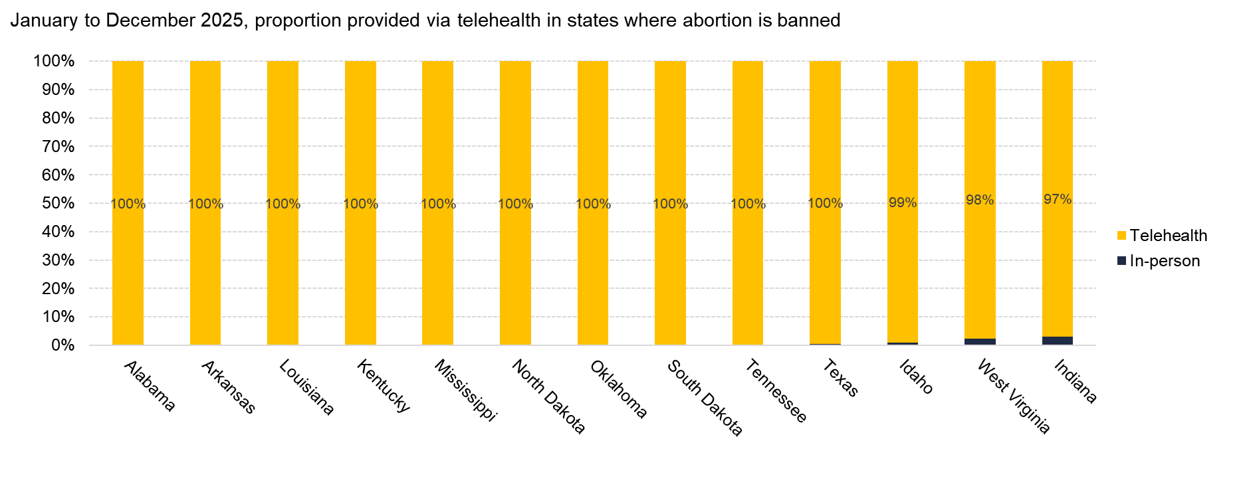
Where abortion is banned, nearly all abortions were provided via telehealth under shield laws, 2025
Source: Society of Family Planning, June 2026

Slide 13
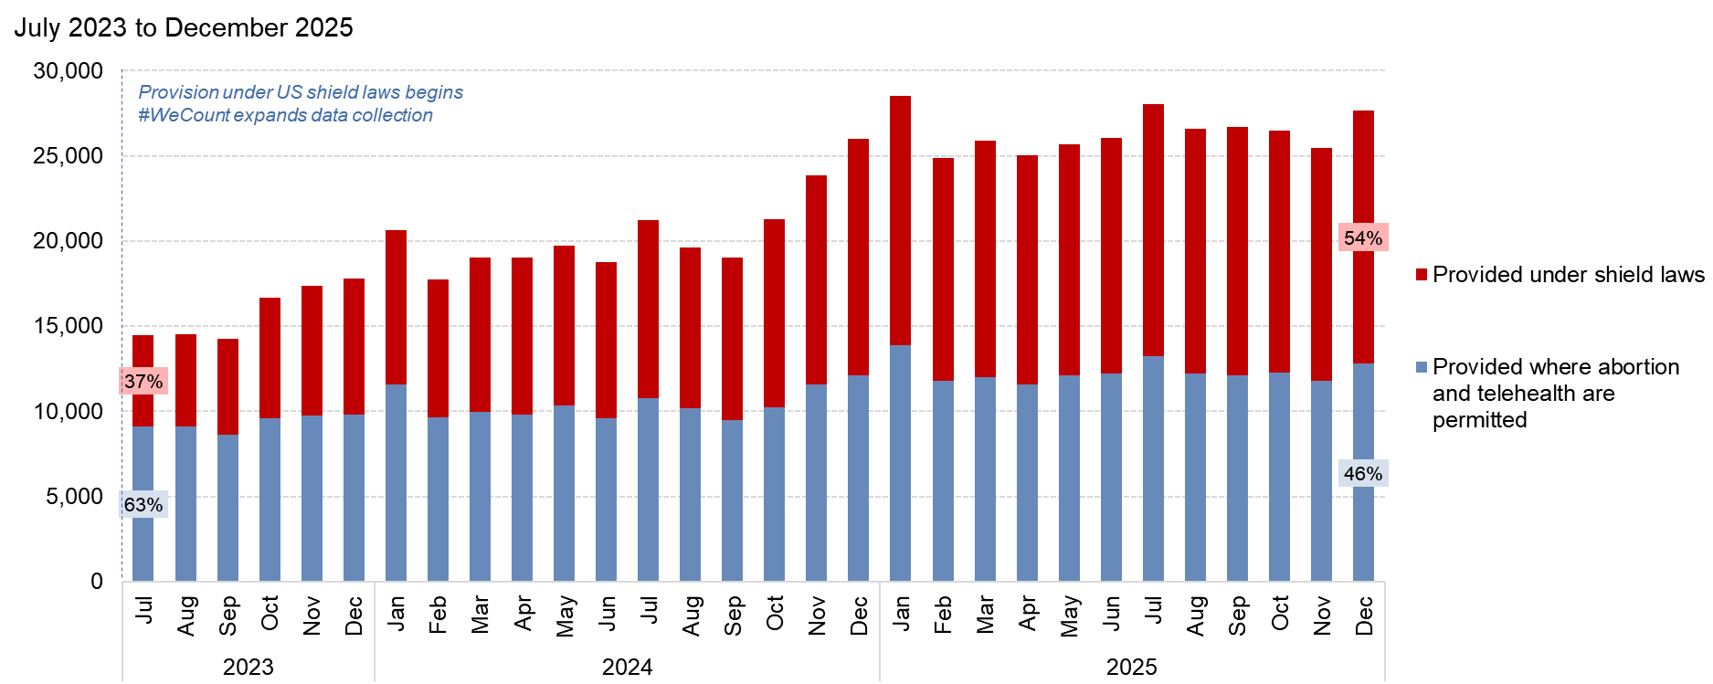
Over half of telehealth abortions are provided under shield laws
Source: Society of Family Planning, June 2026

Slide 14
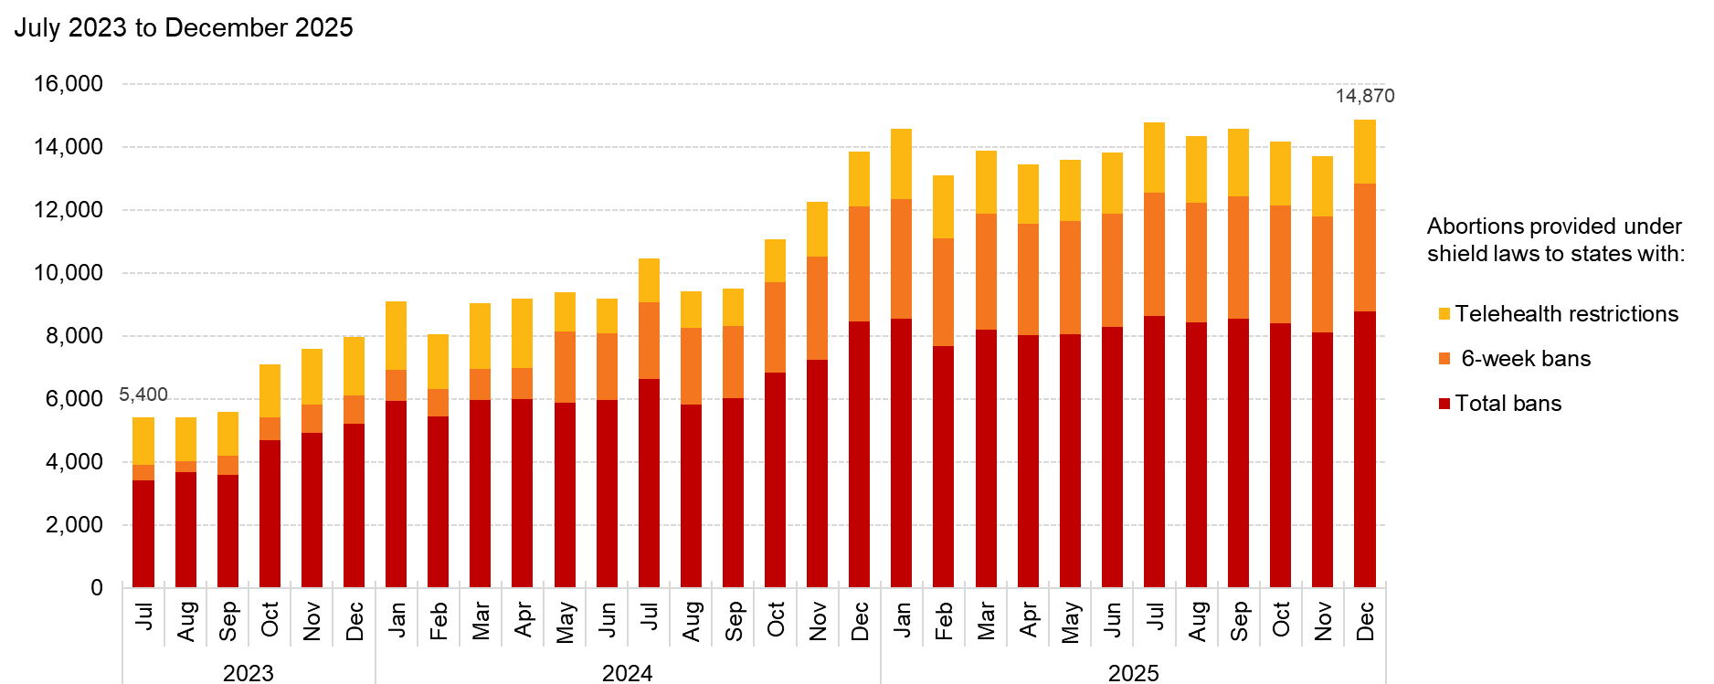
Number of abortions provided via shield laws in 2025 has increased over previous years
Source: Society of Family Planning, June 2026

Slide 15
State-level findings

Slide 16
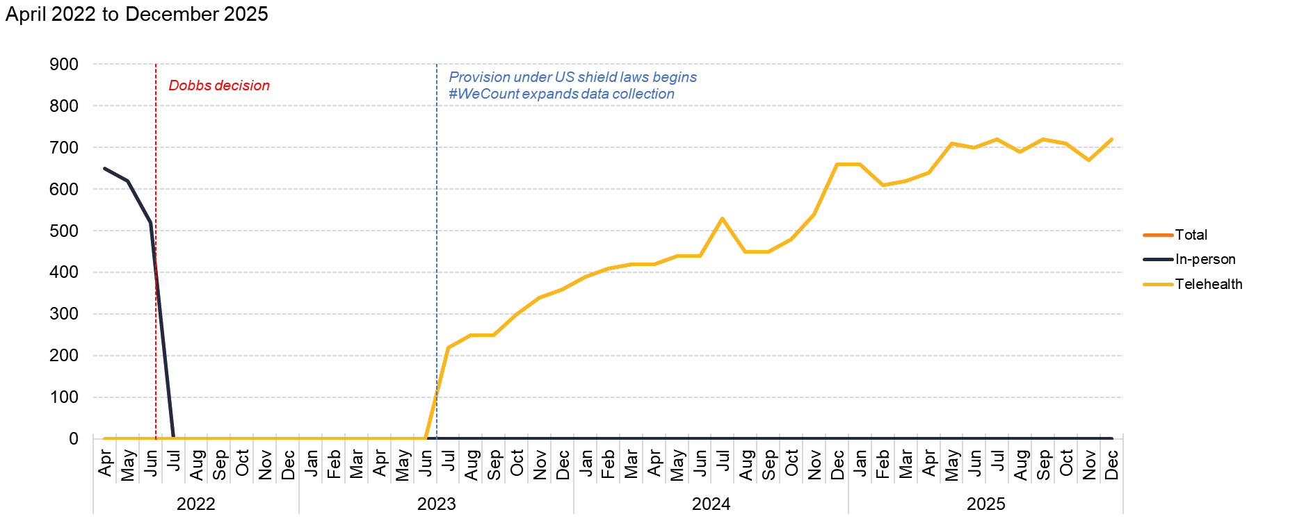
Alabama
Source: Society of Family Planning, June 2026

Slide 17
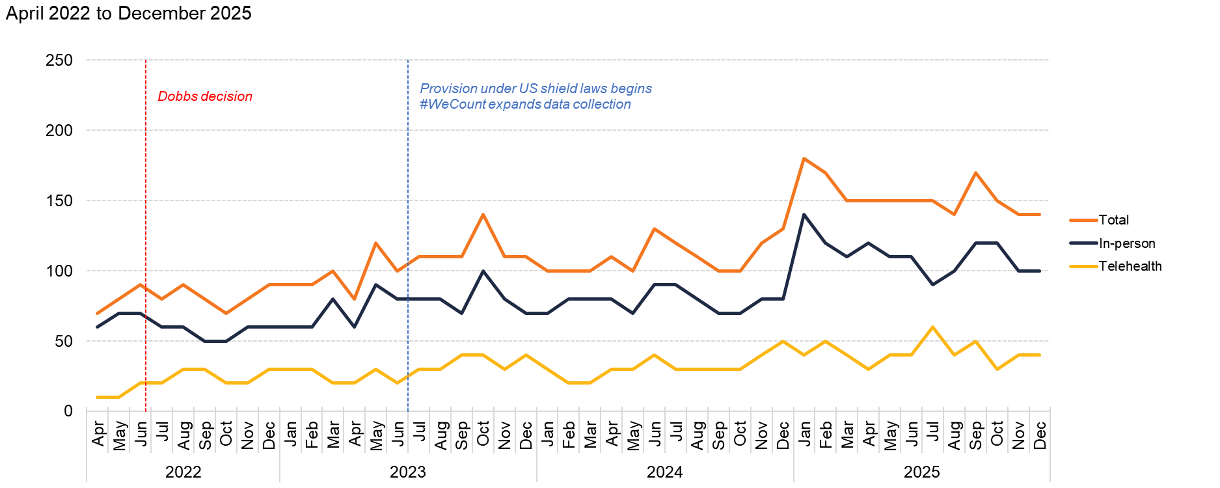
Alaska
Source: Society of Family Planning, June 2026

Slide 18
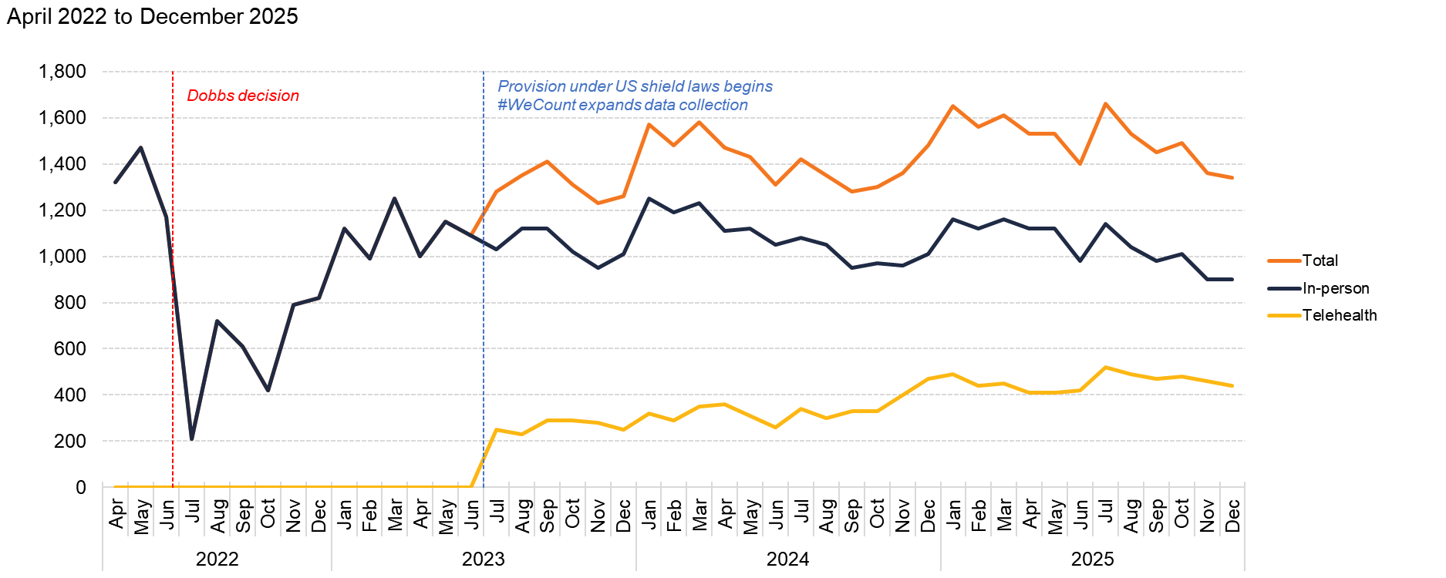
Arizona
Source: Society of Family Planning, June 2026

Slide 19
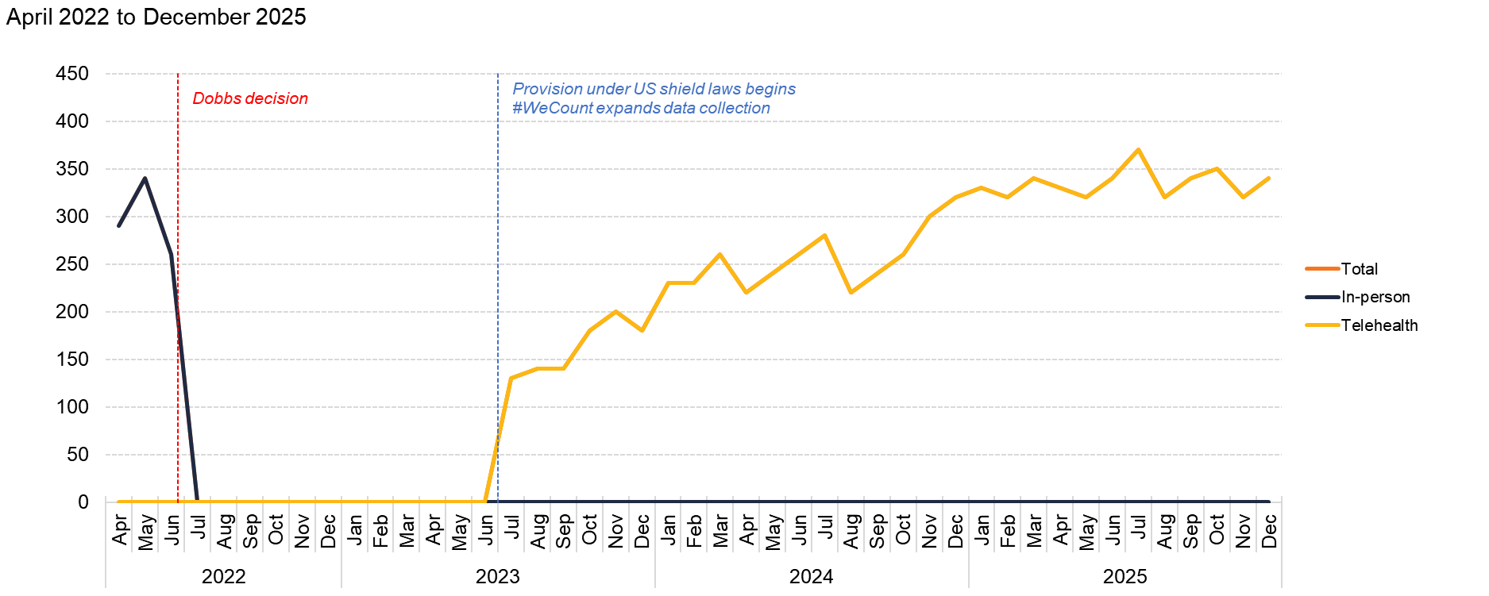
Arkansas
Source: Society of Family Planning, June 2026

Slide 20
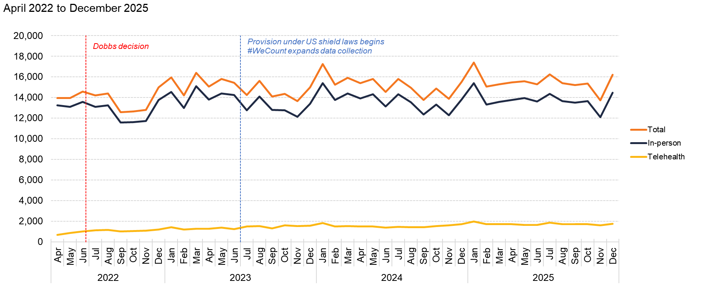
California
Source: Society of Family Planning, June 2026

Slide 21
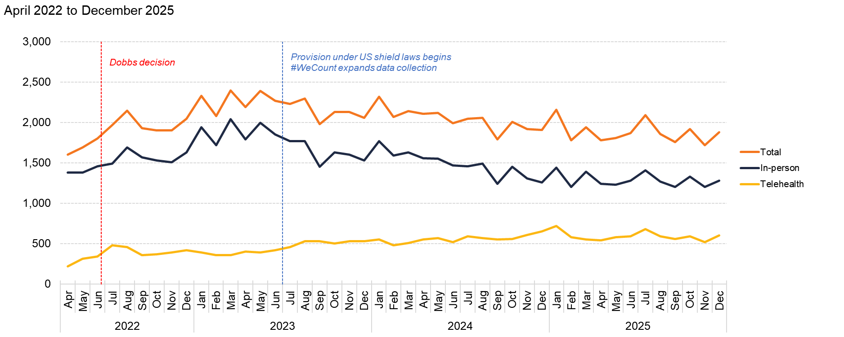
Colorado
Source: Society of Family Planning, June 2026

Slide 22
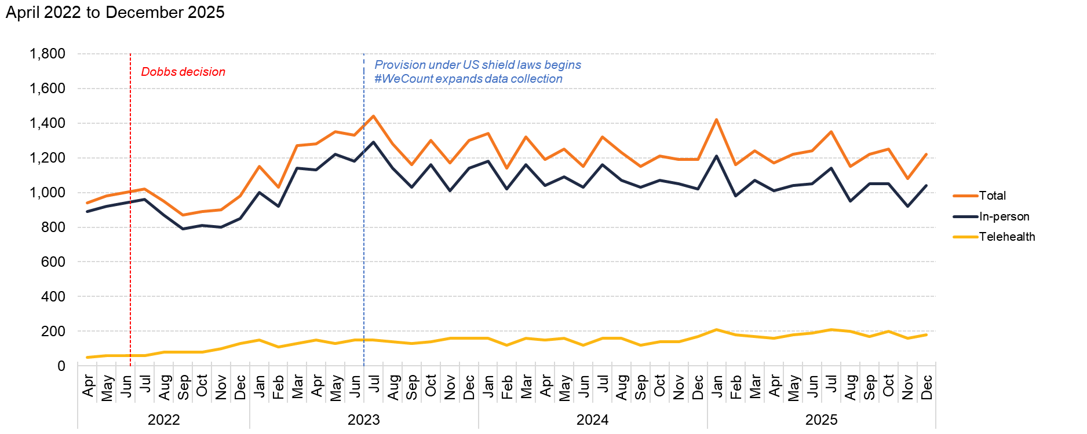
Connecticut
Source: Society of Family Planning, June 2026

Slide 23
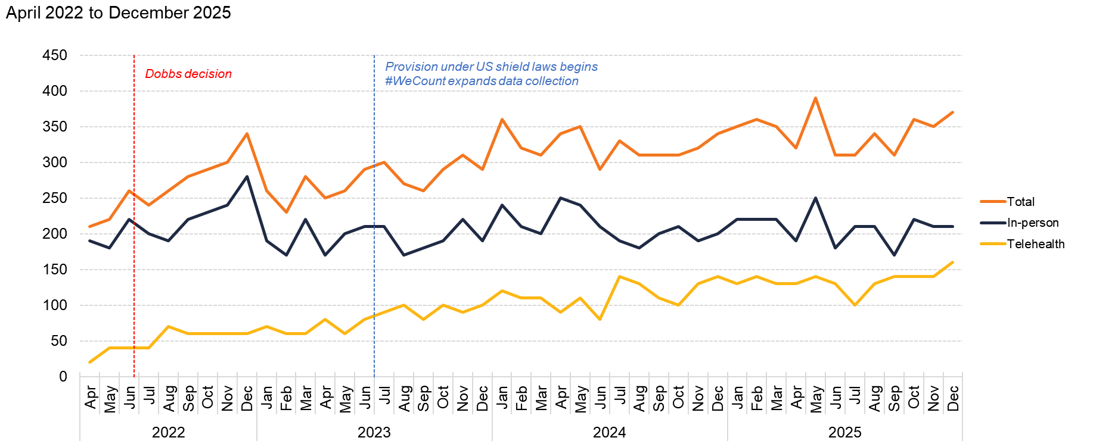
Delaware
Source: Society of Family Planning, June 2026

Slide 24
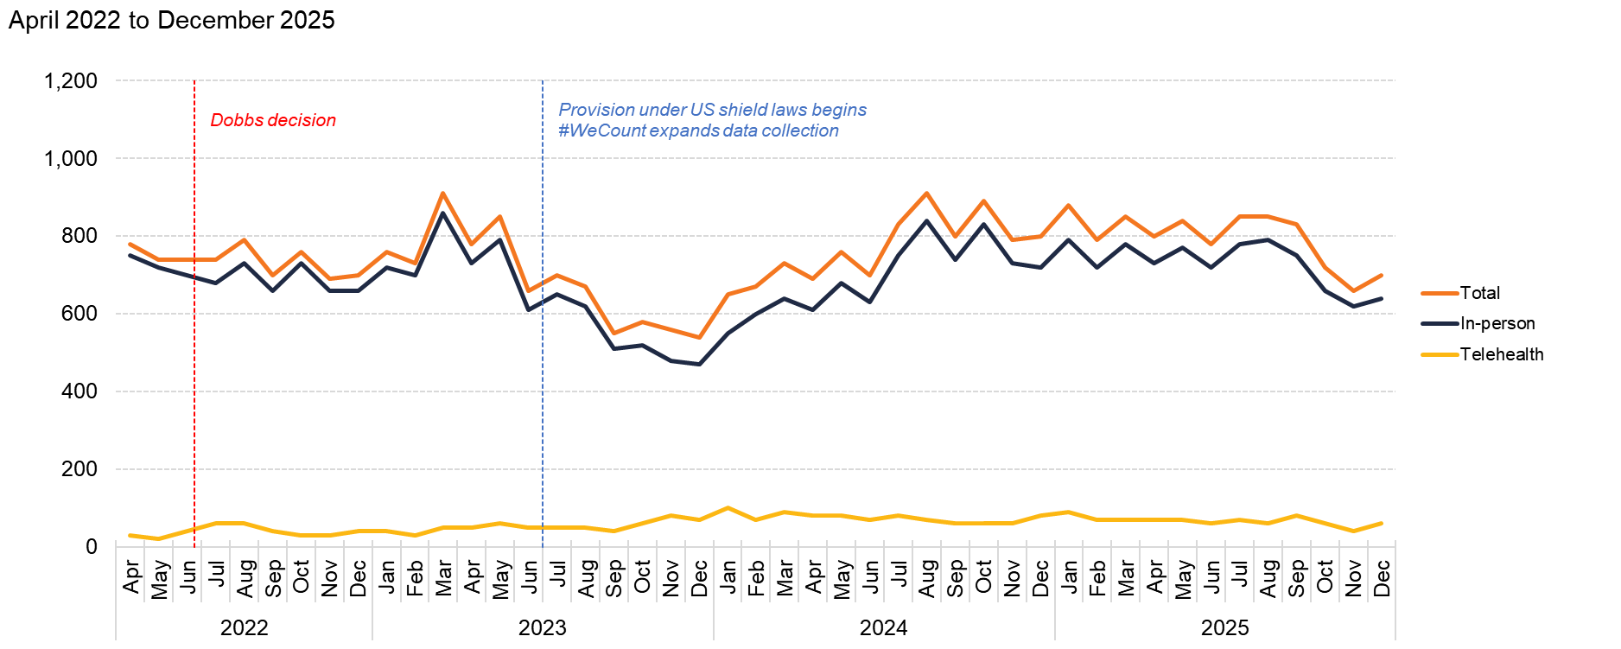
District of Columbia
Source: Society of Family Planning, June 2026

Slide 25
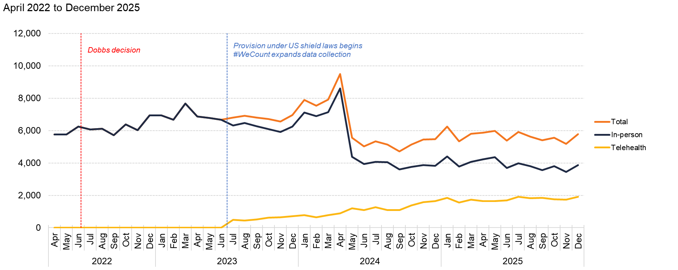
Florida
Source: Society of Family Planning, June 2026

Slide 26
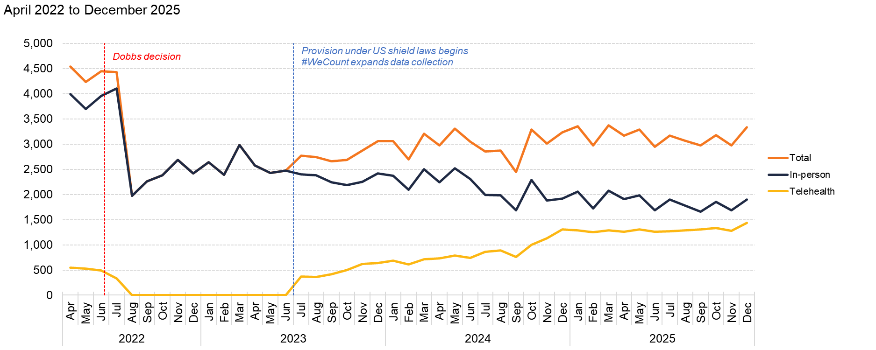
Georgia
Source: Society of Family Planning, June 2026

Slide 27
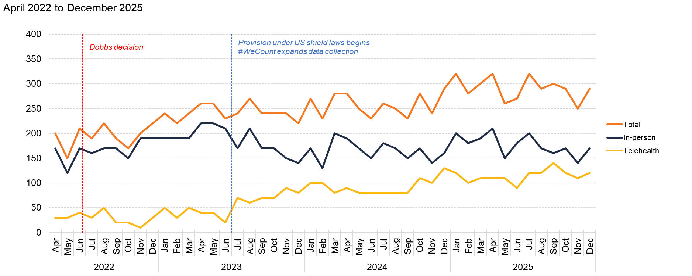
Hawaii
Source: Society of Family Planning, June 2026

Slide 28
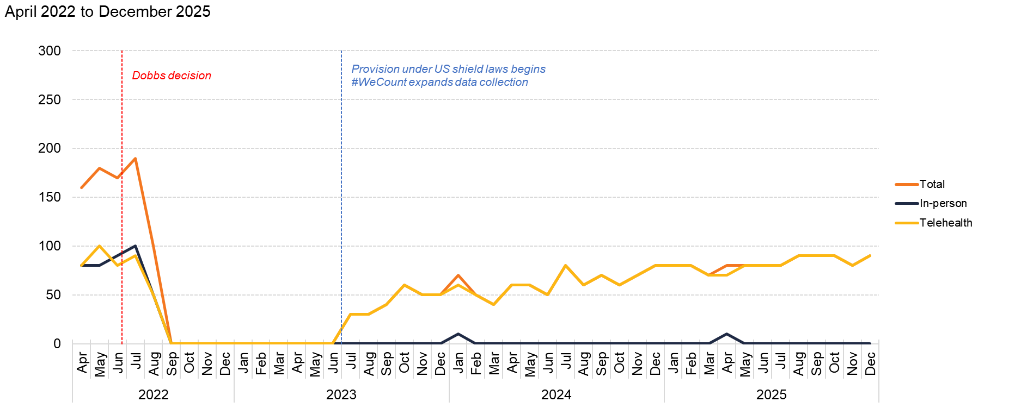
Idaho
Source: Society of Family Planning, June 2026

Slide 29
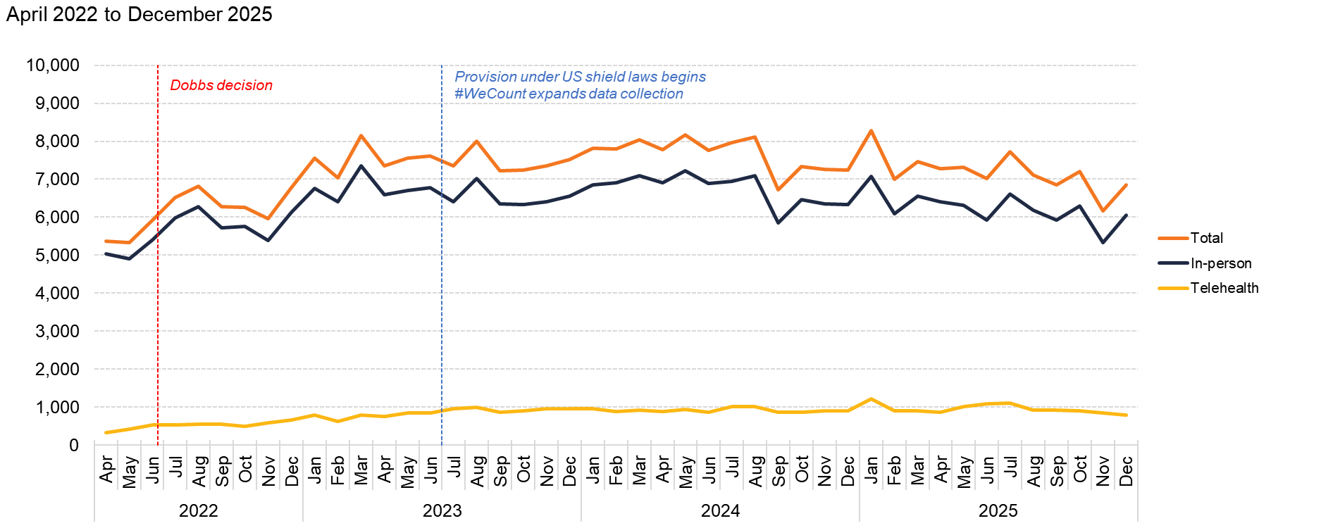
Illinois
Source: Society of Family Planning, June 2026

Slide 30
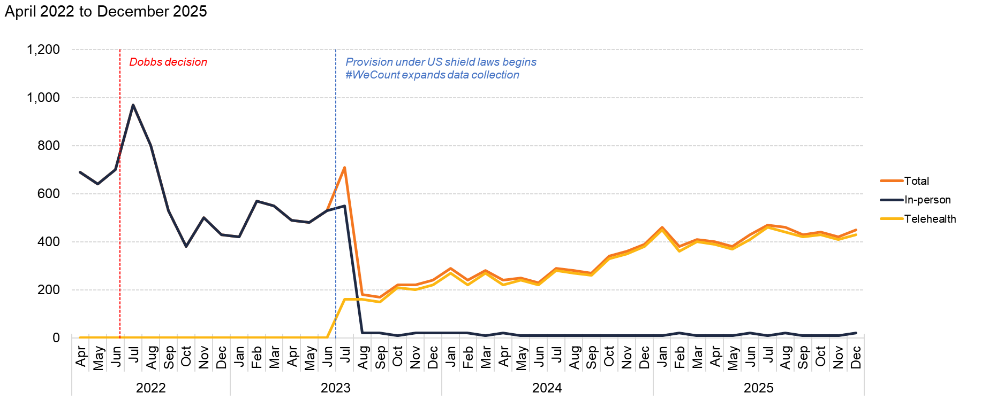
Indiana
Source: Society of Family Planning, June 2026

Slide 31
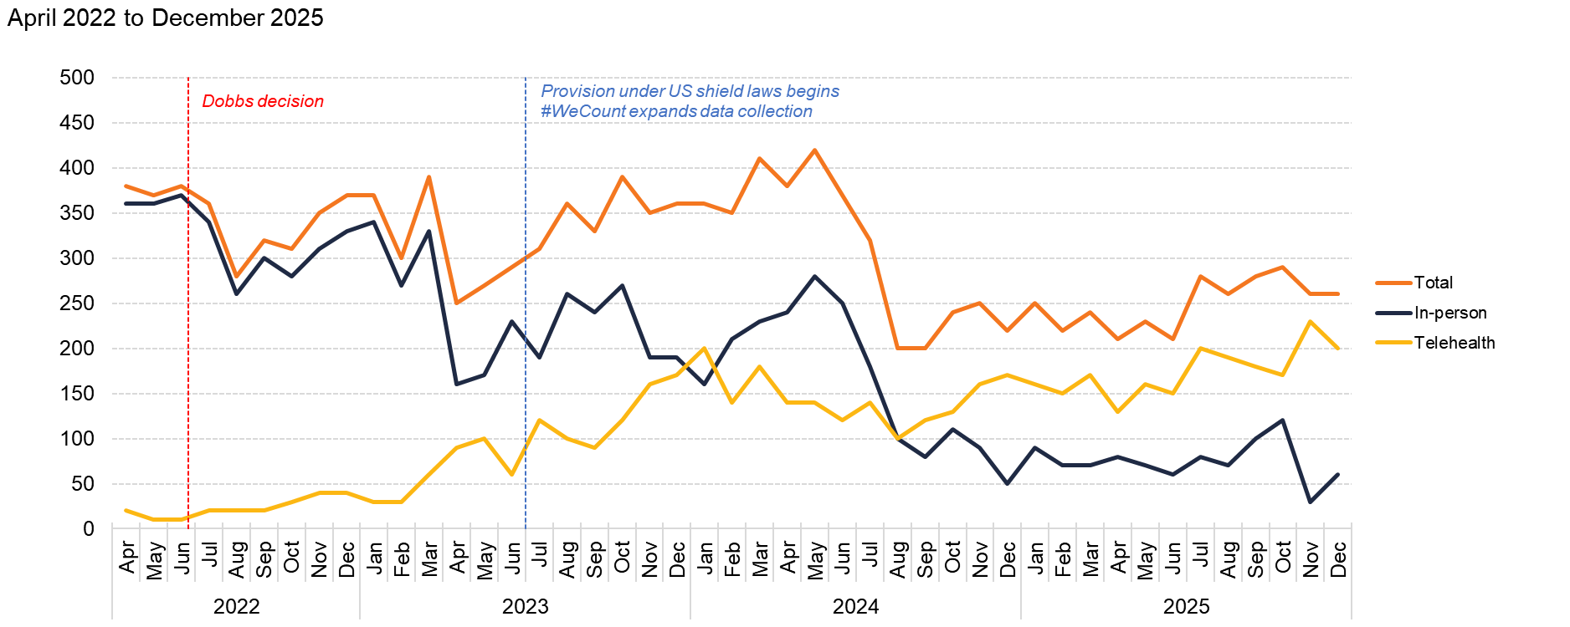
Iowa
Source: Society of Family Planning, June 2026

Slide 32
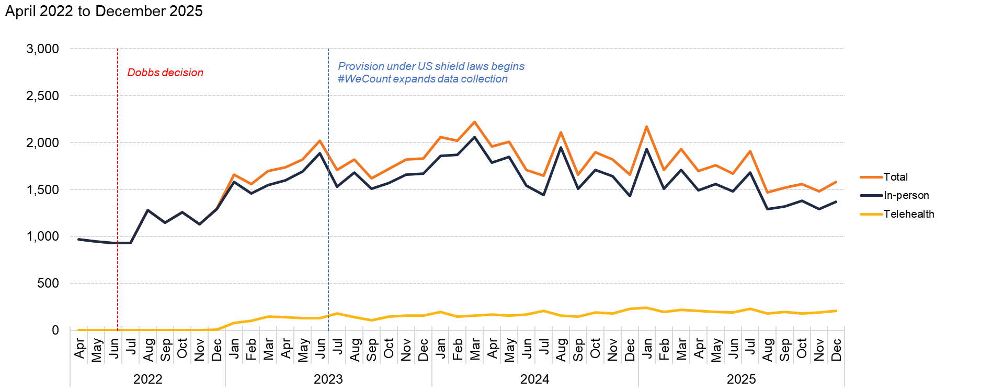
Kansas
Source: Society of Family Planning, June 2026

Slide 33
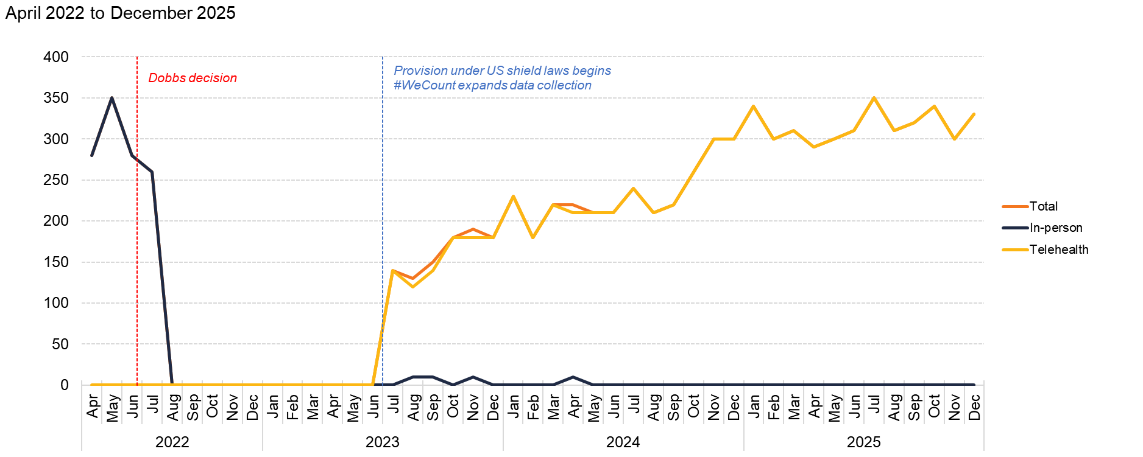
Kentucky
Source: Society of Family Planning, June 2026

Slide 34
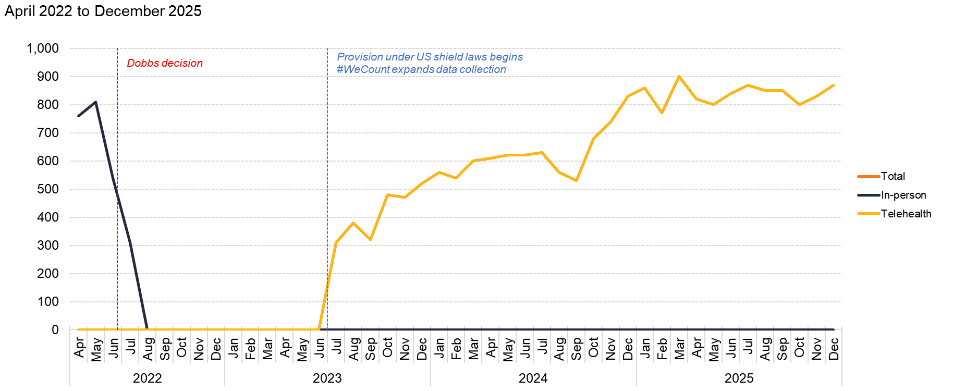
Louisiana
Source: Society of Family Planning, June 2026

Slide 35
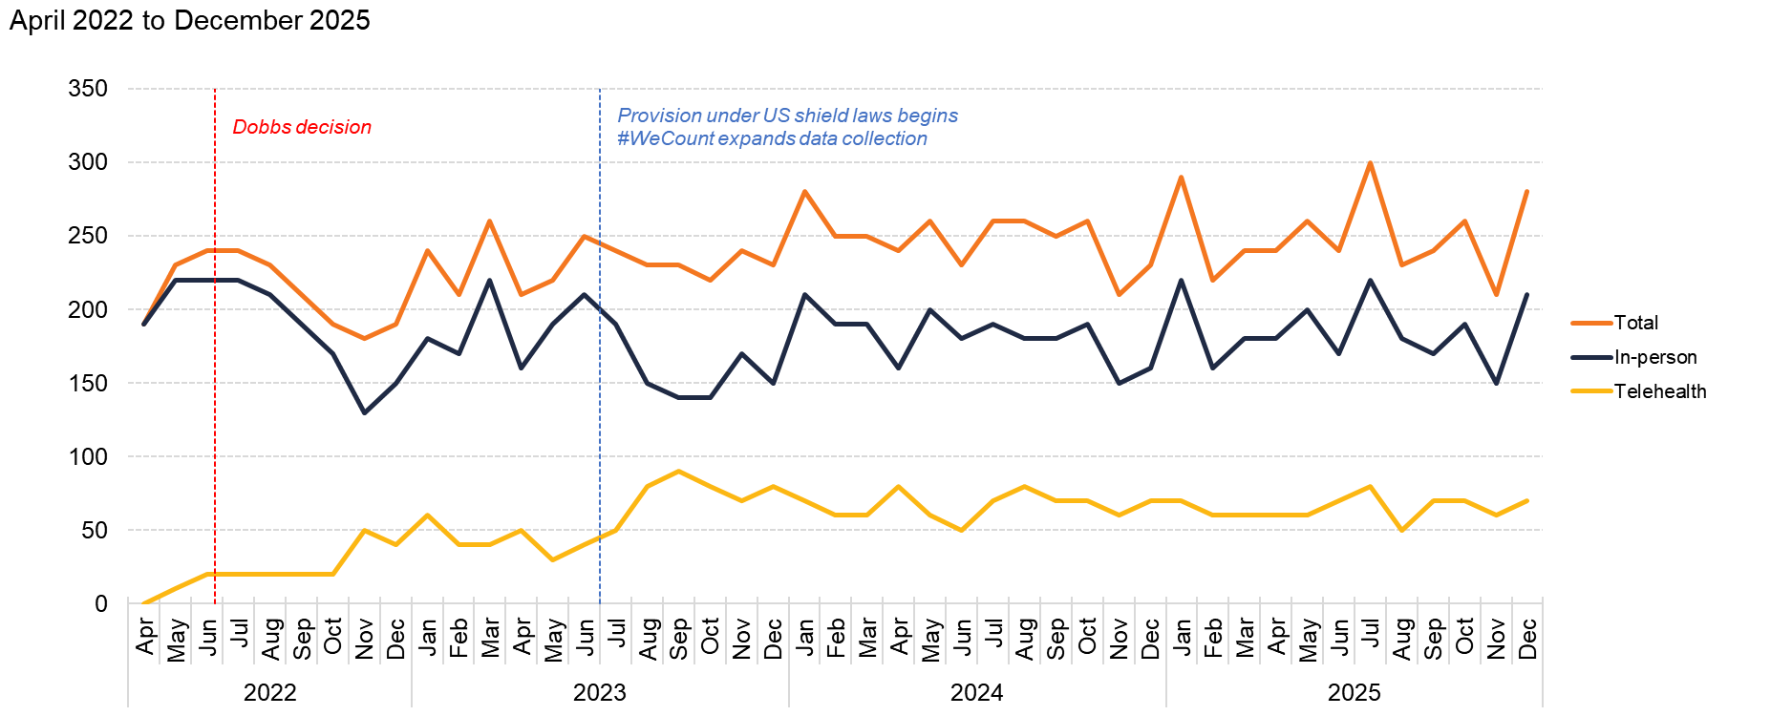
Maine
Source: Society of Family Planning, June 2026

Slide 36
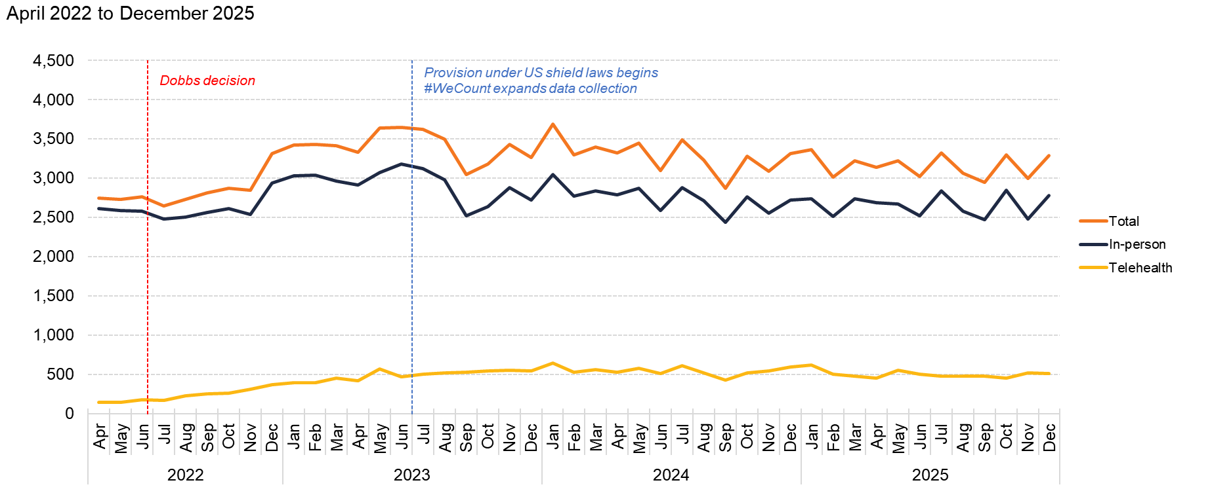
Maryland
Source: Society of Family Planning, June 2026

Slide 37
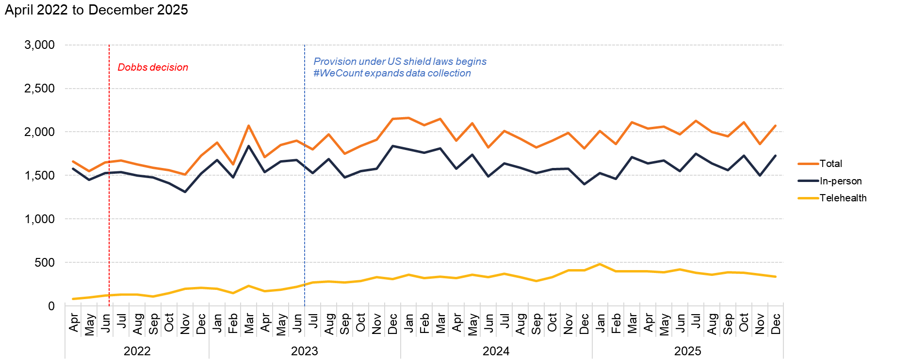
Massachusetts
Source: Society of Family Planning, June 2026

Slide 38
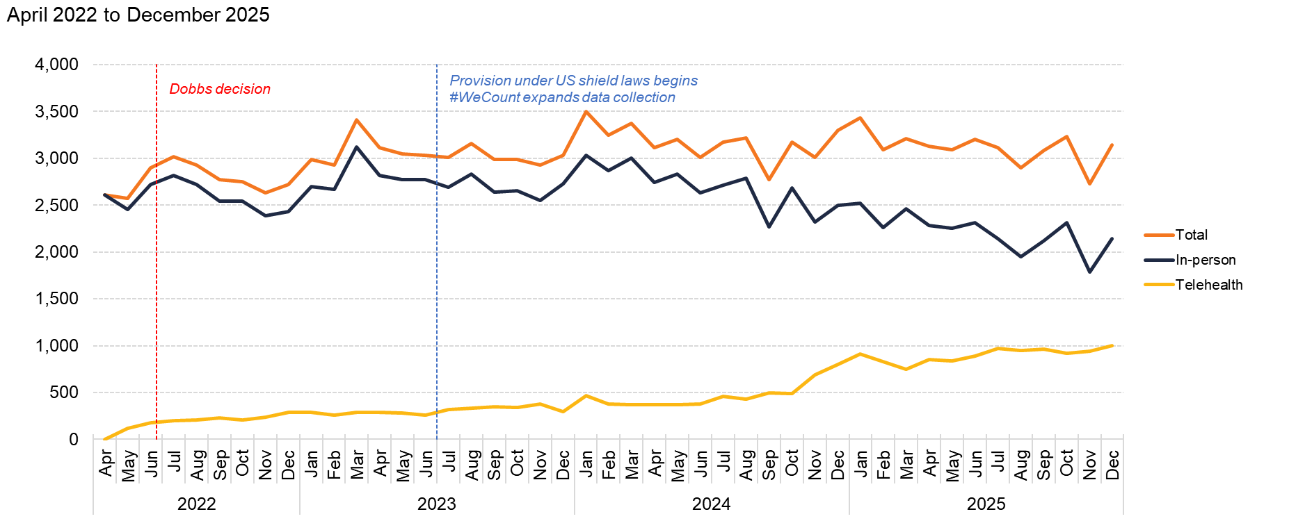
Michigan
Source: Society of Family Planning, June 2026

Slide 39
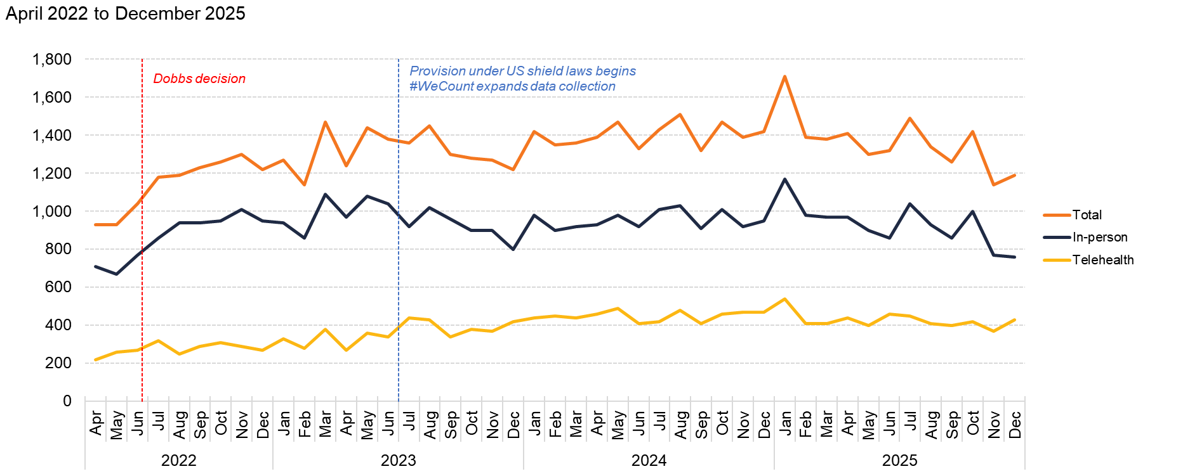
Minnesota
Source: Society of Family Planning, June 2026

Slide 40
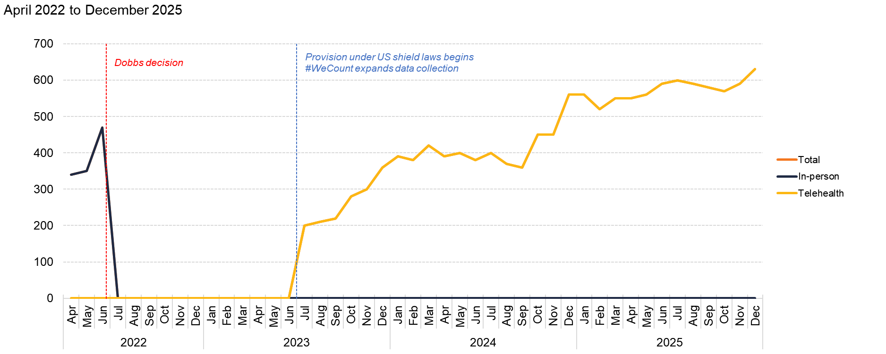
Mississippi
Source: Society of Family Planning, June 2026

Slide 41
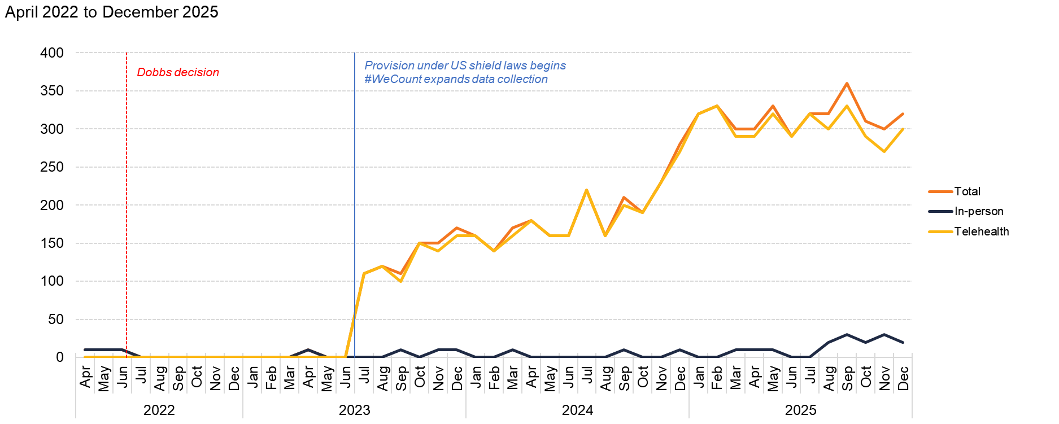
Missouri
Source: Society of Family Planning, June 2026

Slide 42
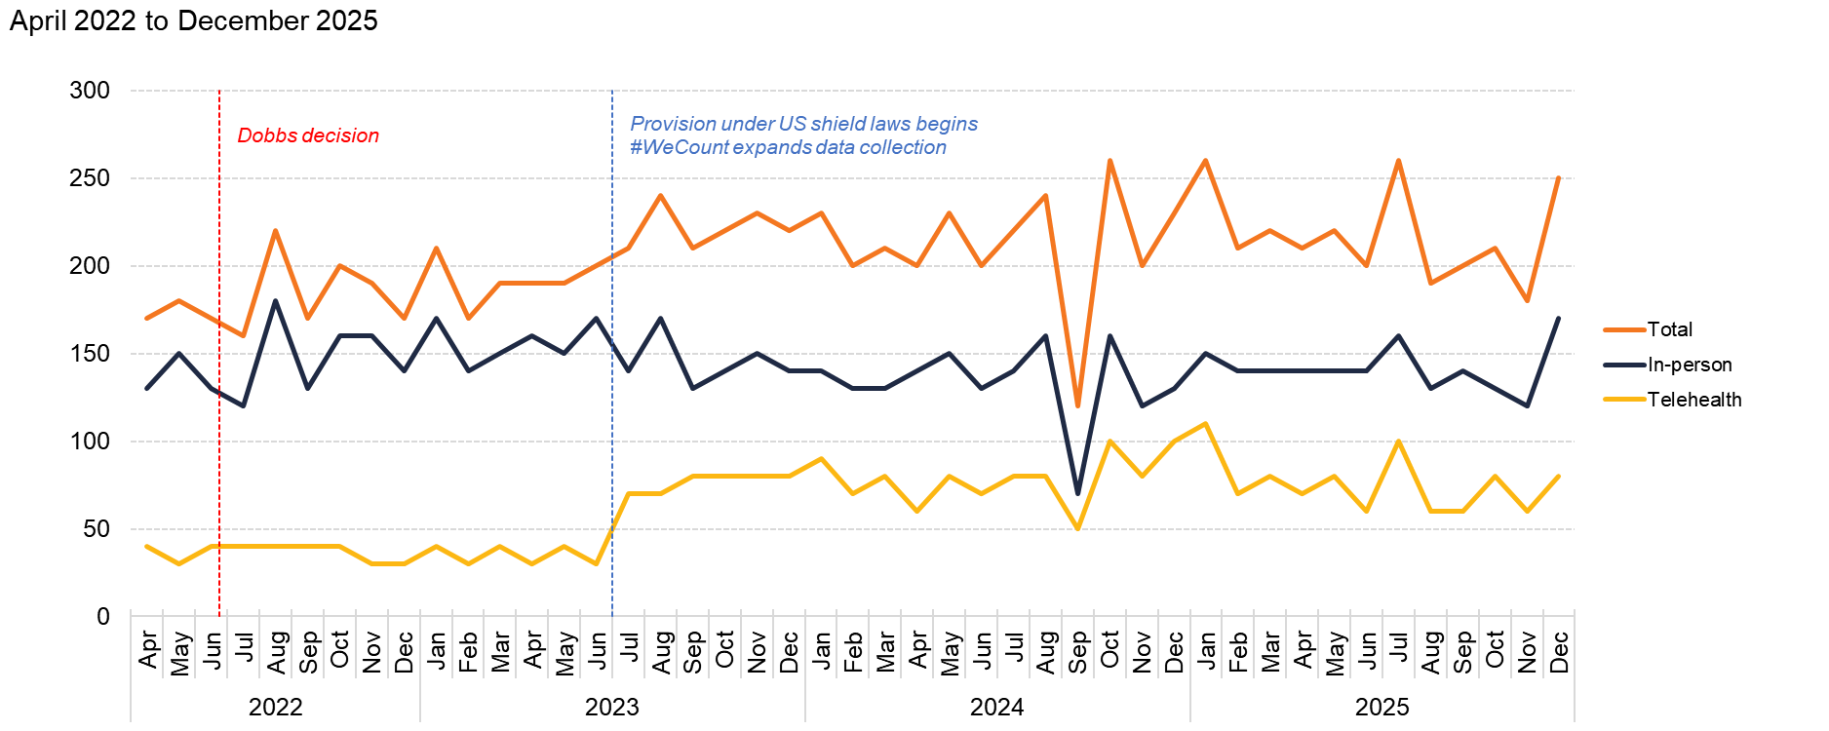
Montana
Source: Society of Family Planning, June 2026

Slide 43
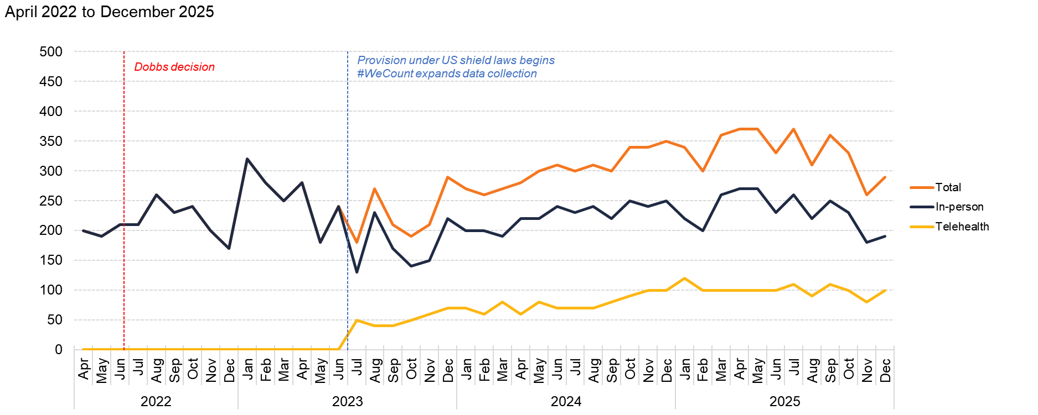
Nebraska
Source: Society of Family Planning, June 2026

Slide 44
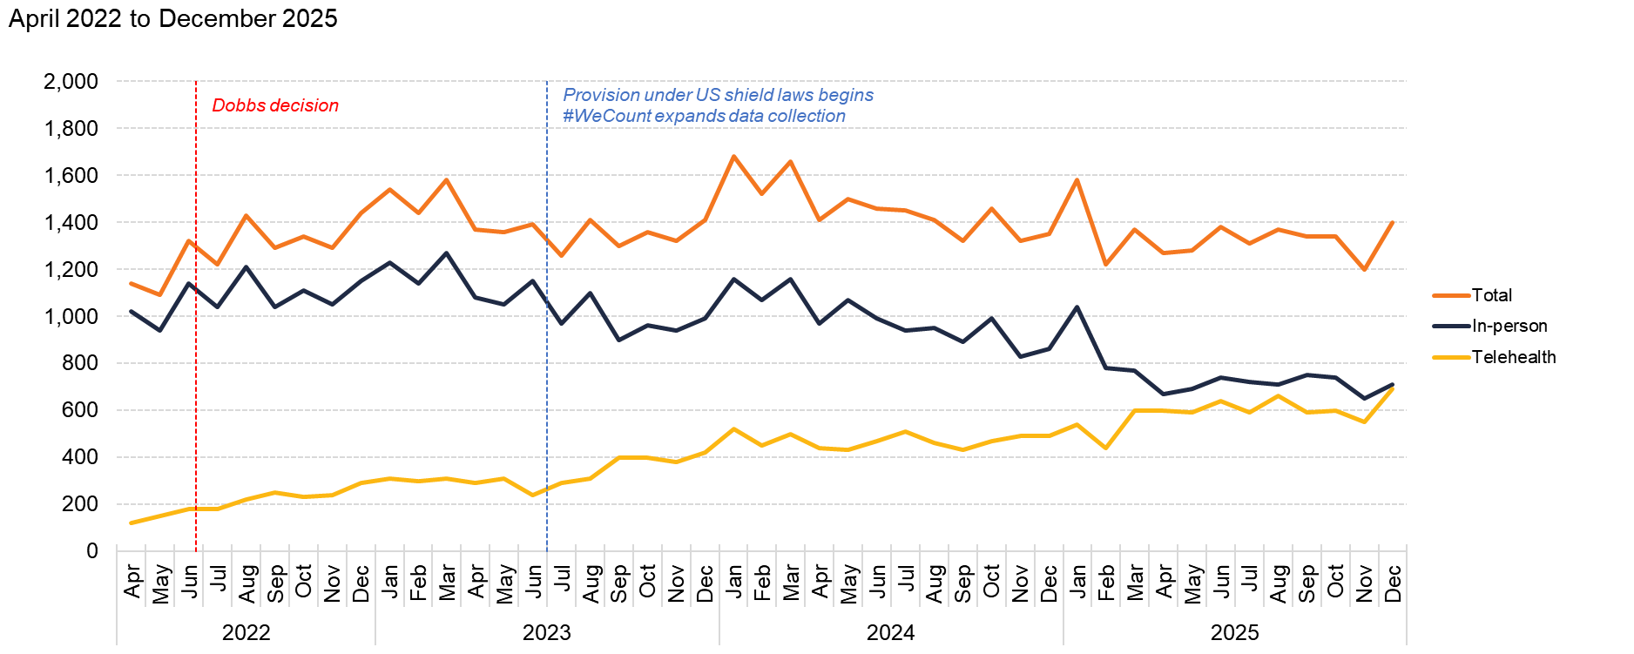
Nevada
Source: Society of Family Planning, June 2026

Slide 45
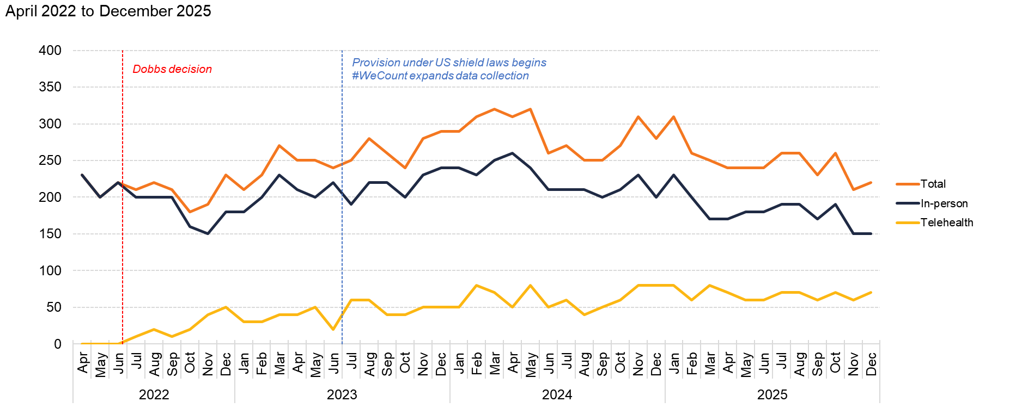
New Hampshire
Source: Society of Family Planning, June 2026

Slide 46
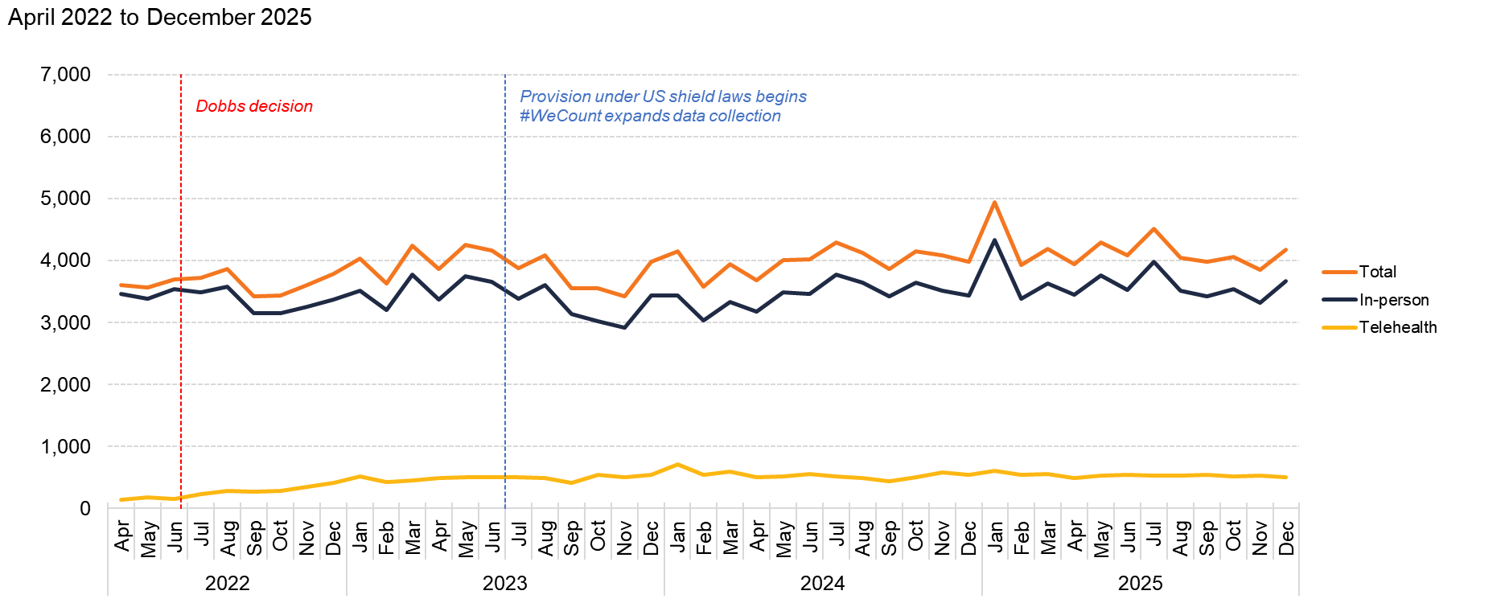
New Jersey
Source: Society of Family Planning, June 2026

Slide 47
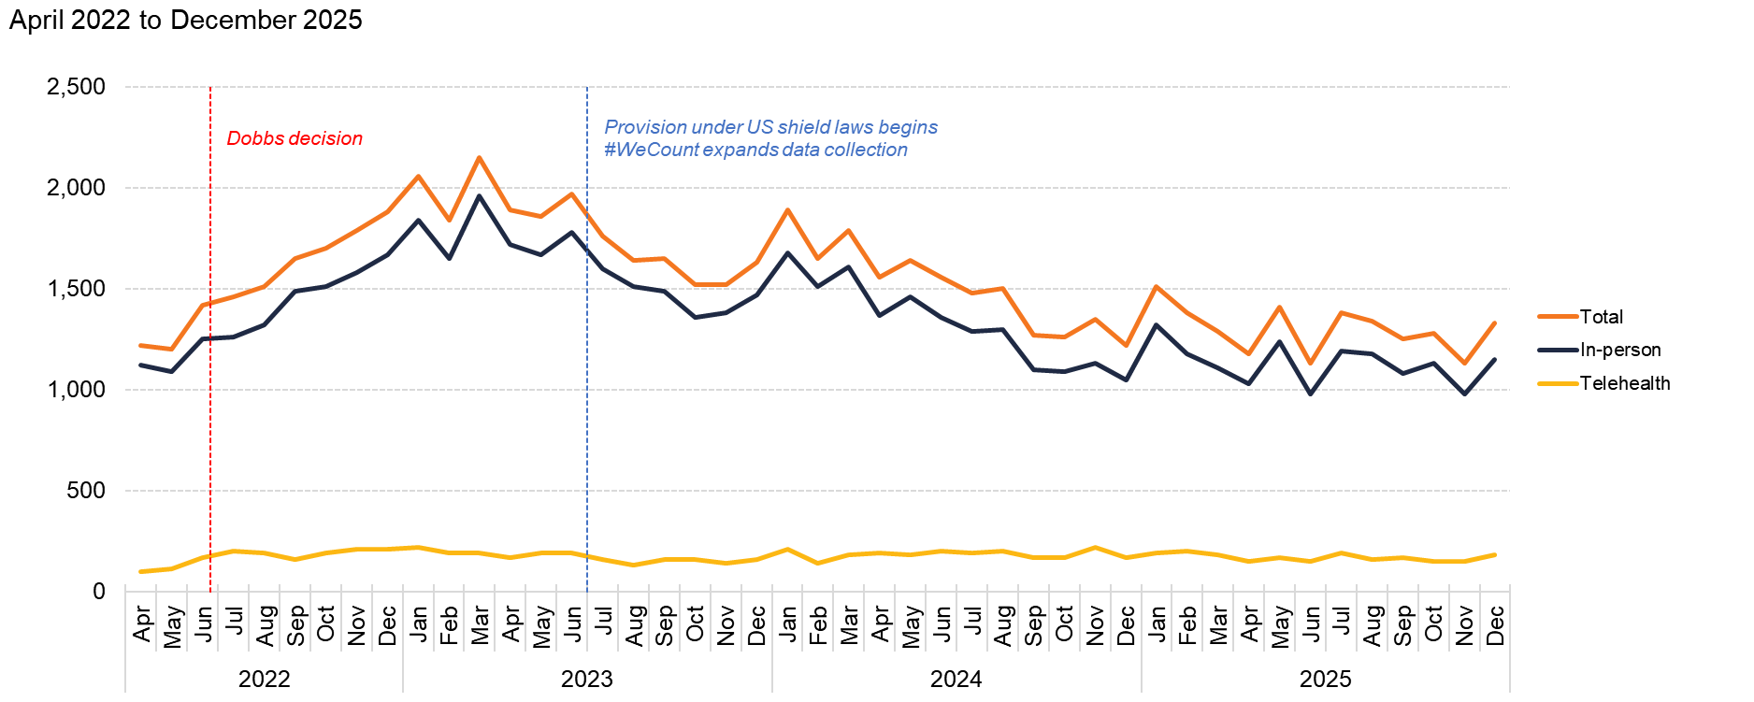
New Mexico
Source: Society of Family Planning, June 2026

Slide 48
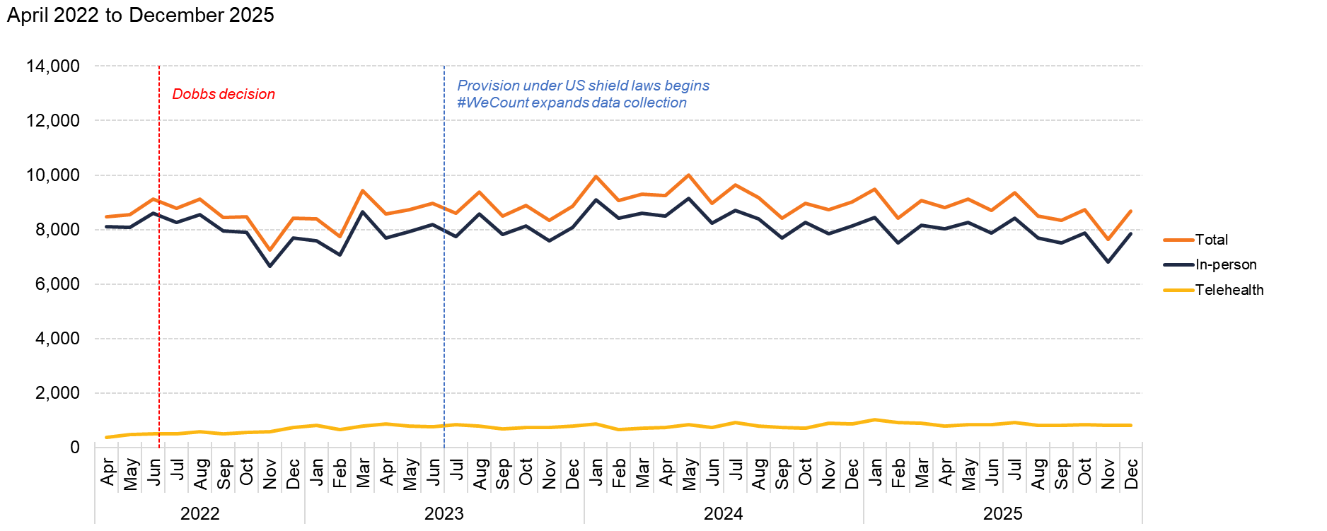
New York
Source: Society of Family Planning, June 2026

Slide 49
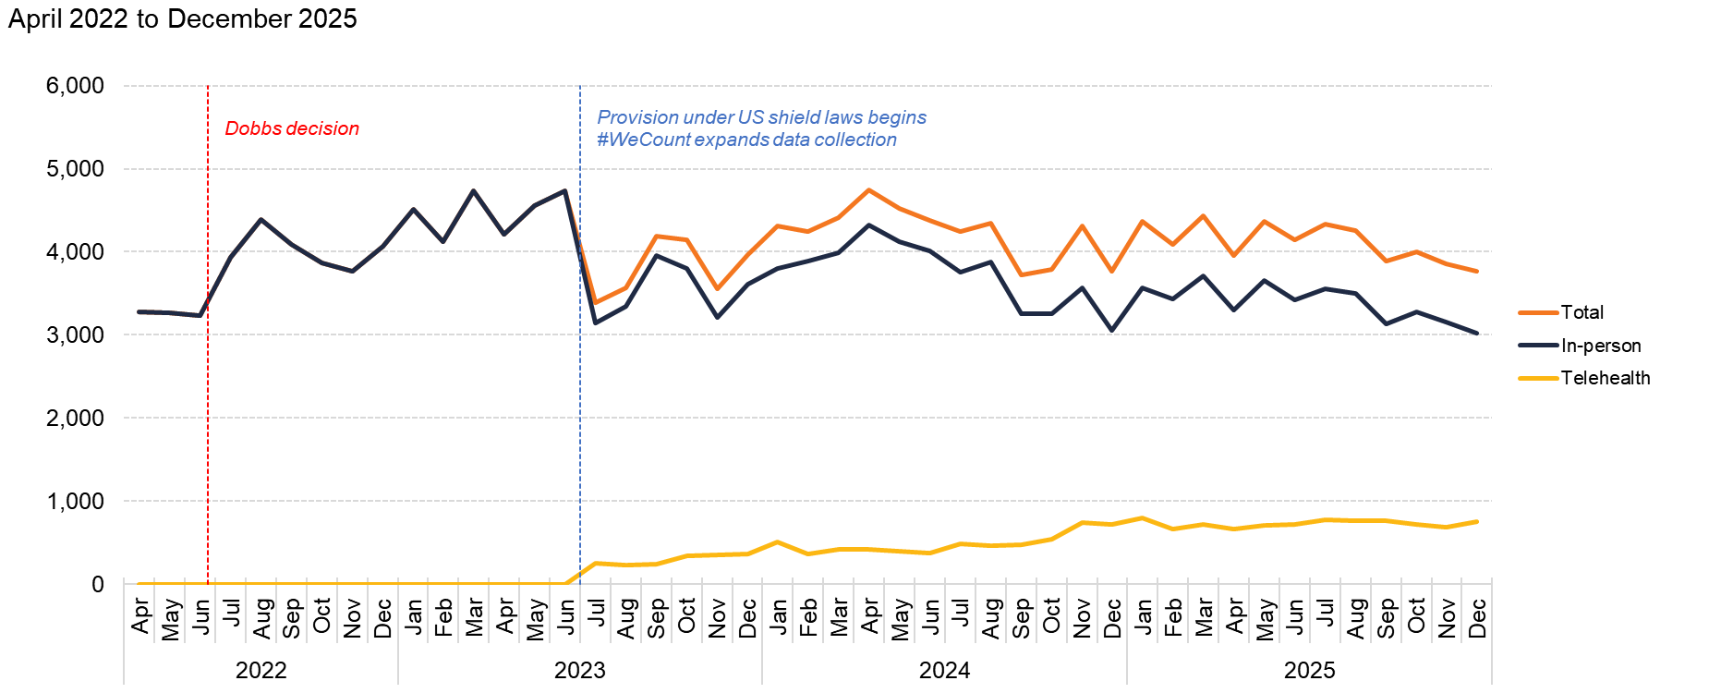
North Carolina
Source: Society of Family Planning, June 2026

Slide 50
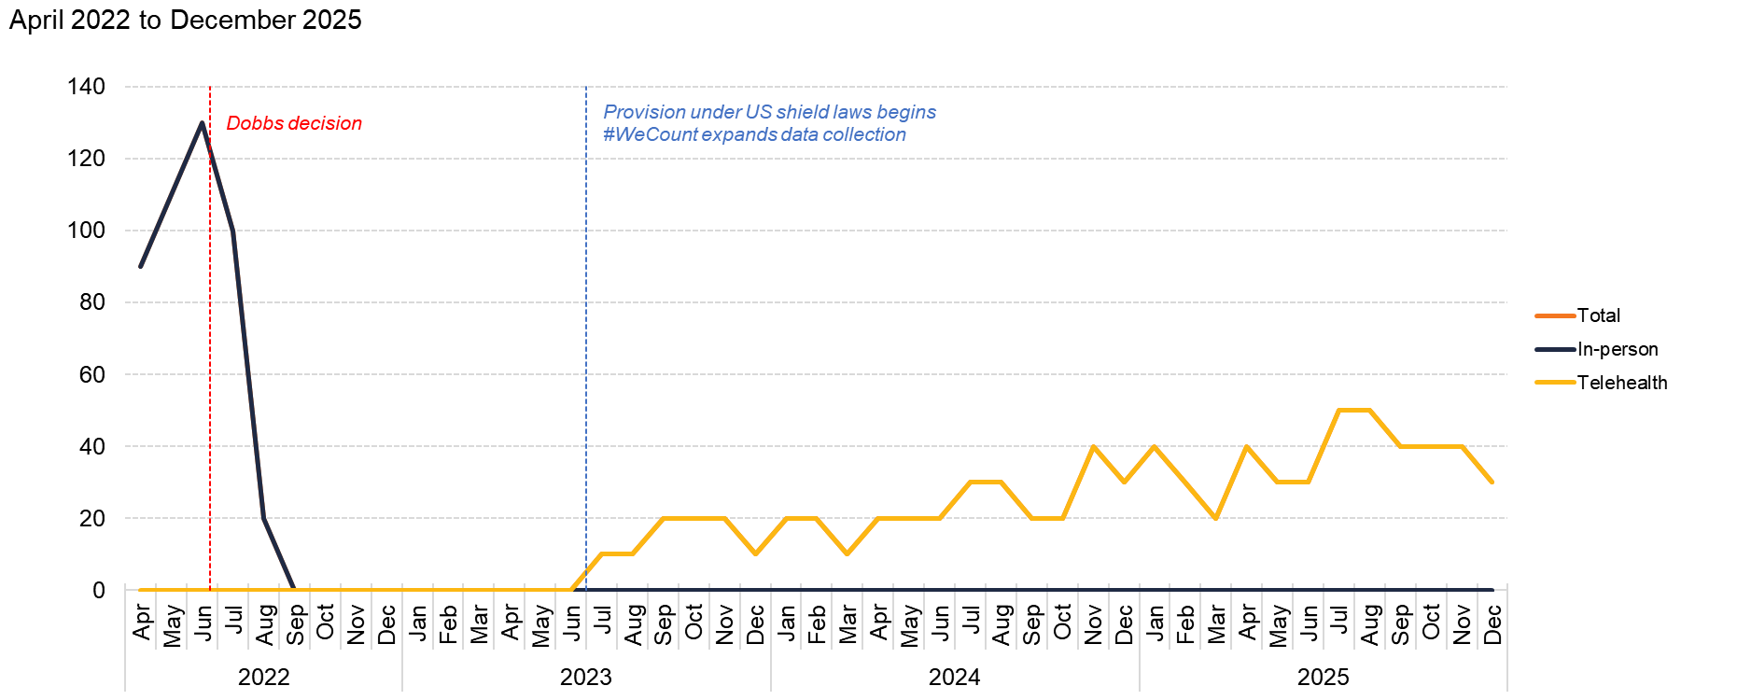
North Dakota
Source: Society of Family Planning, June 2026

Slide 51
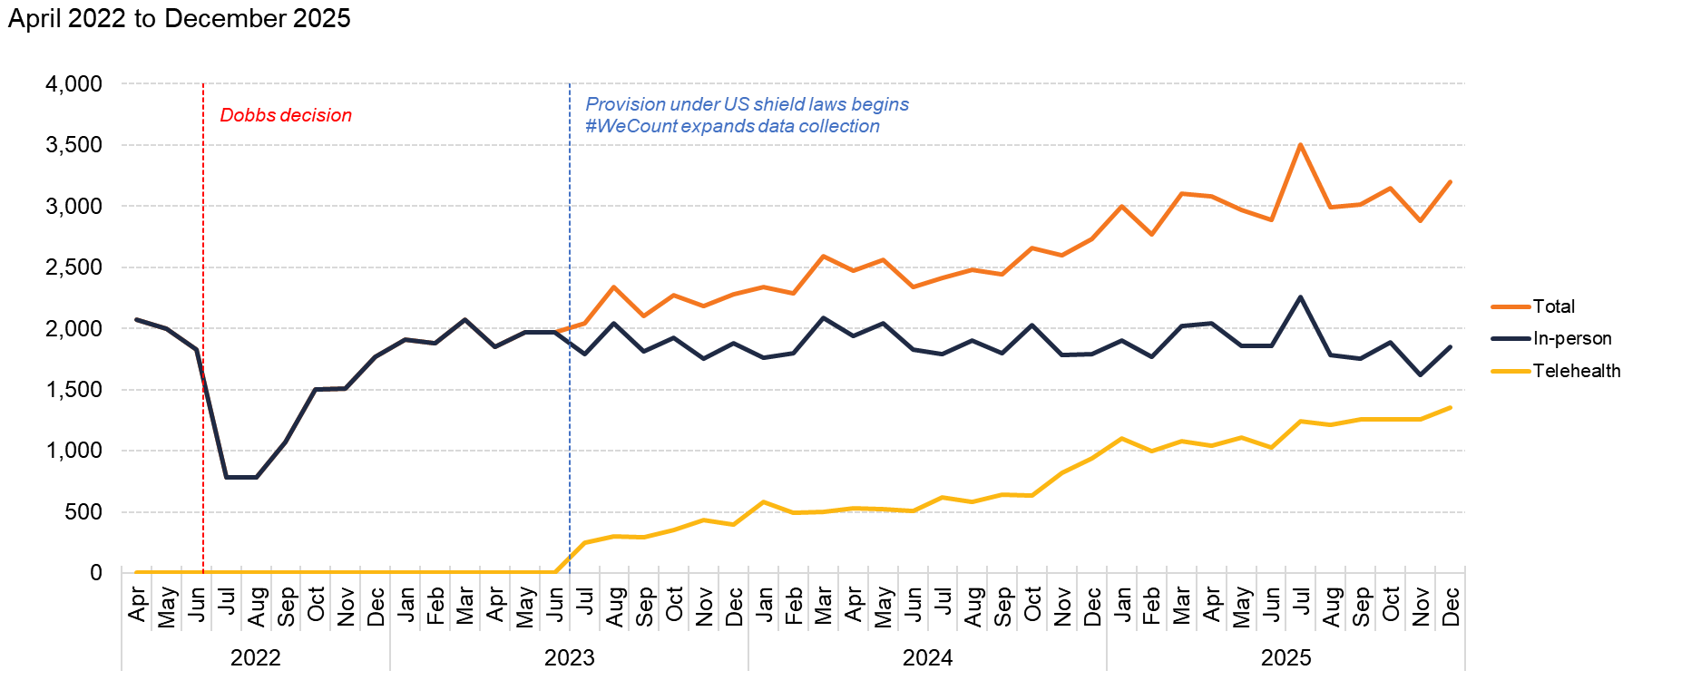
Ohio
Source: Society of Family Planning, June 2026

Slide 52
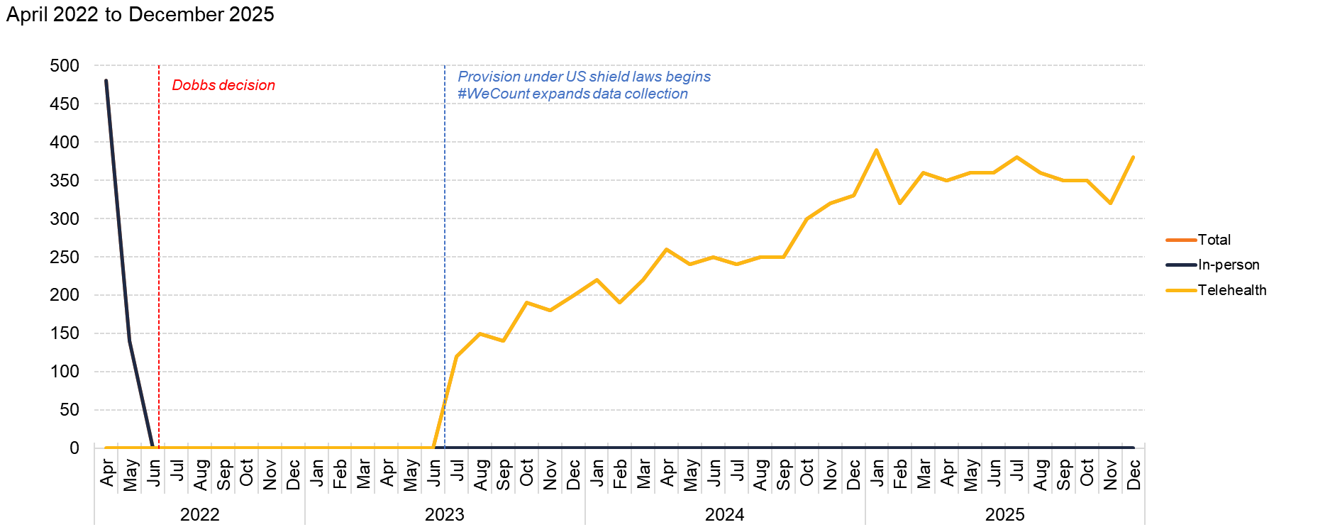
Oklahoma
Source: Society of Family Planning, June 2026

Slide 53

Oregon
Source: Society of Family Planning, June 2026

Slide 54

Pennsylvania
Source: Society of Family Planning, June 2026

Slide 55

Rhode Island
Source: Society of Family Planning, June 2026

Slide 56

South Carolina
Source: Society of Family Planning, June 2026

Slide 57

South Dakota
Source: Society of Family Planning, June 2026

Slide 58

Tennessee
Source: Society of Family Planning, June 2026

Slide 59

Texas
Source: Society of Family Planning, June 2026

Slide 60

Utah
Source: Society of Family Planning, June 2026

Slide 61

Vermont
Source: Society of Family Planning, June 2026

Slide 62

Virginia
Source: Society of Family Planning, June 2026

Slide 63

Washington
Source: Society of Family Planning, June 2026

Slide 64

West Virginia
Source: Society of Family Planning, June 2026

Slide 65

Wisconsin
Source: Society of Family Planning, June 2026

Slide 66

Wyoming
Source: Society of Family Planning, June 2026

