Slide 1
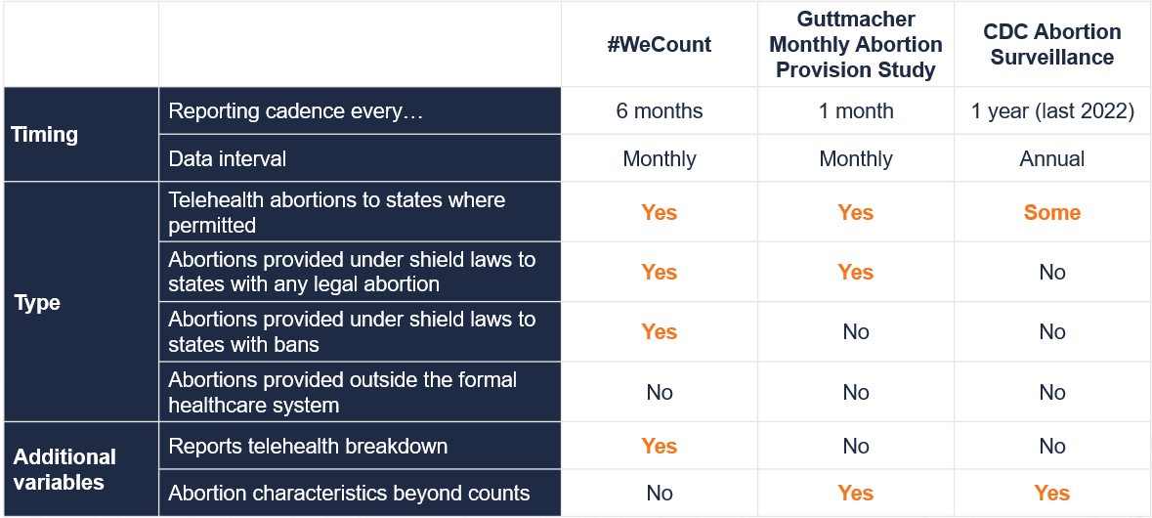
#WeCount in context: the landscape of research efforts to count abortions
Source: Society of Family Planning, December 2025

Slide 2
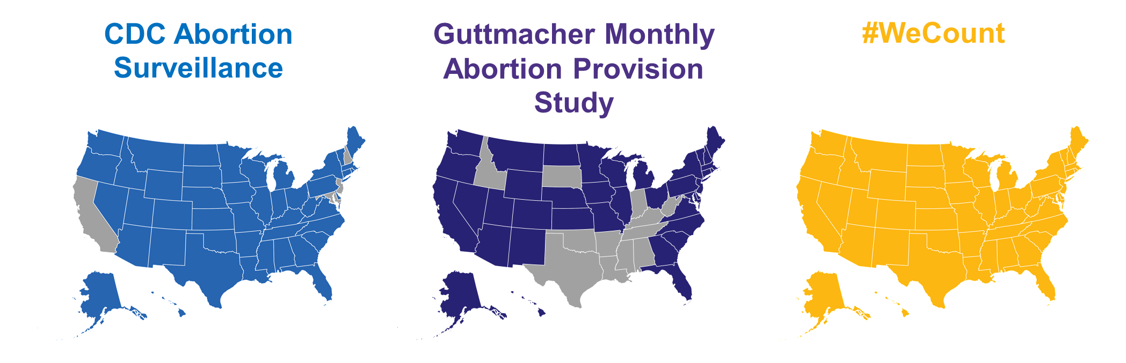
States reflected across efforts to count abortions
Source: Society of Family Planning, December 2025

Slide 3
National findings
Notes:
Alison

Slide 4
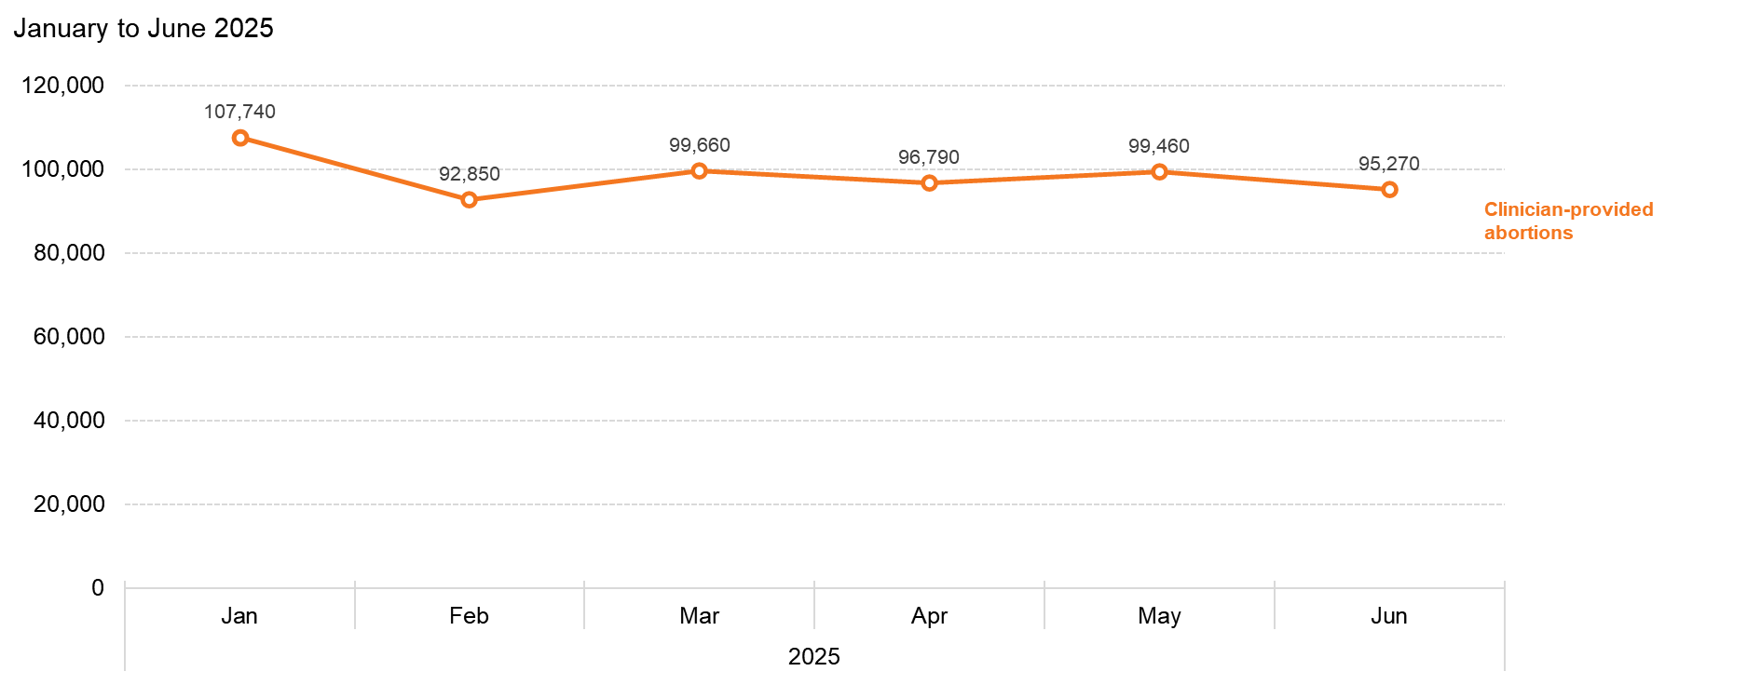
US abortions totaled 591,770 in the first six months of 2025
Source: Society of Family Planning, December 2025

Slide 5
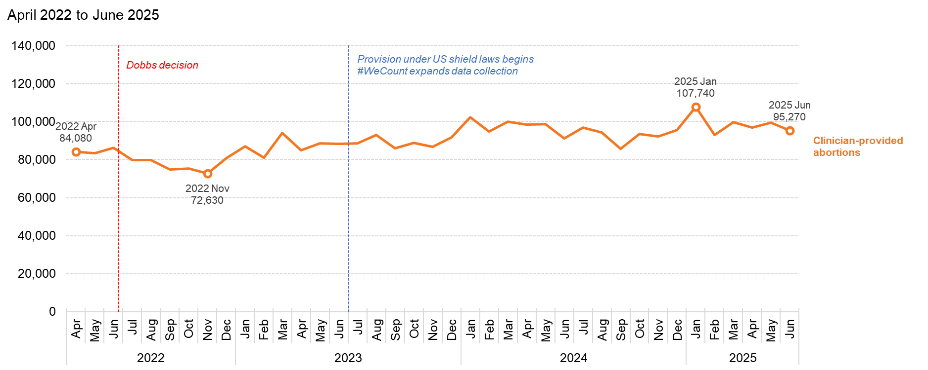
Abortions in the US have increased since Dobbs
Source: Society of Family Planning, December 2025

Slide 6
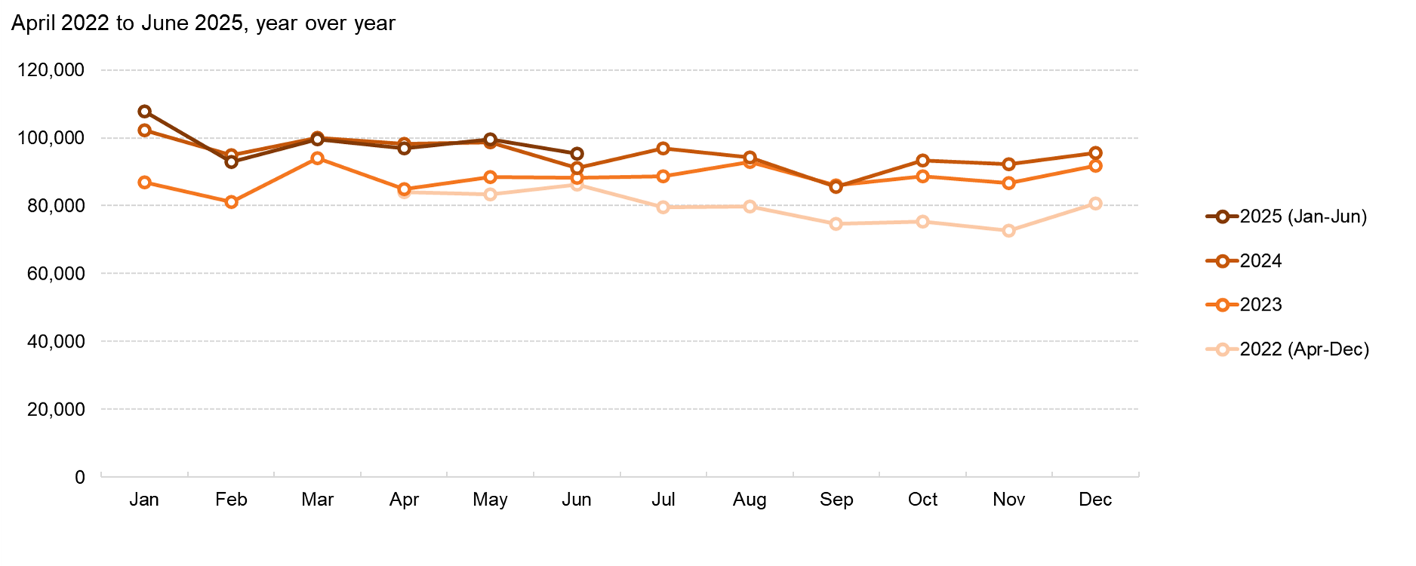
Abortion volume fluctuates from month to month, and has increased year-over-year
Source: Society of Family Planning, December 2025

Slide 7
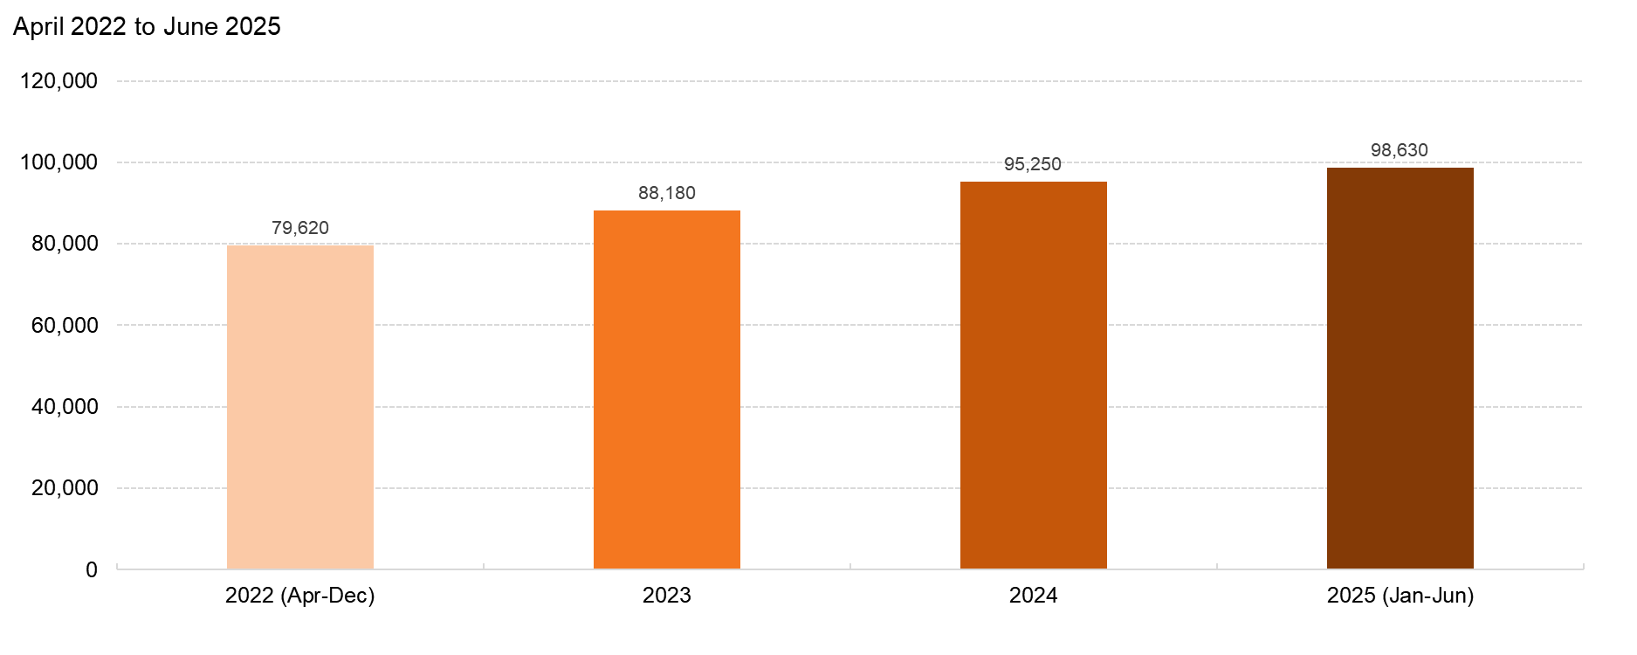
Monthly average number of abortions increased each year
Source: Society of Family Planning, December 2025

Slide 8
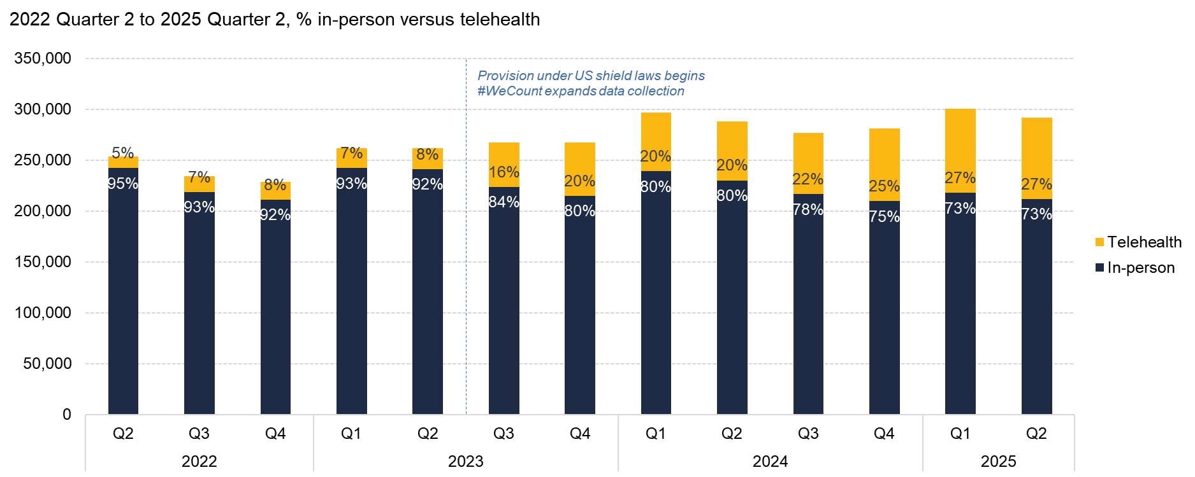
In the first six months of 2025, 27% of abortions were provided via telehealth
Source: Society of Family Planning, December 2025

Slide 9
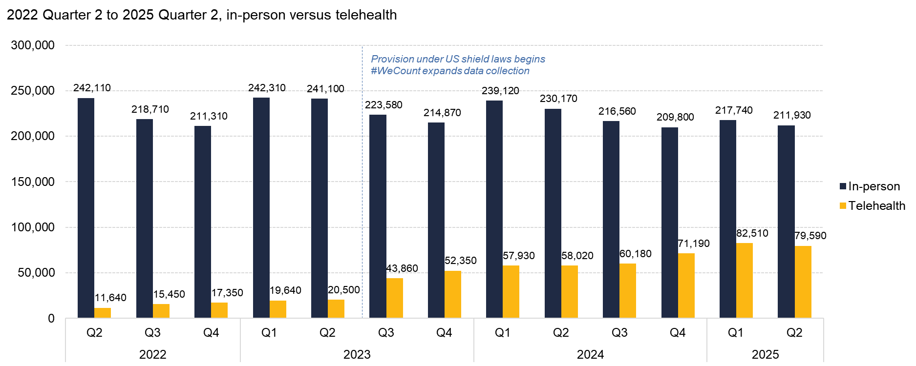
In-person abortion care declined slightly, while telehealth grew
Source: Society of Family Planning, December 2025

Slide 10
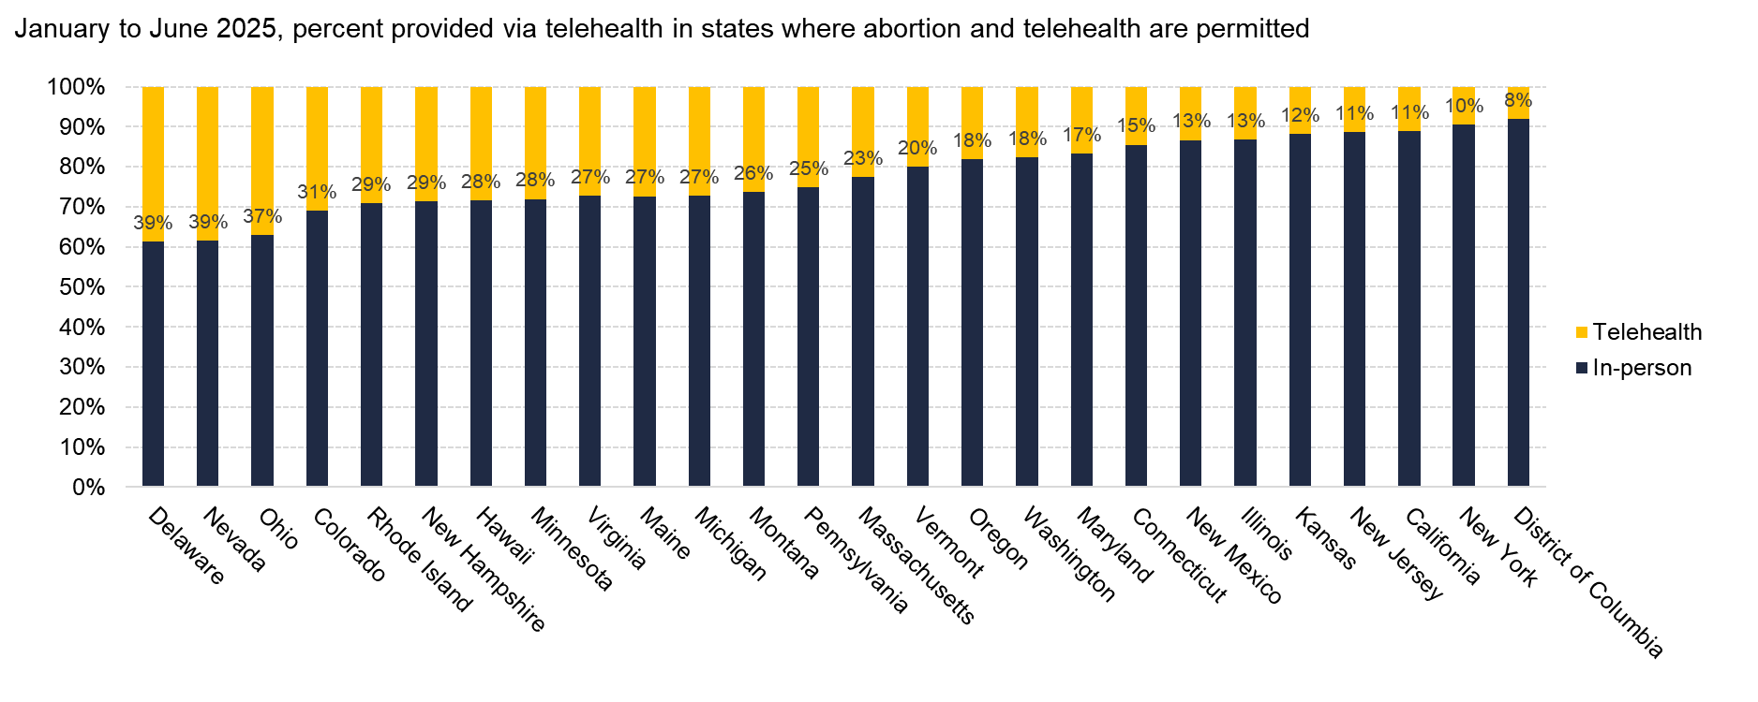
Where abortion and telehealth are permitted, the share of abortions provided via telehealth varied widely
Source: Society of Family Planning, December 2025

Slide 11
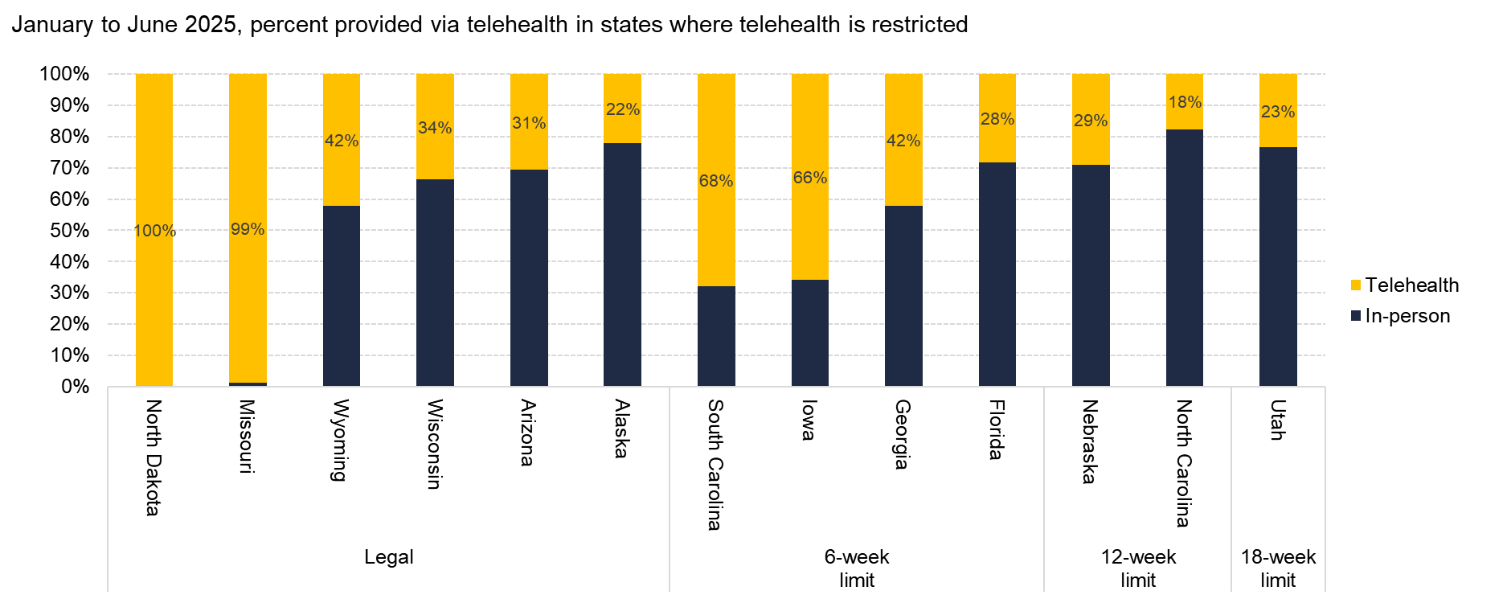
Where telehealth abortion is restricted, the share of abortions provided via telehealth under shield laws varied widely
Source: Society of Family Planning, December 2025

Slide 12
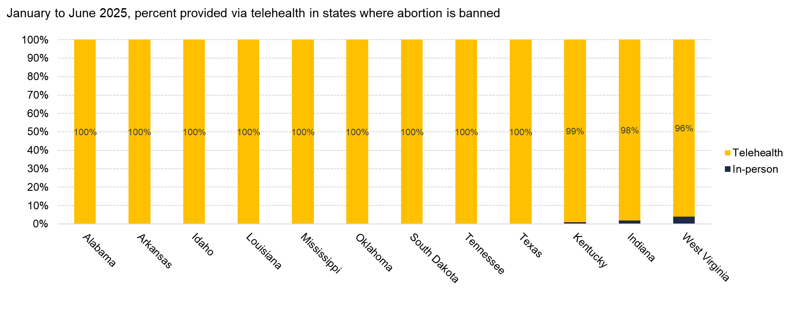
Where abortion is banned, nearly all abortions were provided via telehealth under shield laws
Source: Society of Family Planning, December 2025

Slide 13
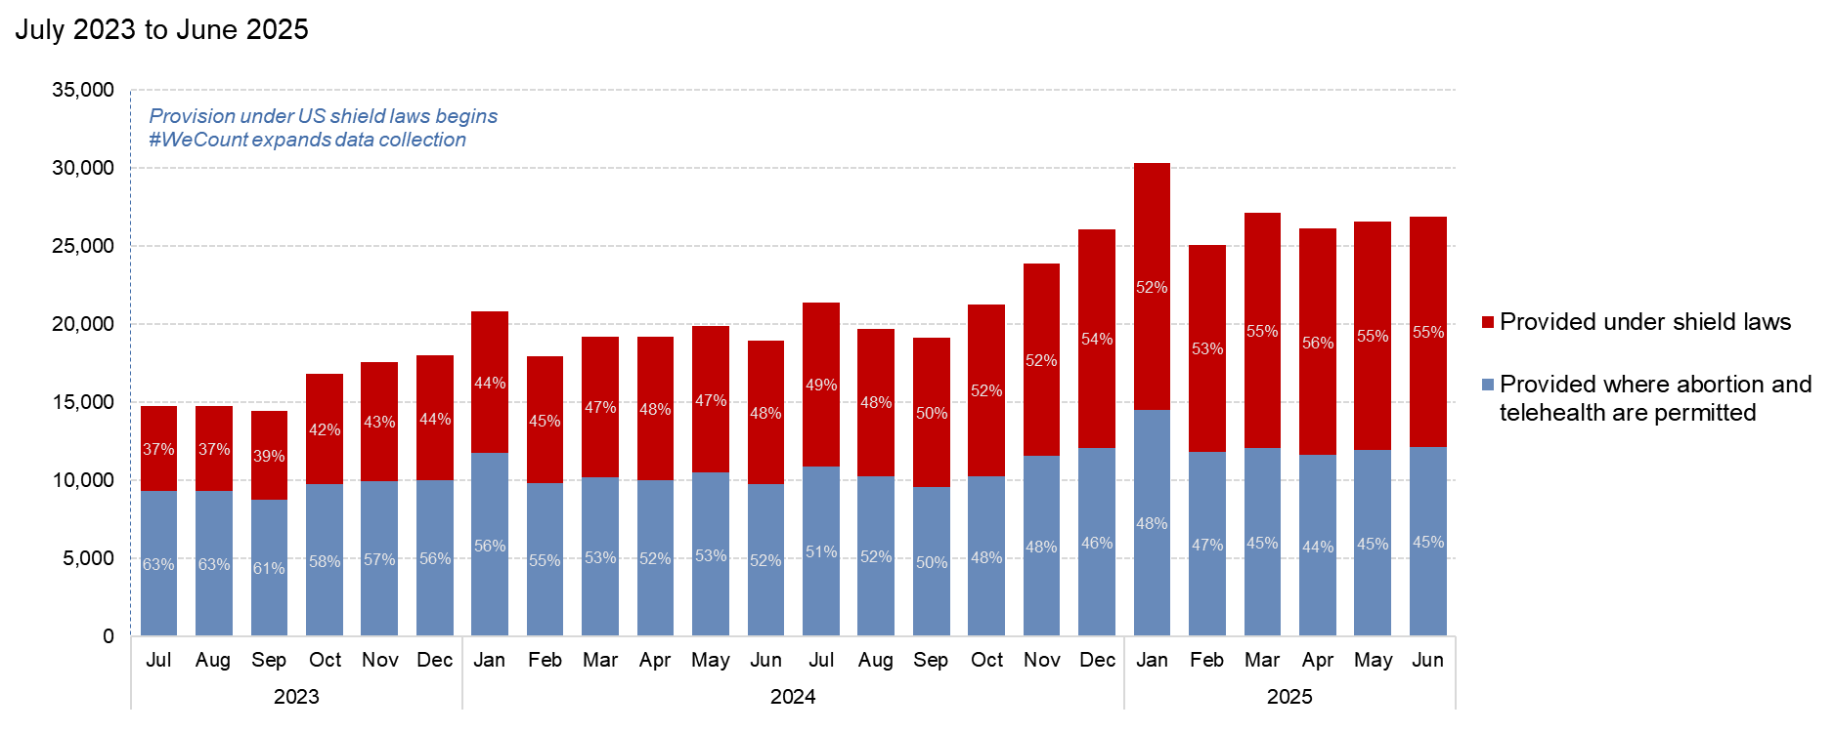
A growing share of telehealth abortions are provided under shield laws
Source: Society of Family Planning, December 2025

Slide 14
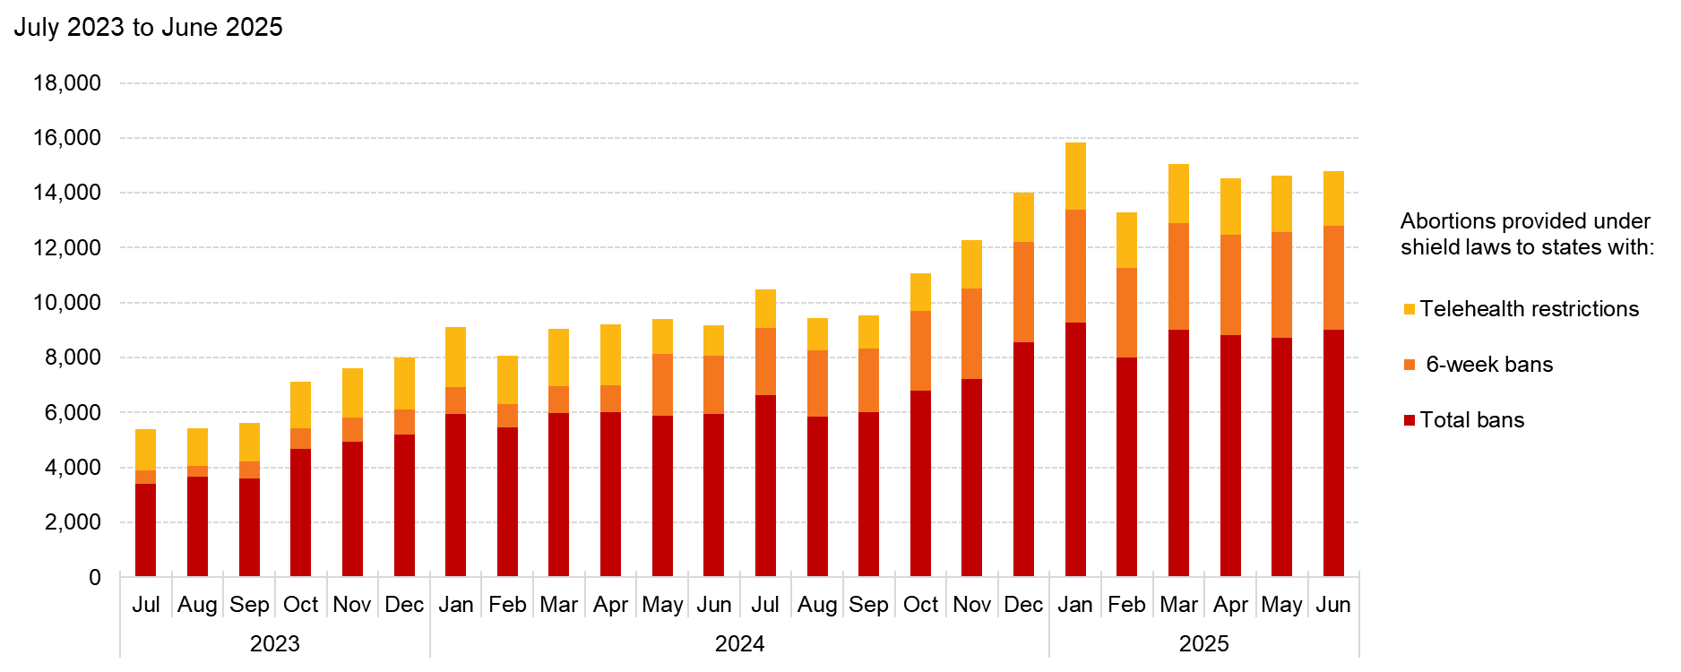
Number of abortions provided via shield laws is increasing
Source: Society of Family Planning, December 2025

Slide 15
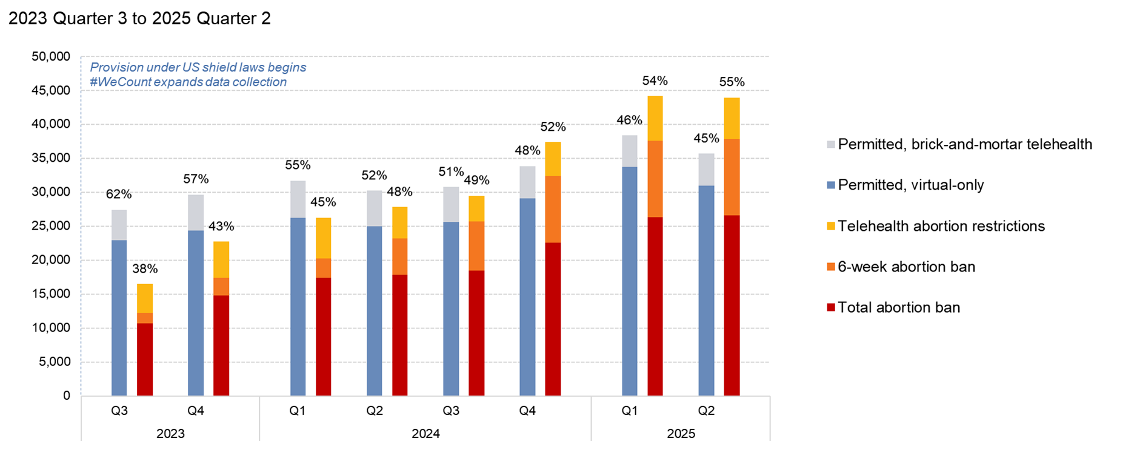
Abortions provided under shield laws account for a growing share of all telehealth abortions
Source: Society of Family Planning, December 2025

Slide 16
State-level findings

Slide 17
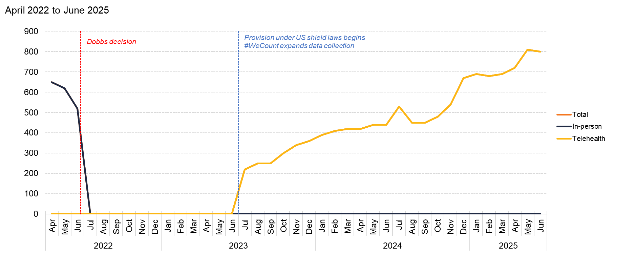
Alabama
Source: Society of Family Planning, December 2025

Slide 18
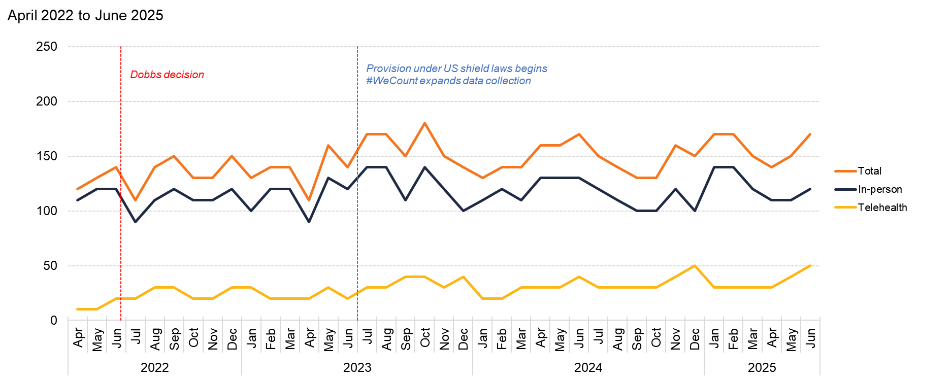
Alaska
Source: Society of Family Planning, December 2025

Slide 19
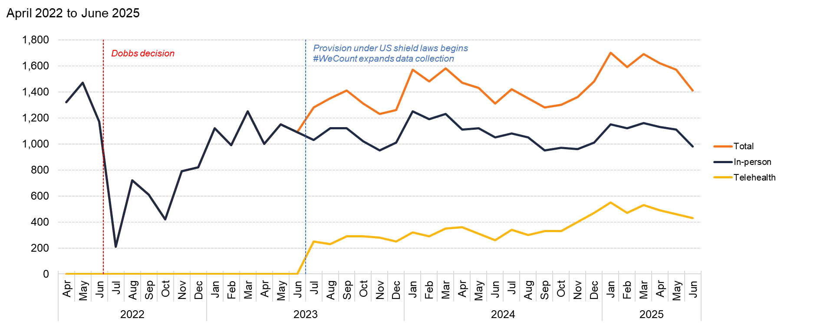
Arizona
Source: Society of Family Planning, December 2025

Slide 20
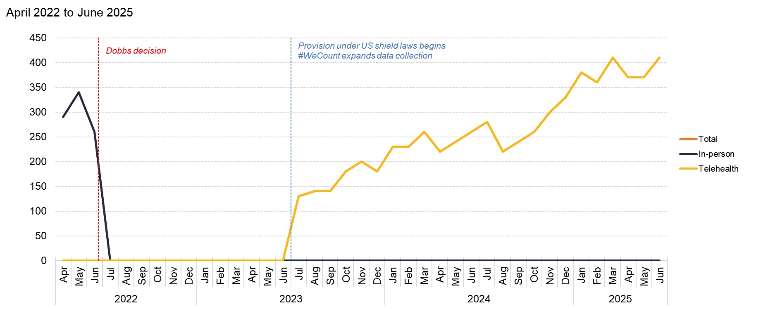
Arkansas
Source: Society of Family Planning, December 2025

Slide 21
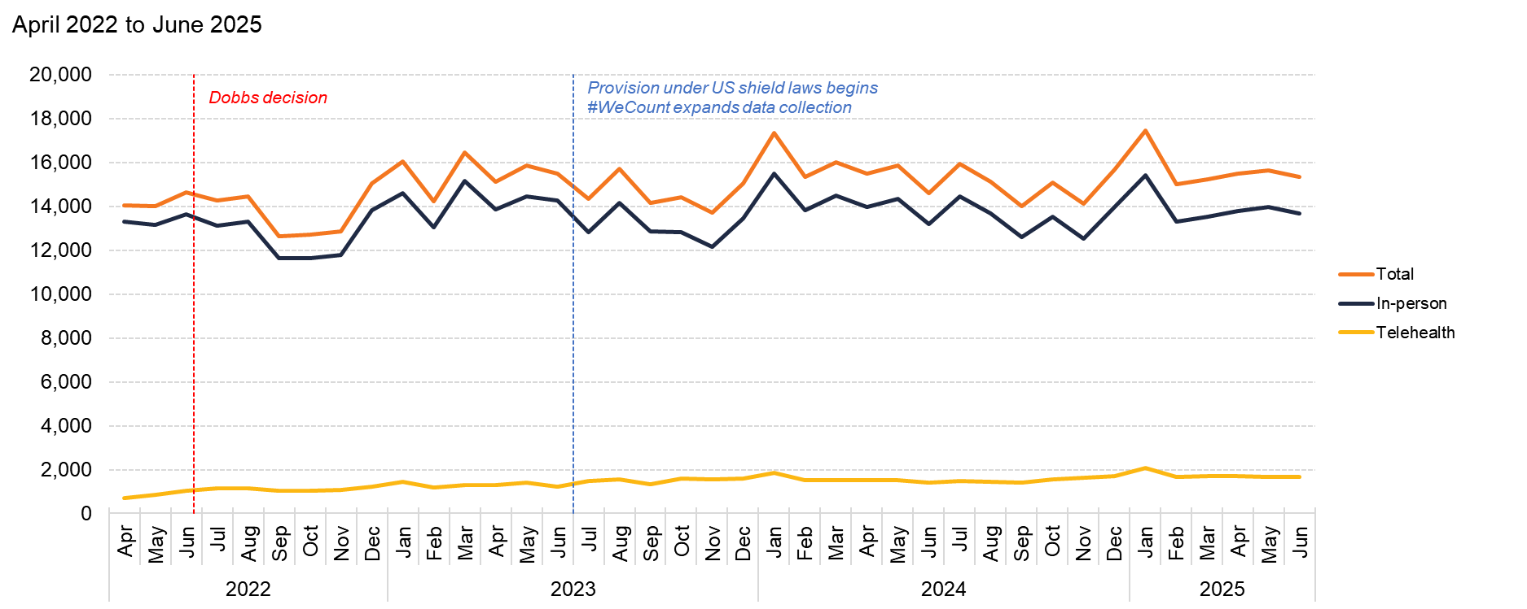
California
Source: Society of Family Planning, December 2025

Slide 22
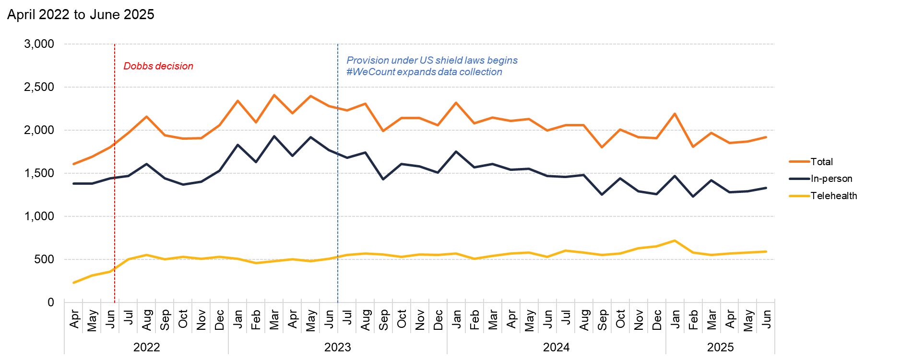
Colorado
Source: Society of Family Planning, December 2025

Slide 23
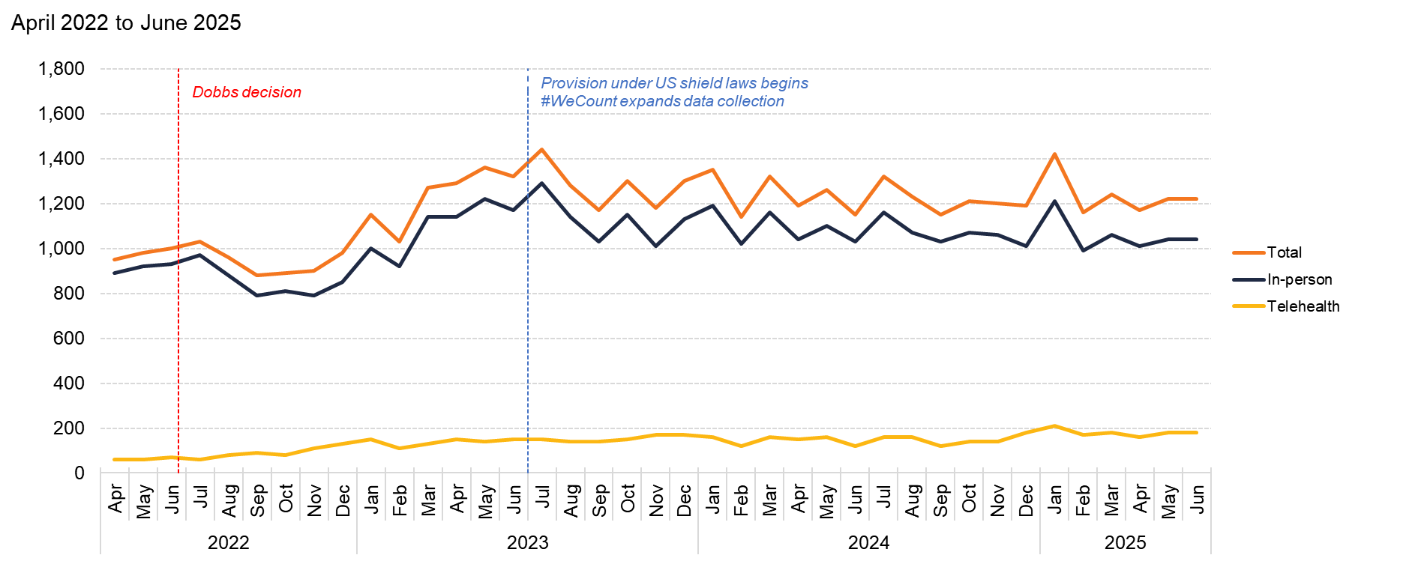
Connecticut
Source: Society of Family Planning, December 2025

Slide 24
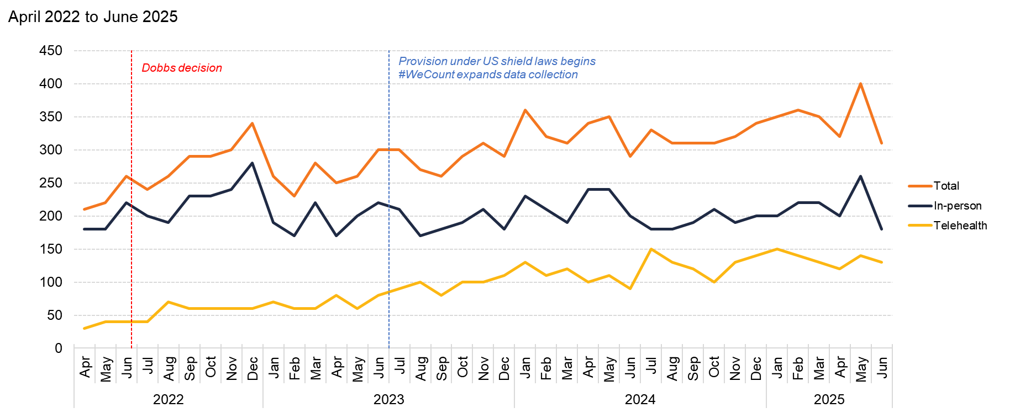
Delaware
Source: Society of Family Planning, December 2025

Slide 25
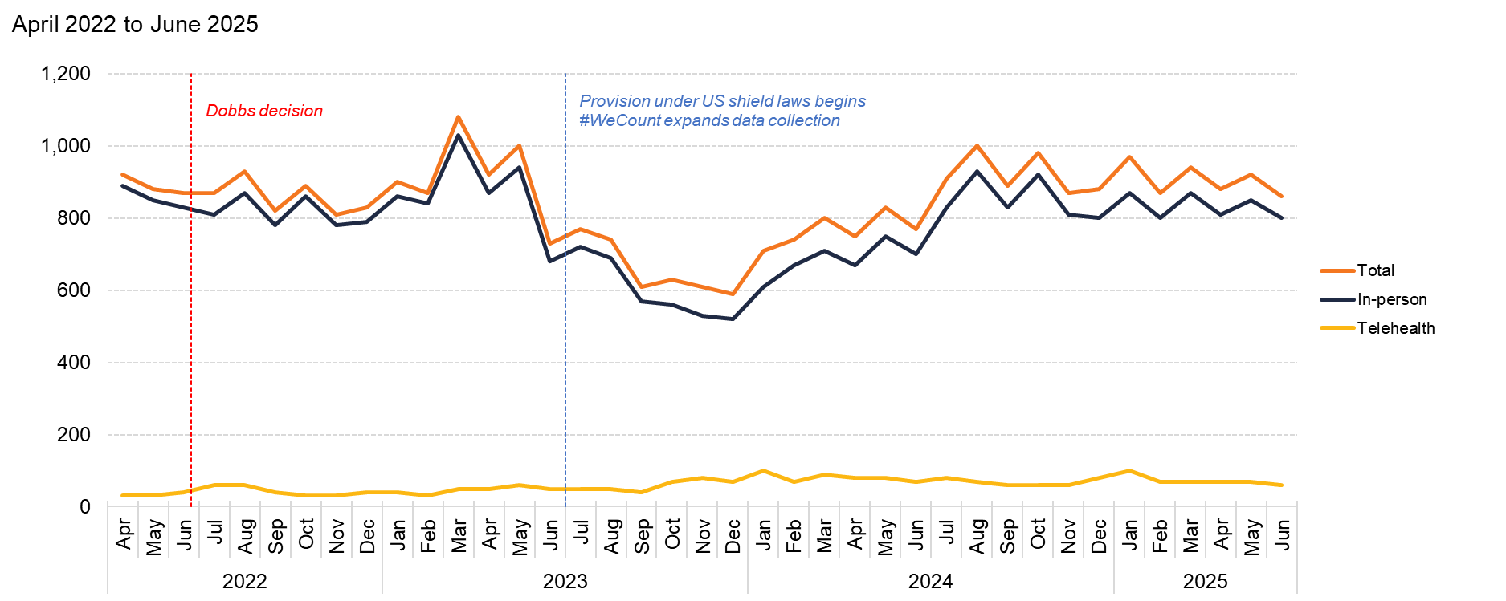
District of Columbia
Source: Society of Family Planning, December 2025

Slide 26
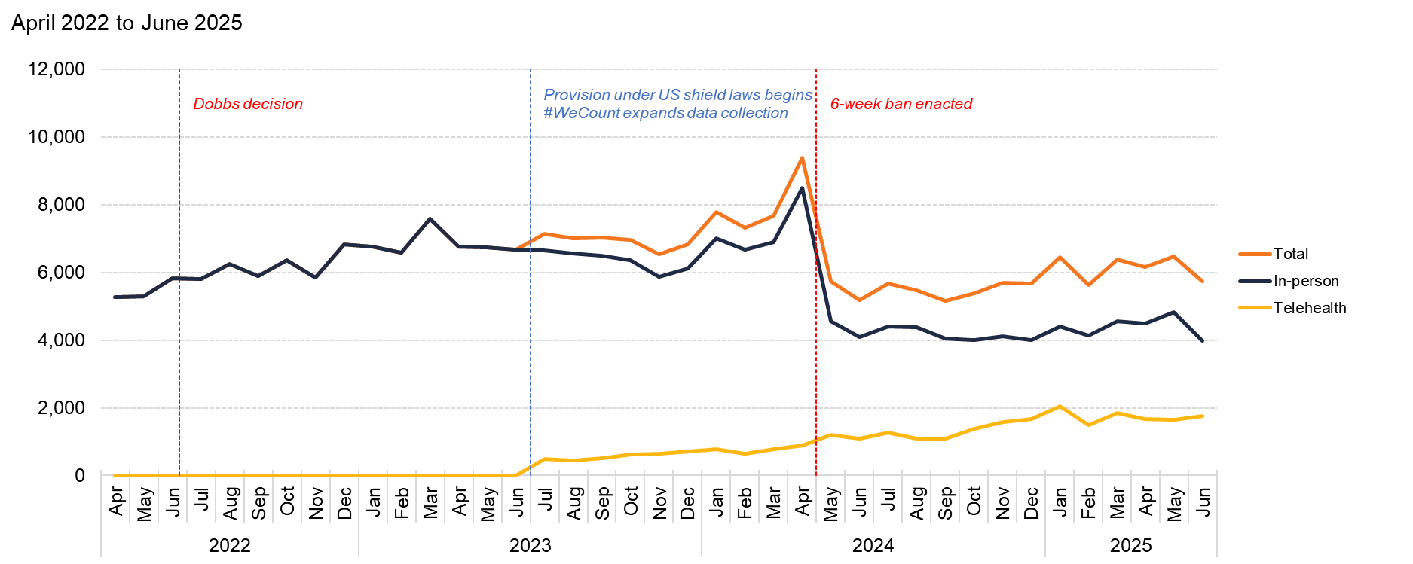
Florida
Source: Society of Family Planning, December 2025

Slide 27
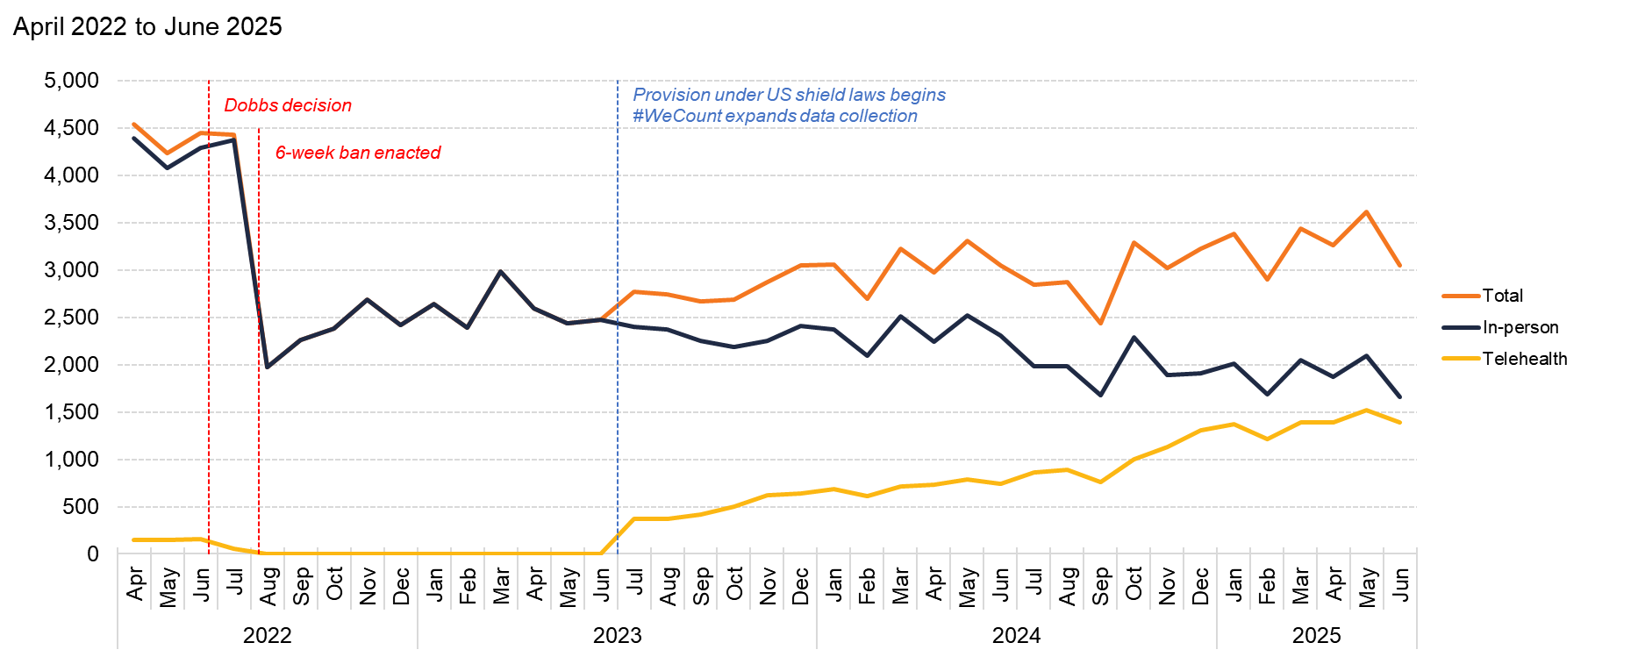
Georgia
Source: Society of Family Planning, December 2025

Slide 28
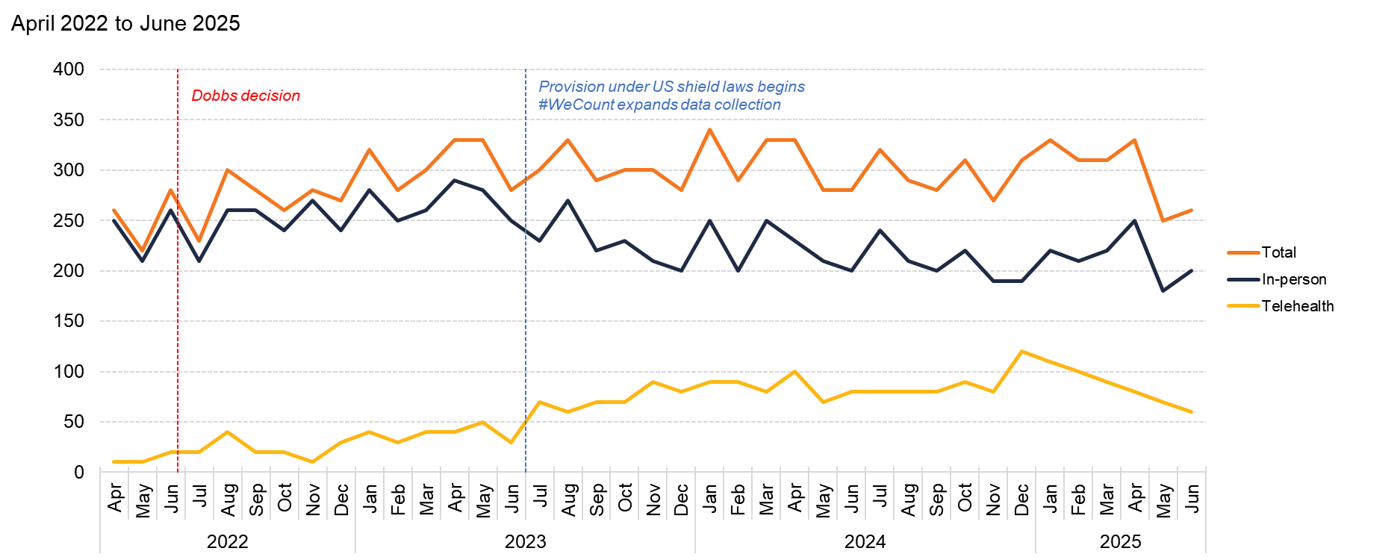
Hawaii
Source: Society of Family Planning, December 2025

Slide 29
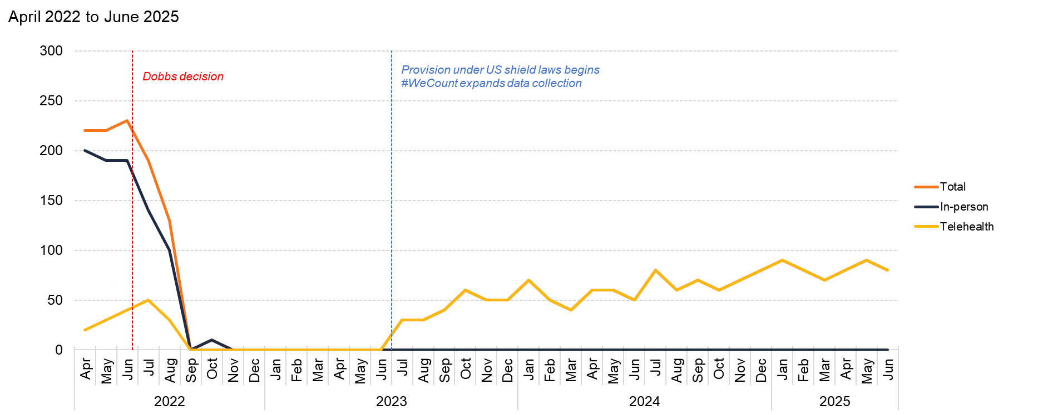
Idaho
Source: Society of Family Planning, December 2025

Slide 30
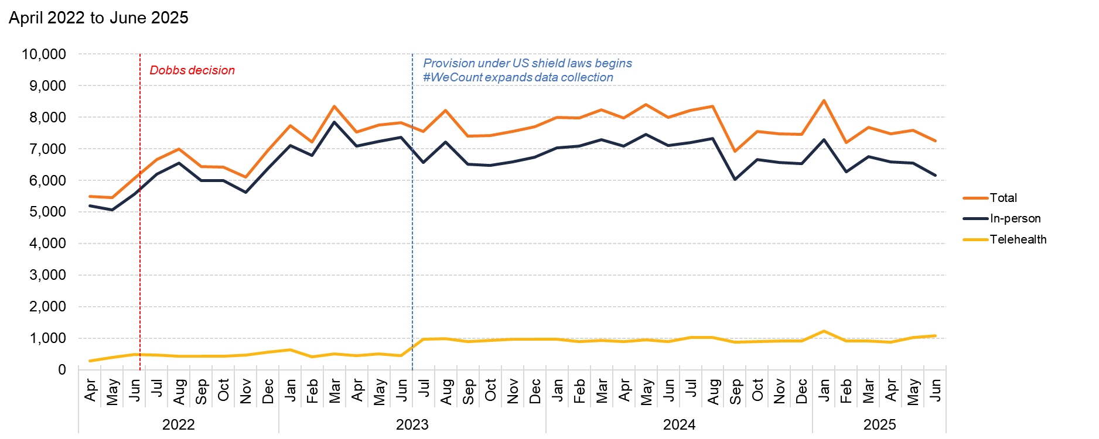
Illinois
Source: Society of Family Planning, December 2025

Slide 31
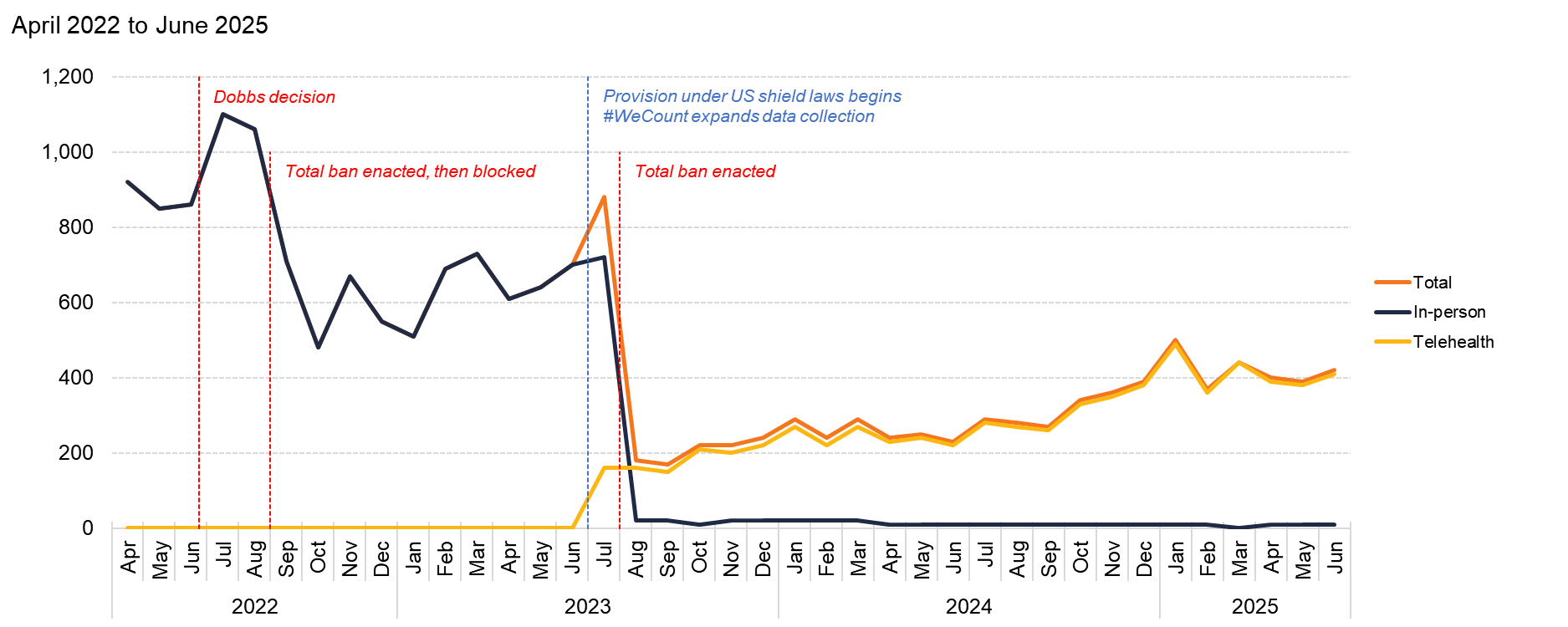
Indiana
Source: Society of Family Planning, December 2025

Slide 32
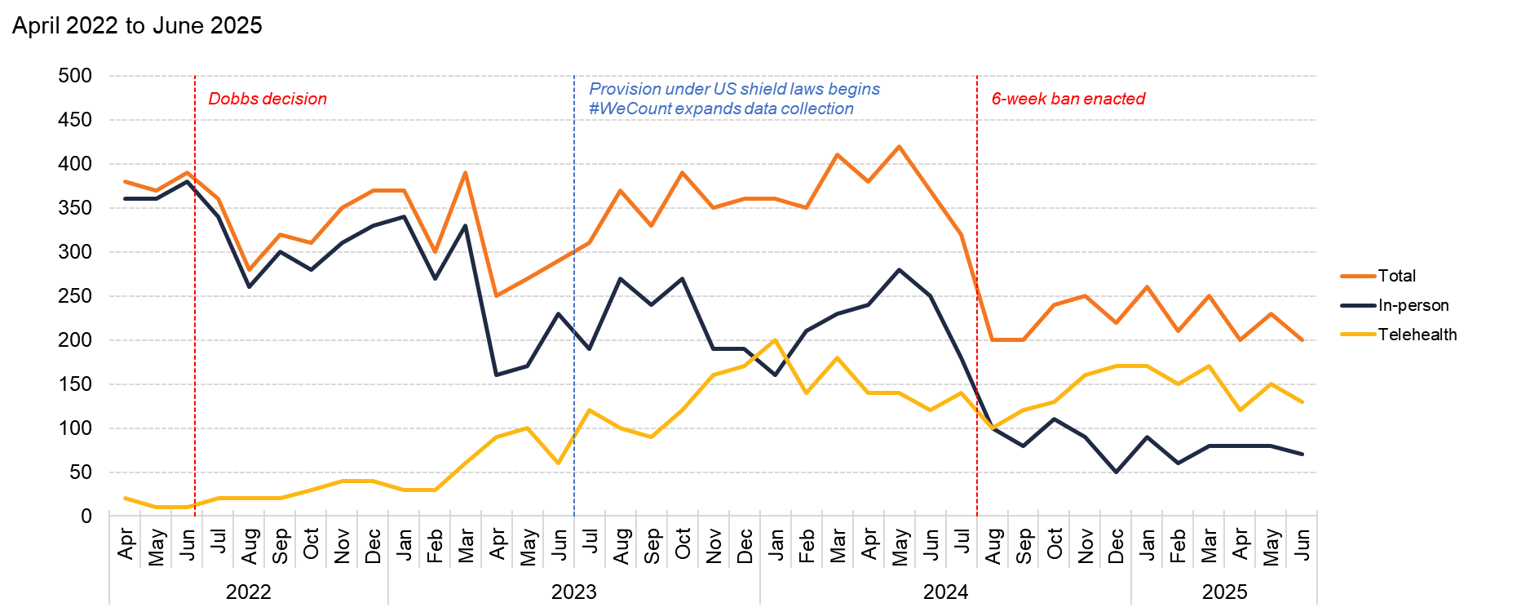
Iowa
Source: Society of Family Planning, December 2025

Slide 33
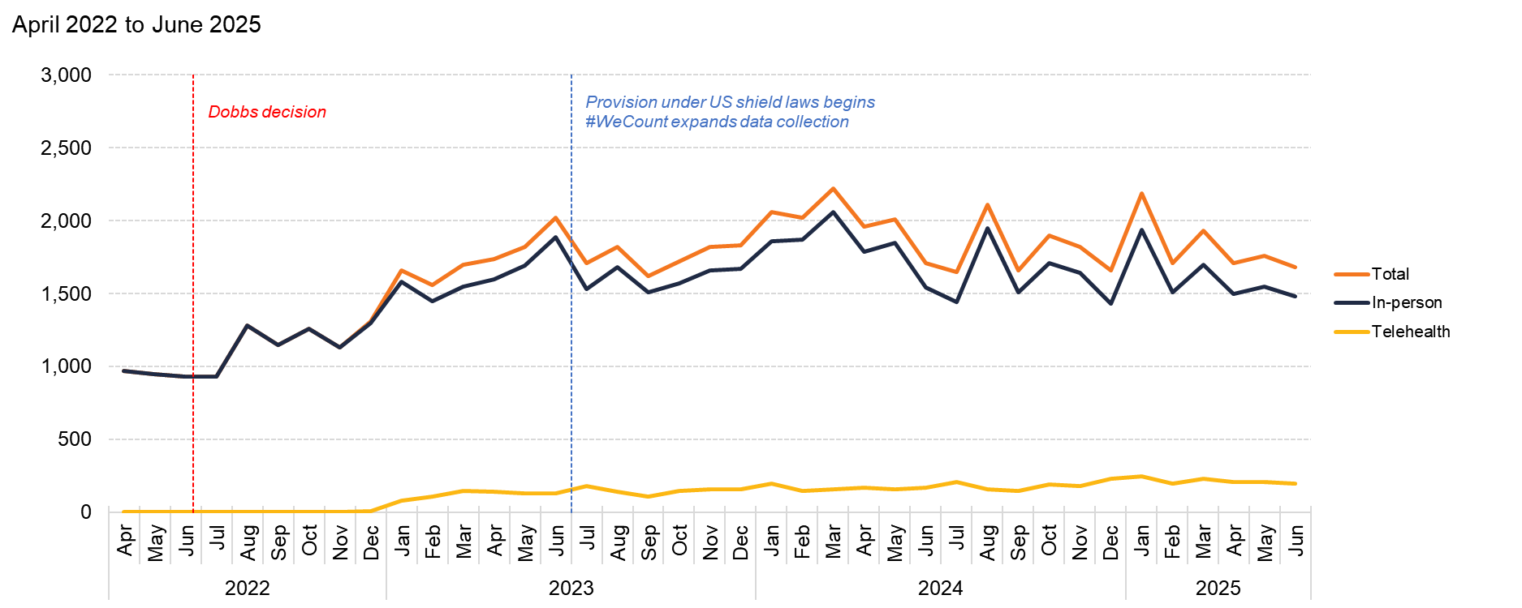
Kansas
Source: Society of Family Planning, December 2025

Slide 34
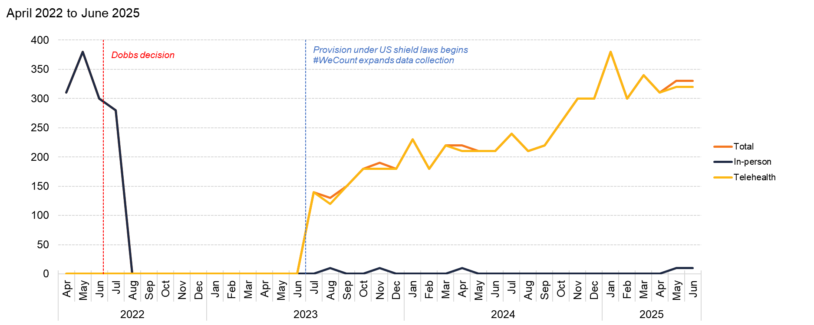
Kentucky
Source: Society of Family Planning, December 2025

Slide 35
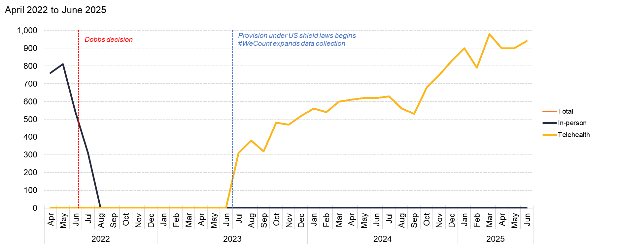
Louisiana
Source: Society of Family Planning, December 2025

Slide 36
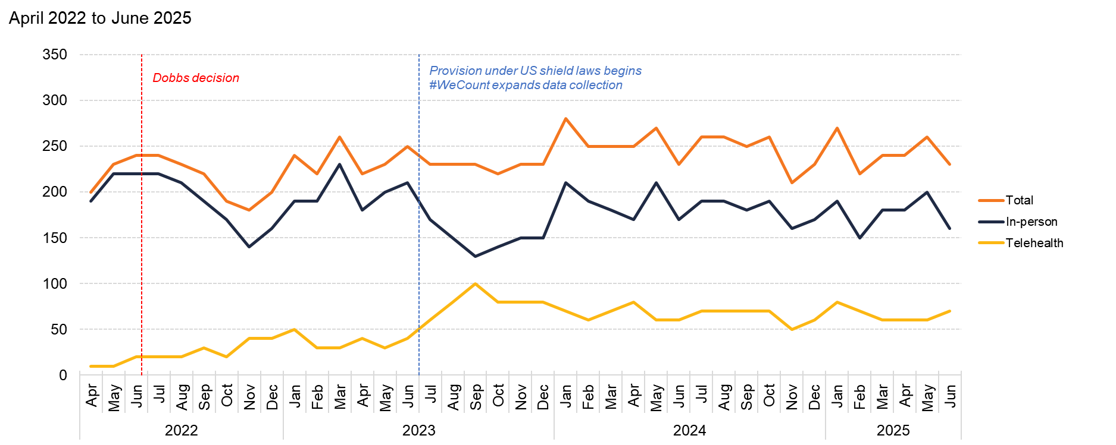
Maine
Source: Society of Family Planning, December 2025

Slide 37
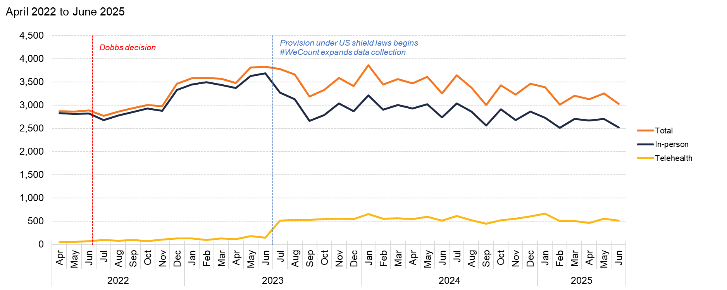
Maryland
Source: Society of Family Planning, December 2025

Slide 38
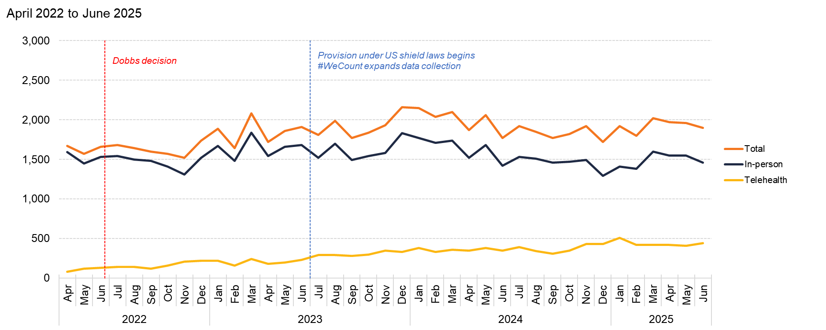
Massachusetts
Source: Society of Family Planning, December 2025

Slide 39
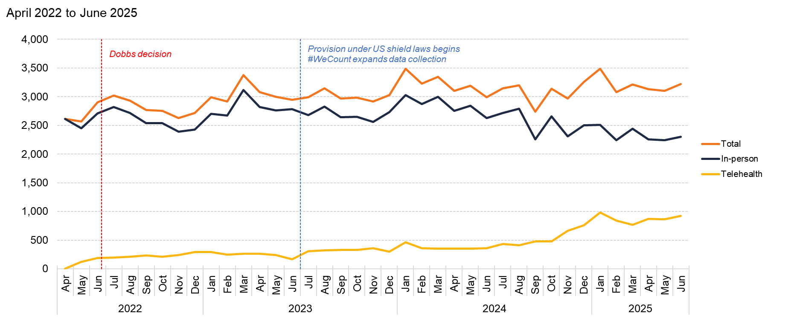
Michigan
Source: Society of Family Planning, December 2025

Slide 40
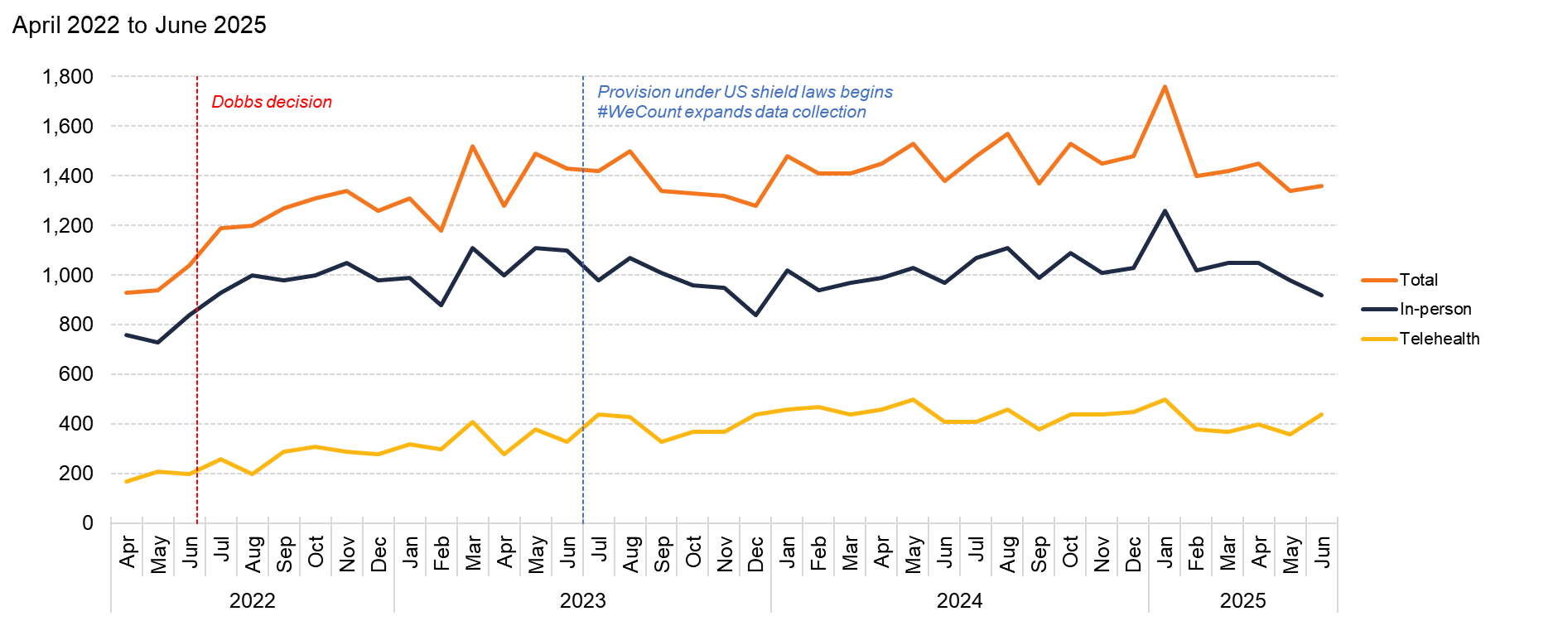
Minnesota
Source: Society of Family Planning, December 2025

Slide 41
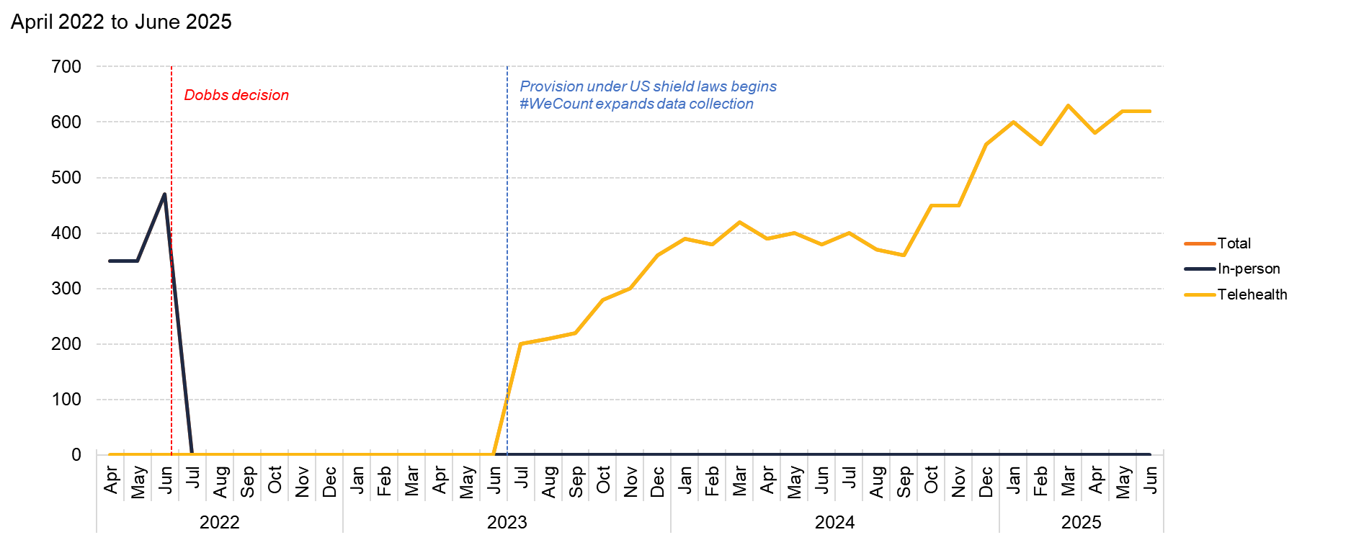
Mississippi
Source: Society of Family Planning, December 2025

Slide 42
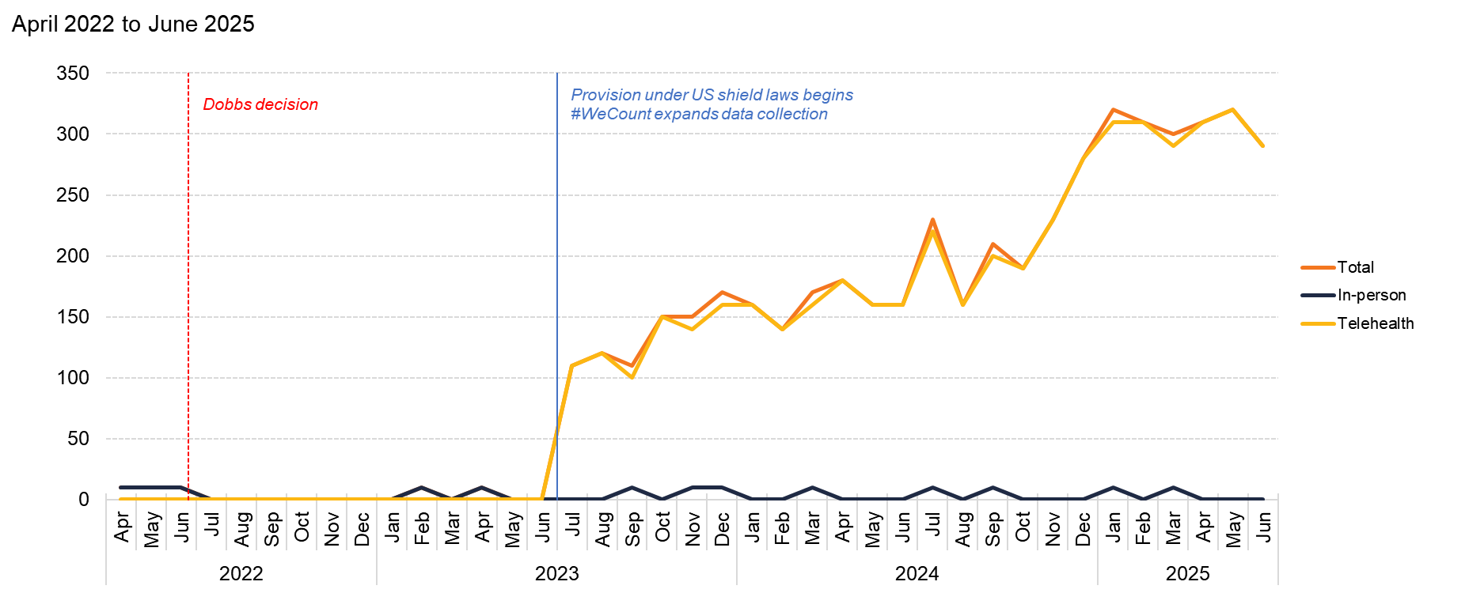
Missouri
Source: Society of Family Planning, December 2025

Slide 43
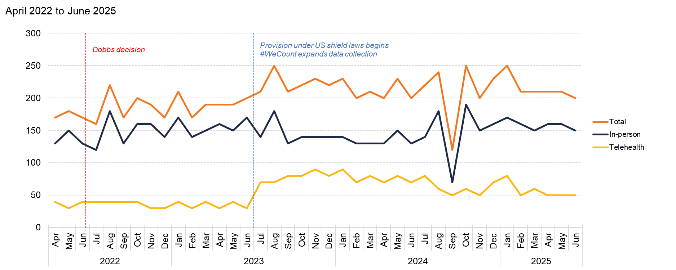
Montana
Source: Society of Family Planning, December 2025

Slide 44
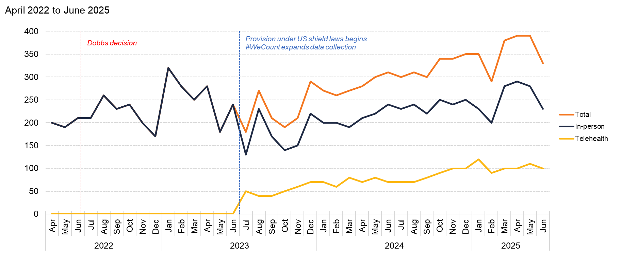
Nebraska
Source: Society of Family Planning, December 2025

Slide 45
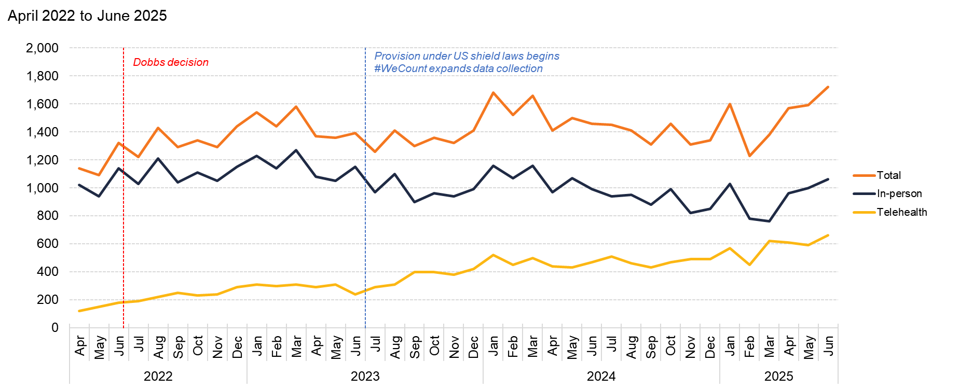
Nevada
Source: Society of Family Planning, December 2025

Slide 46
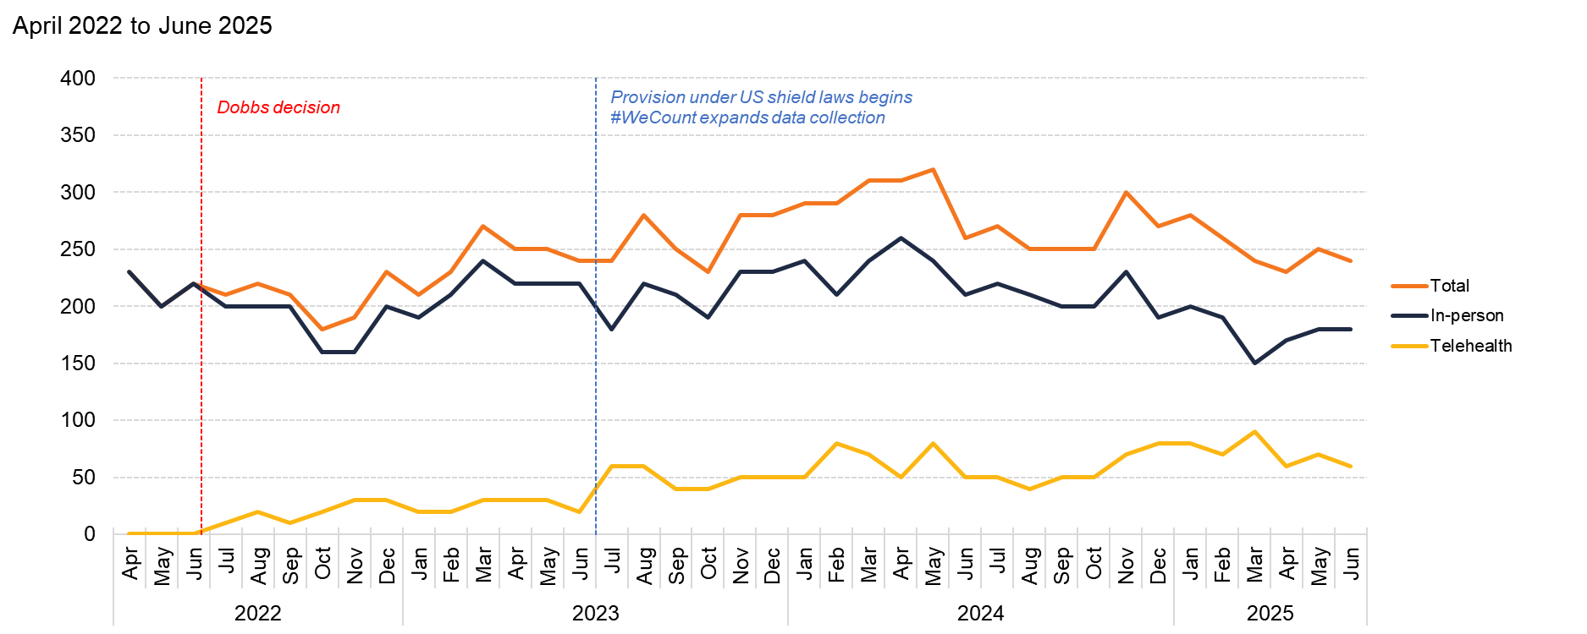
New Hampshire
Source: Society of Family Planning, December 2025

Slide 47
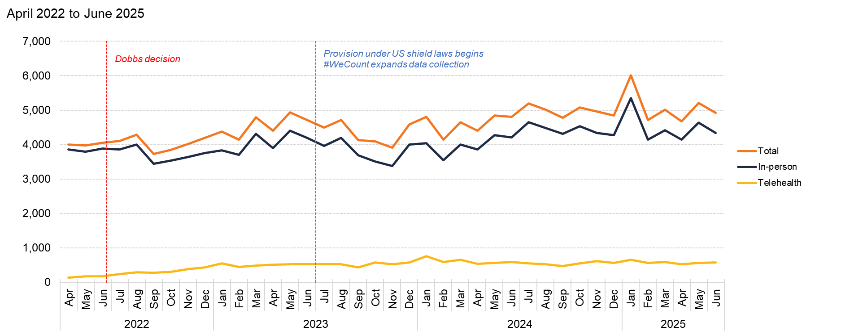
New Jersey
Source: Society of Family Planning, December 2025

Slide 48
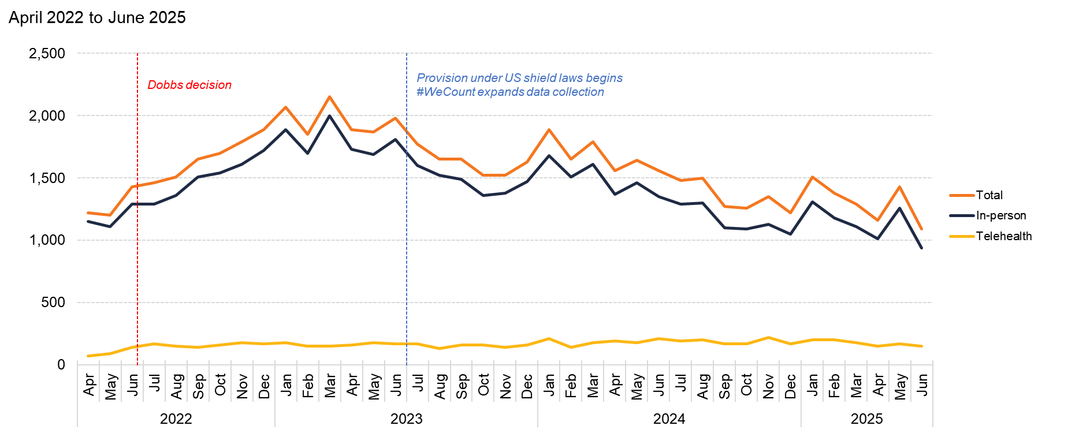
New Mexico
Source: Society of Family Planning, December 2025

Slide 49
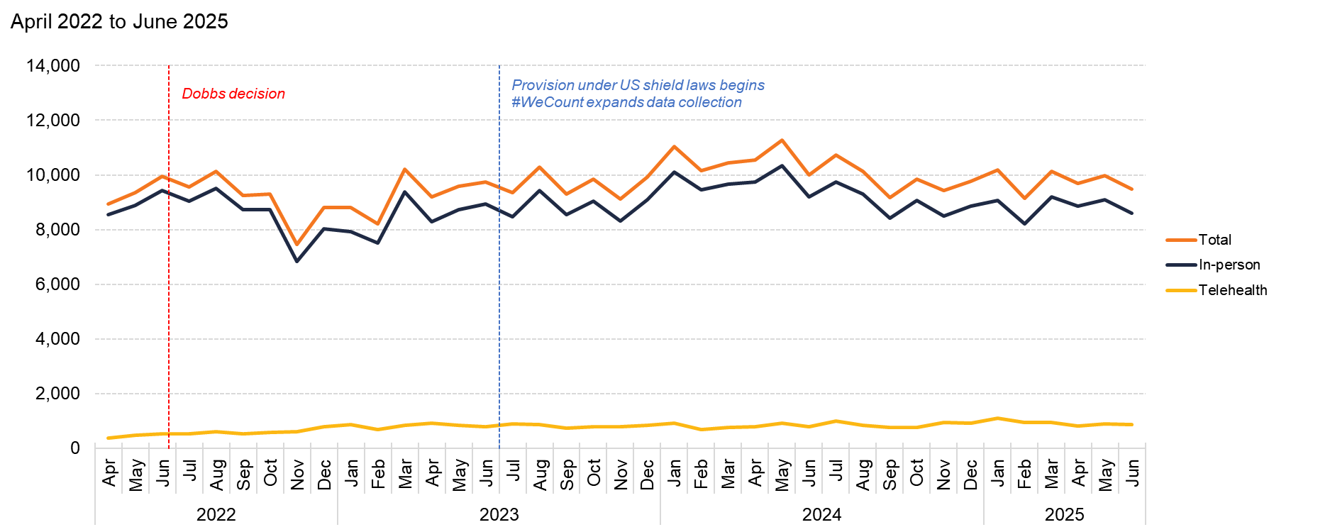
New York
Source: Society of Family Planning, December 2025

Slide 50
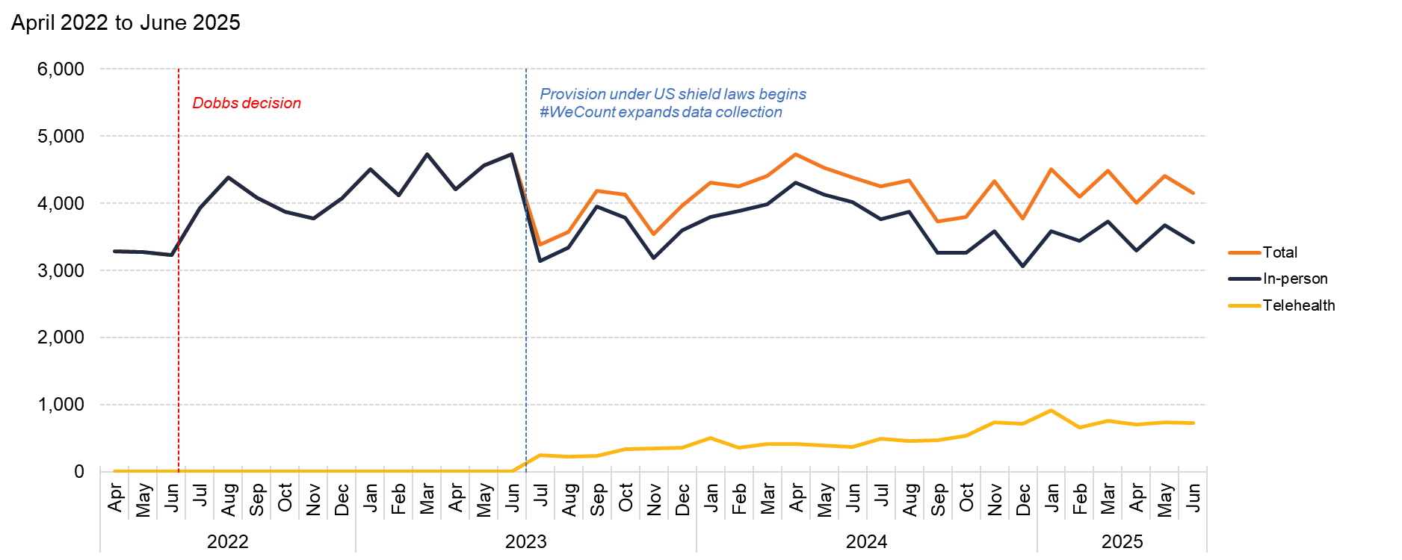
North Carolina
Source: Society of Family Planning, December 2025

Slide 51
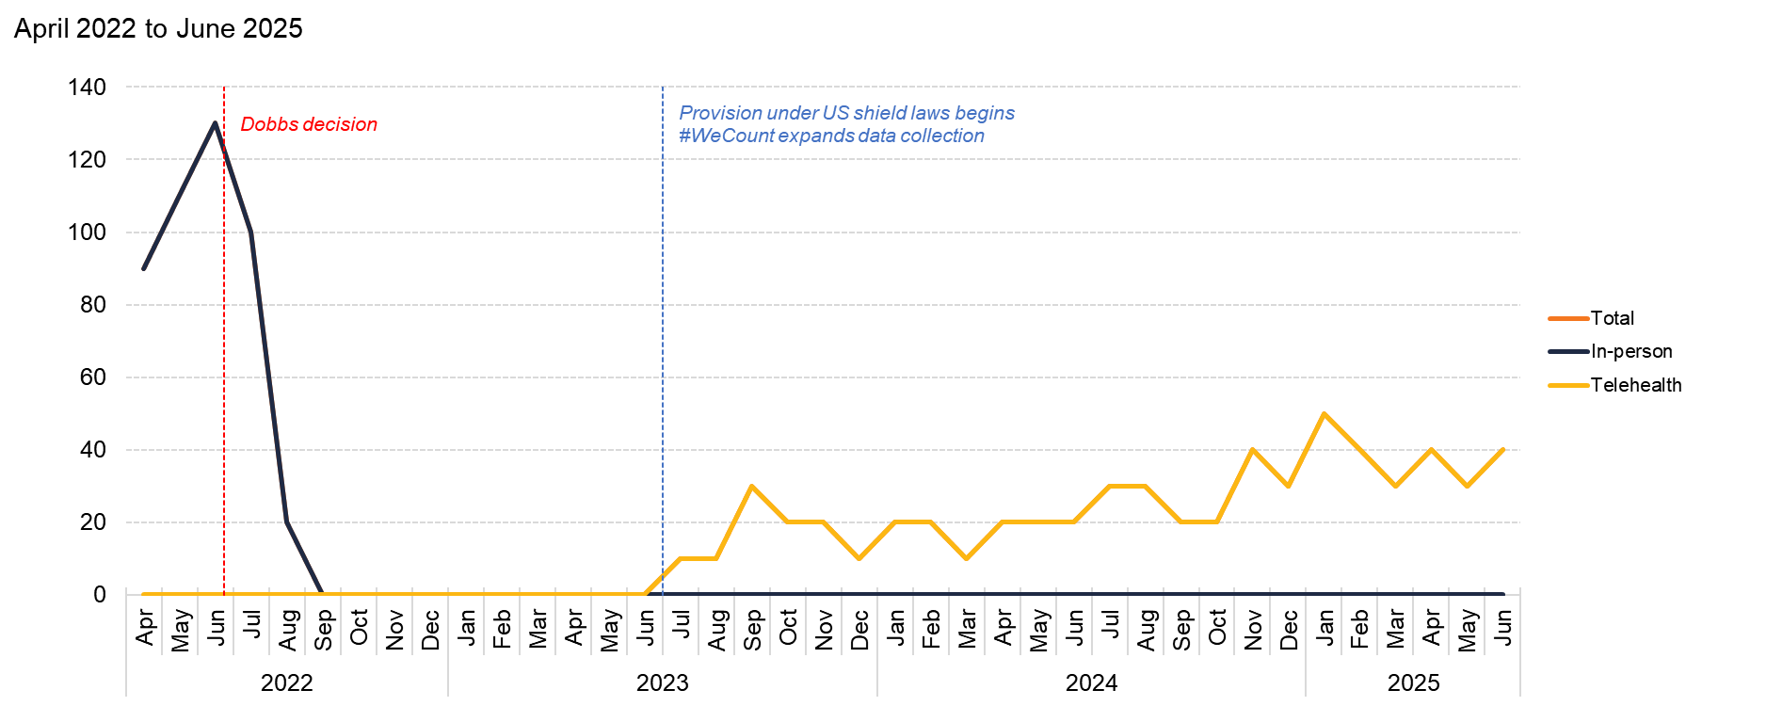
North Dakota
Source: Society of Family Planning, December 2025

Slide 52
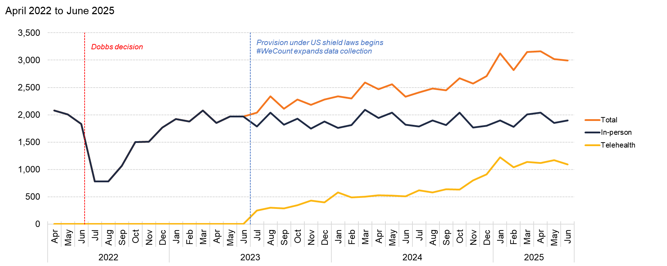
Ohio
Source: Society of Family Planning, December 2025

Slide 53

Oklahoma
Source: Society of Family Planning, December 2025

Slide 54

Oregon
Source: Society of Family Planning, December 2025

Slide 55

Pennsylvania
Source: Society of Family Planning, December 2025

Slide 56

Rhode Island
Source: Society of Family Planning, December 2025

Slide 57

South Carolina
Source: Society of Family Planning, December 2025

Slide 58

South Dakota
Source: Society of Family Planning, December 2025

Slide 59

Tennessee
Source: Society of Family Planning, December 2025

Slide 60

Texas
Source: Society of Family Planning, December 2025

Slide 61

Utah
Source: Society of Family Planning, December 2025

Slide 62

Vermont
Source: Society of Family Planning, December 2025

Slide 63

Virginia
Source: Society of Family Planning, December 2025

Slide 64

Washington
Source: Society of Family Planning, December 2025

Slide 65

West Virginia
Source: Society of Family Planning, December 2025

Slide 66

Wisconsin
Source: Society of Family Planning, December 2025

Slide 67

Wyoming
Source: Society of Family Planning, December 2025

